Slide 1
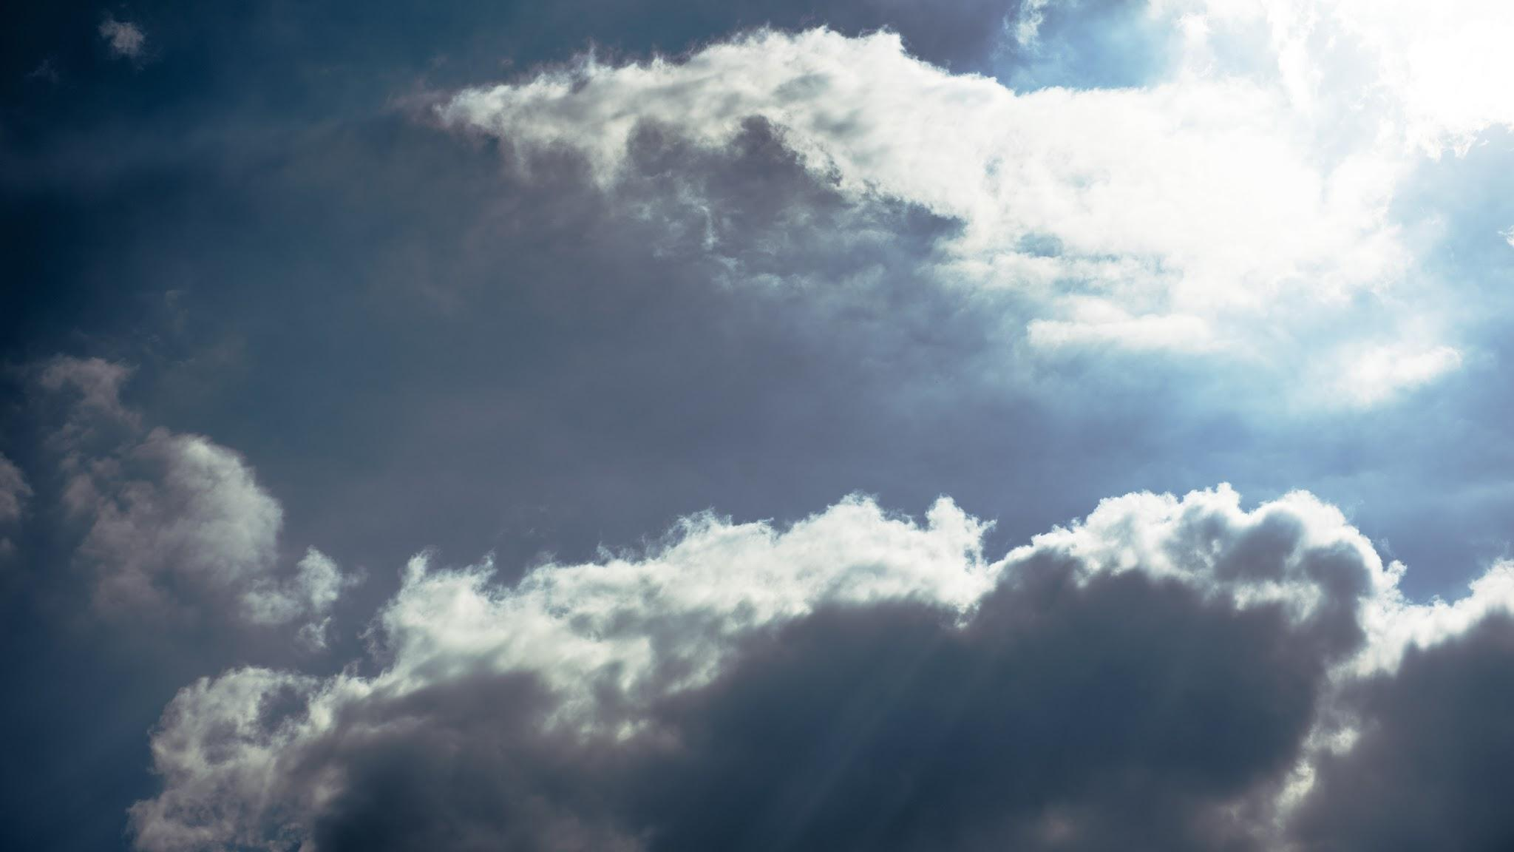
This week
Doorway to Heaven
Divine Bridge Between Heaven and Earth
Key Scripture: Genesis 28:12

Slide 2
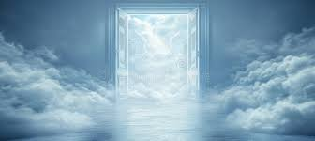

Slide 3
Genesis 28:12
He had a dream in which he saw a stairway resting on the earth, with its top reaching to heaven, and the angels of God were ascending and descending on it.

Slide 4
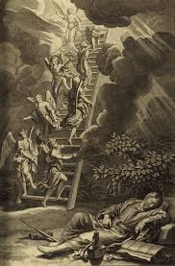
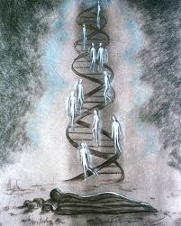
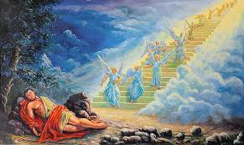
Jacob’s Ladder

Slide 5
John 1:51
He then added, “Very truly I tell you, you will see heaven open, and the angels of God ascending and descending on the Son of Man.”

Slide 6
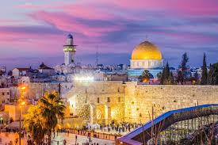
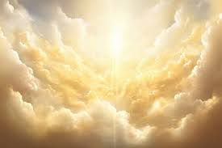
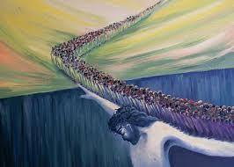
Jesus is the bridge!

