Slide 1
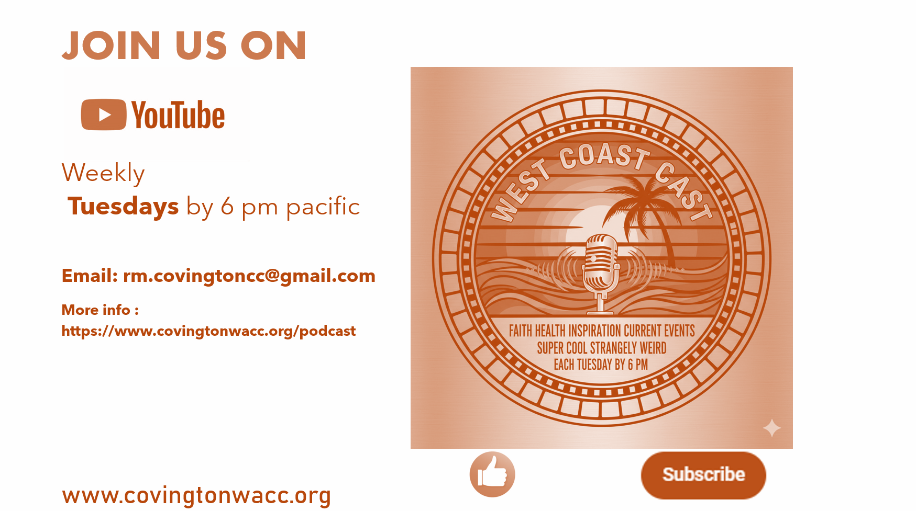
www.covingtonwacc.org/podcast
Podcast 38

Slide 2
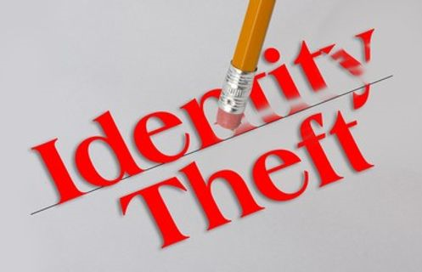
Warning:
This is only for people who have said Yes to Christ..
The Lost? I have no idea who you are. Do you ?

Slide 3
In the World | In Christ Laura Story - I Can Just Be Me (with lyrics) | Earth | Heaven
Volatile, Temporary, can be stolen, | Eternal, Secure | Volatile, can be stolen, | Eternal, unshakable Whether you know it or not
Birth certificate | Born again Newsboys - Born Again (Lyric Video) | origin | destination
Name, usually by parents | The Name He has for you. | Designation, can be stolen | Complete thought. Beyond words.
Address | Kingdom | Number | Promise - Now and Later
DL | n/a | number | Don't need one.
SSN | Citizen of Heaven | Number | Planned long ago.
accounts | Paid by the blood of Christ | harsh reckoning | Eternal Grace
Philosophical existence | Eternal Existence | Temporary, circumstances | Timeless
Biometrics | Heart /Life /Soul | Malleable | Impossible to duplicate or fake.

Slide 4
In the World | In Christ | Earth | Heaven
Name, usually by parents | The Name He has for you. | Designation, can be stolen | Complete thought. Beyond words.
Address | Kingdom Third Day - Children of God - with Lyrics | Number | Promise - Now and Later
DL | n/a | number | Don't need one.
SSN | Citizen of Heaven | Number | Planned long ago.
accounts | Paid by the blood of Christ | harsh reckoning | Eternal Grace
Philosophical existence | Eternal Existence | Temporary, circumstances | Timeless
Biometrics | Heart /Life /Soul | Malleable | Impossible to duplicate or fake.

Slide 5
In the World | In Christ | Earth | Heaven
accounts | Paid by the blood of Christ | harsh reckoning | Eternal Grace
Philosophical existence | Eternal Existence | Temporary, circumstances | Timeless
Biometrics | Heart /Life /Soul | Malleable | Impossible to duplicate or fake.

Slide 6
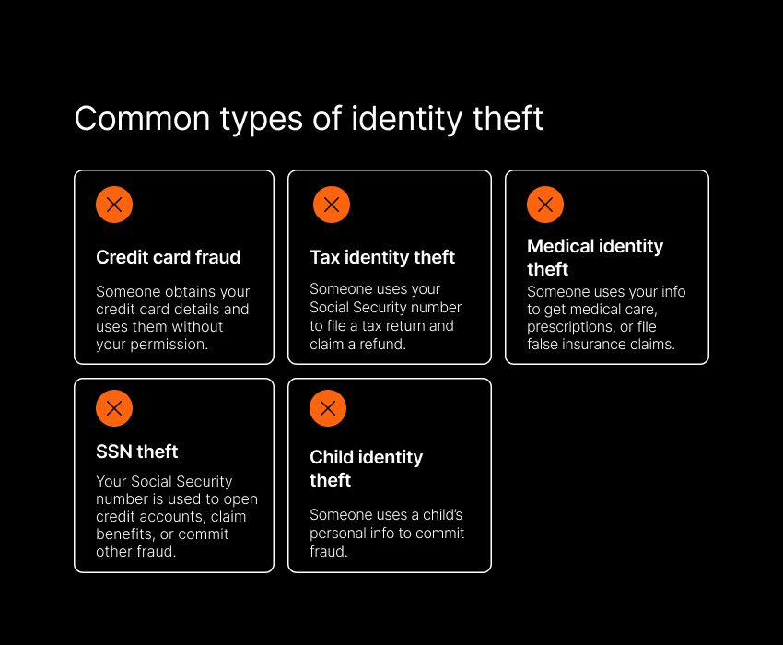
Spiritual Identity Theft
Other people and Satan use deception to try to assign you your position in the Moment, life, interaction, social media, whatever.

Slide 7
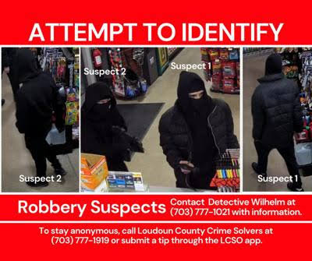
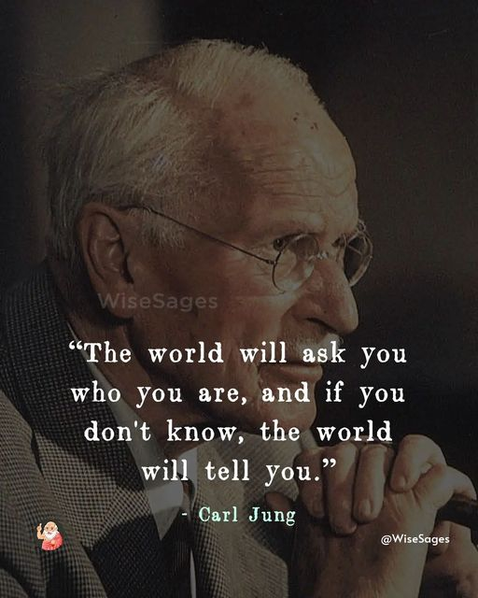
You’ve been robbed!
In Christ, you have an identity, the World has stolen it from you.
The Church has been sacked. Like the days of old, it was invaded and STOLEN From. We have no idea what we lost and what was taken from us. One such thing that was stolen was your Identity.
It has robbed you of your inheritance. Every second of every day it is trying to scream at you that your identity in Christ is not real. And it is working.
A lot of people in Church don't know what it means to be in Christ. Even more apparently do not know who they are.

Slide 8
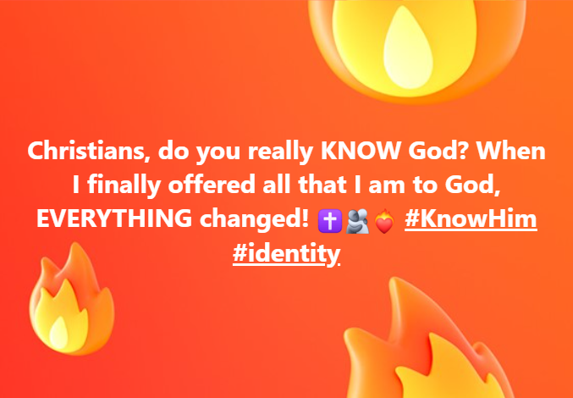
Ben Fuller - Who I Am (Official Lyric Video)

Slide 9

The Crime
What was taken?
  Identity [from The American Heritage® Dictionary of the English Language, 5th Edition. More at Wordnik]
  /ī-dĕn′tĭ-tē/
  noun
  The condition of being a certain person or thing.
  What is the identity of the author of the manuscript?
  The set of characteristics by which a person or thing is definitively recognizable or known.
  The awareness that an individual or group has of being a distinct, persisting entity.

Slide 10
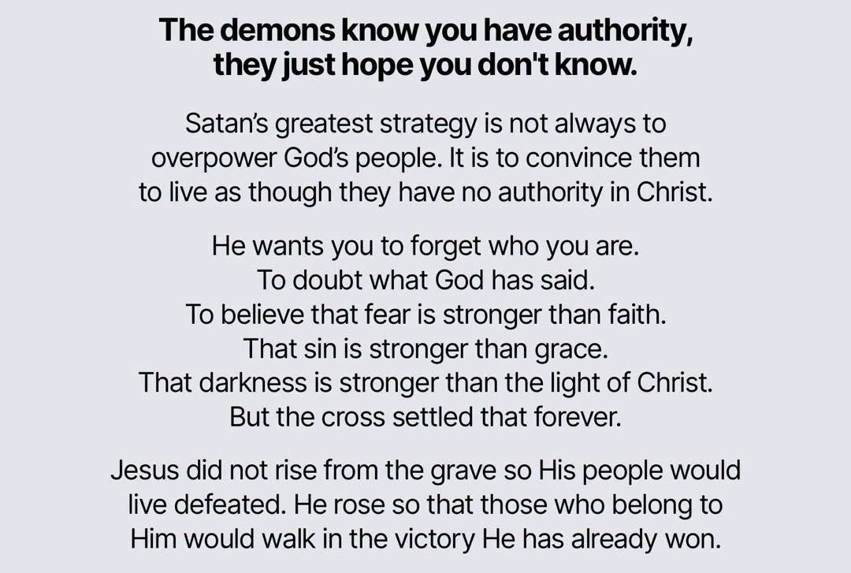
The motive
The Enemy wants you stupid, ignorant, and chasing the wind.
  People who don’t know who they are
    get easily mislead,
    look in the wrong places,
    or turn into narcissistic monsters.
If he can convince the kings kids they are poor peasants, they are robbed of
  power,
  purpose, and
  placement in the kingdom.

Slide 11
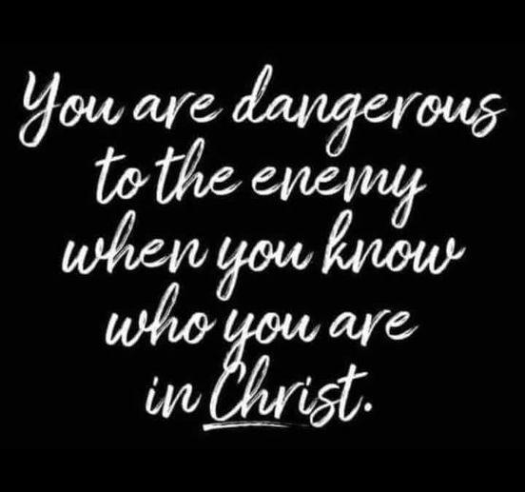
The Cost
Years of wasted pointless life, something LIKE living - but hollow, a pointless, powerless, joyless existence
The enemy is afraid of you.

Slide 12

Who God says you are
Ephesians 1, 2, 3
Here is what Paul says we are across Ephesians 1, 2, and 3:
Ephesians 1: Our Spiritual Blessings and Identity in Christ
  Saints / Holy and Faithful: Set apart, holy, and faithful in Christ Jesus (Eph 1:1).
  Chosen: Selected by God before the creation of the world (Eph 1:4, 1:11).
  Holy and Blameless: Made clean and without fault in His sight through love (Eph 1:4).
  Adopted Children: Predestined and welcomed into His family as sons and daughters through Jesus Christ (Eph 1:5).
  Redeemed and Forgiven: People who have freedom and the complete pardon of sins through Christ's blood, according to the riches of His grace (Eph 1:7).
  Included: Marked with a seal—the promised Holy Spirit—who acts as a deposit guaranteeing our eternal inheritance (Eph 1:13–14).

Slide 13

Who God says you are
Ephesians 1, 2, 3
Here is what Paul says we are across Ephesians 1, 2, and 3:
Ephesians 2: Our Transformation from Death to Life
  Made Alive with Christ: Brought back to spiritual life even when we were dead in our transgressions (Eph 2:5).
  Raised Up and Seated with Christ: Positioned spiritually in the heavenly realms with Jesus (Eph 2:6).
  God’s Workmanship (Masterpiece): Created anew in Christ Jesus to do the good things God prepared for us in advance (Eph 2:10).
  Brought Near: No longer far off, but brought close to God through the blood of Christ (Eph 2:13).
  Fellow Citizens and Members of God’s Household: No longer foreigners or strangers, but members of God's own family (Eph 1:19).
  Part of a Holy Temple / Dwelling for God: Built together on the foundation of the apostles and prophets, with Christ as the cornerstone, to become a place where God lives by His Spirit (Eph 2:21–22).

Slide 14
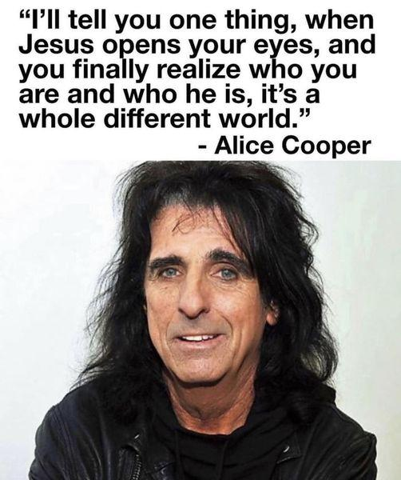
Who God says you are
Ephesians 1, 2, 3
Here is what Paul says we are across Ephesians 1, 2, and 3:
Ephesians 3: Our Inclusion and Bold Access
Fellow Heirs, Members of One Body, and Sharers in the Promise: Co-heirs with Christ, where Jew and Gentile alike are united fully under the Gospel (Eph 3:6).
Bold and Confident Access: People who can approach God freely and with complete confidence through faith in Him (Eph 3:12).

Slide 15
Lie #1: Gods gifts are for you when you die.
They are for Right NOW. Today. While you Live in this world.

Slide 16


YOUR NEW Identity
That doesn’t mean "when you die" It means right NOW.

Slide 17
You became new the day you said yes to Christ.
You got the following on Day 1:
New life - your new life starts now . It started that day you said yes to Christ.
New identity - you became a child of the most high God. The day you said yes to Christ.
New Desires - God began changes the day you said yes to Christ, you may have noticed that those lies, tv show, that group of friends, that politician, that money, the sports team, that music , those movies, that video game, no longer "get it" for you. In short, you get a new Conscience which not only highlights the don'ts, but inspires different actions. The OUT signifies what we DO. The In Signifies what HE Does.

Slide 18
Out | in
pride | humility
Lies | Truth
The world | The Word
selfishness | Real Love (selflessness)
Me first | Him first
Greed | Charity
Clicks n likes | The joy of the Lord
Worry | Peace
Human Nature | God's Nature

Slide 19
New Goal
New Residents - Christ and the Holy Spirit move in to your heart right away . You may notice the things that make you happy change. You may notice subtle objections to "that song" or "that news show” or "that activist group". You may become sensitive to lies, you may develop the ability to see beyond the current hour.
New Goal - To become more like Christ, to let him Transform you by changing the way you think (Romans 12:2 (NLT))

Slide 20
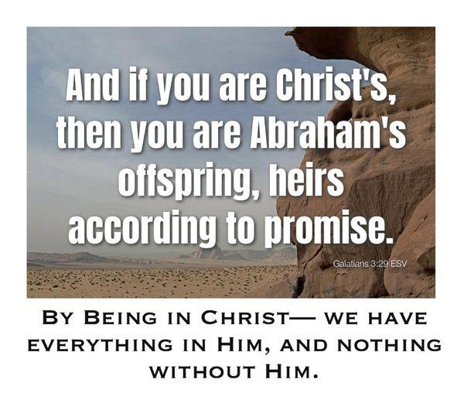

Slide 21
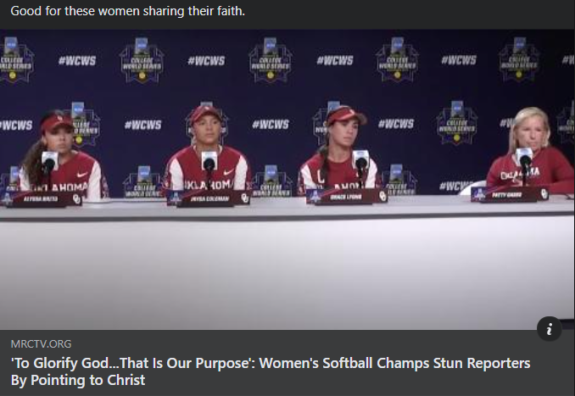
Purpose (This has Spiritual Meaning!)
John 10:10 (NLT)
The thief’s purpose is to steal and kill and destroy. My purpose is to give them a rich and satisfying life.
Our purpose: Your Action Items – D A I L Y
do the good things he planned for us long ago.
Ephesians 2:10 (NLT)
For we are God’s masterpiece. He has created us anew in Christ Jesus, so we can do the good things he planned for us long ago.
live a holy life.
2 Timothy 1:9 (NLT)
For God saved us and called us to live a holy life. He did this, not because we deserved it, but because that was his plan from before the beginning of time—to show us his grace through Christ Jesus.
learn to know God’s will for you,
Romans 12:2 (NLT)
Don’t copy the behavior and customs of this world, but let God transform you into a new person by changing the way you think. Then you will learn to know God’s will for you, which is good and pleasing and perfect.
Seek the Kingdom of God above all else, and live righteously
Matthew 6:33 (NLT)
Seek the Kingdom of God above all else, and live righteously, and he will give you everything you need.
Glorify him
Isaiah 43:7 (NLT)
Bring all who claim me as their God, for I have made them for my glory. It was I who created them.’”
Psalms 86:9 (NLT)
All the nations you made will come and bow before you, Lord; they will praise your holy name.
1 Corinthians 10:31 (NLT)
So whether you eat or drink, or whatever you do, do it all for the glory of God.
Romans 11:36 (NLT)
For everything comes from him and exists by his power and is intended for his glory. All glory to him forever! Amen.
1 Corinthians 6:19 (NLT)
Don’t you realize that your body is the temple of the Holy Spirit, who lives in you and was given to you by God? You do not belong to yourself,
1 Corinthians 6:20 (NLT)
for God bought you with a high price. So you must honor God with your body.
Matthew 5:16 (NLT)
In the same way, let your good deeds shine out for all to see, so that everyone will praise your heavenly Father.
your purpose is to know God and glorify Him

Slide 22
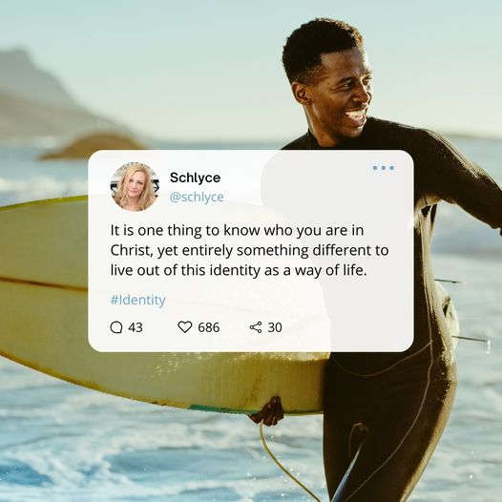
Purpose (This has Spiritual Meaning!)
John 10:10 (NLT)
The thief’s purpose is to steal and kill and destroy. My purpose is to give them a rich and satisfying life.
Our purpose: Your Action Items
Glorify him
Isaiah 43:7 (NLT)
Bring all who claim me as their God, for I have made them for my glory. It was I who created them.’”
Psalms 86:9 (NLT)
All the nations you made will come and bow before you, Lord; they will praise your holy name.
1 Corinthians 10:31 (NLT)
So whether you eat or drink, or whatever you do, do it all for the glory of God.
Romans 11:36 (NLT)
For everything comes from him and exists by his power and is intended for his glory. All glory to him forever! Amen.
1 Corinthians 6:19 (NLT)
Don’t you realize that your body is the temple of the Holy Spirit, who lives in you and was given to you by God? You do not belong to yourself,
1 Corinthians 6:20 (NLT)
for God bought you with a high price. So you must honor God with your body.
Matthew 5:16 (NLT)
In the same way, let your good deeds shine out for all to see, so that everyone will praise your heavenly Father.

Slide 23
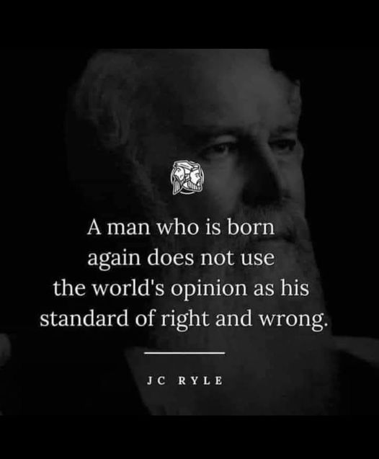
Purpose (This has Spiritual Meaning!)
John 10:10 (NLT)
The thief’s purpose is to steal and kill and destroy. My purpose is to give them a rich and satisfying life.
RECAP!
Our purpose: Your Action Items
do the good things he planned for us long ago.
live a holy life.
learn to know God’s will for you,
Seek the Kingdom of God above all else, and live righteously
Glorify him
BIG Hint: If you throw a tantrum on social media because your political party / guy / entity got demolished with unflattering facts, You are off-course.
Five for Fighting- The Riddle (lyrics)

Slide 24





RECLAIM your identity !

Slide 25
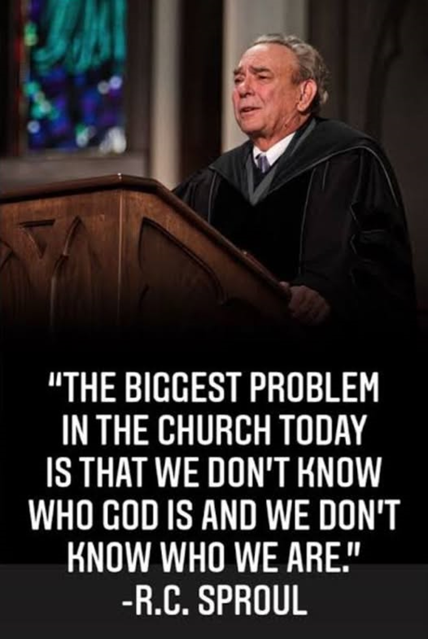
TL DR
2 things – NOT Optional
Know God , Really KNOW Him, not just Facts and Figures, ABIDE
The Belonging Co - Every Victory (Lyrics) ft. Danny Gokey
Know who YOU really are.
Who am I – Casting Crowns Lyrics
Who I am – Ben Fuller Lyrics

Slide 26
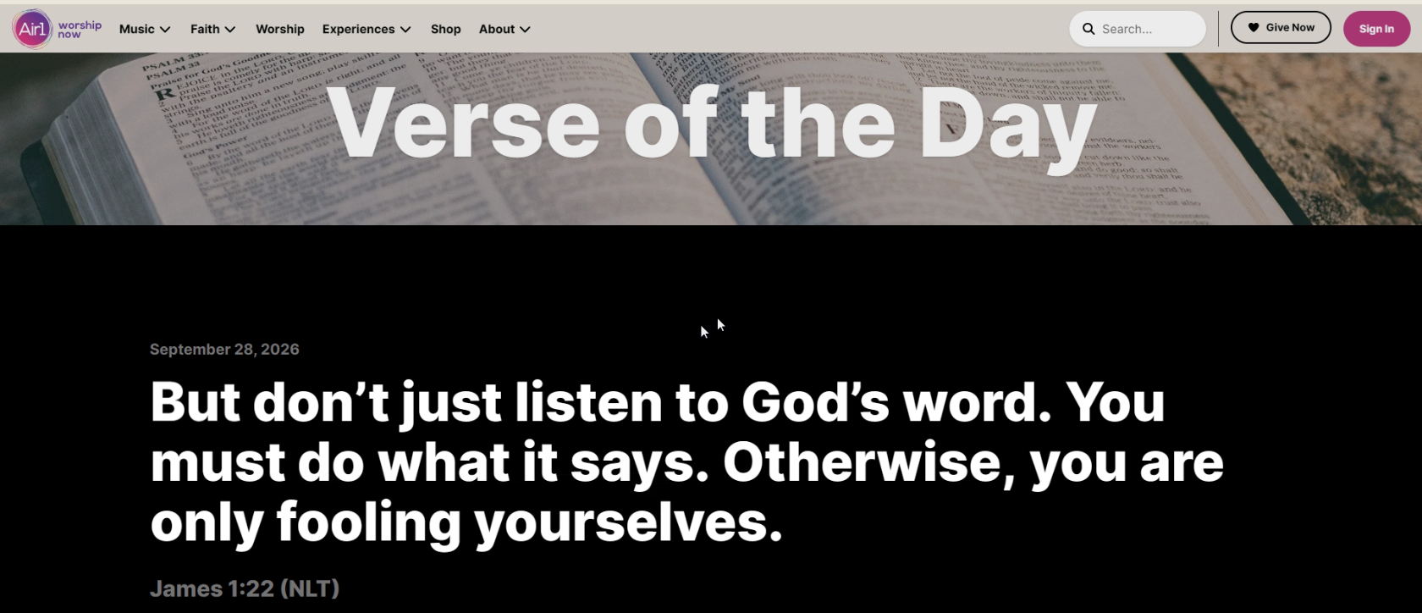

Slide 27
15 easy steps
Do these Daily
Third Day - Children of God - with Lyrics
You don’t get your identity from Sitting in a Building for an hour each week.
Know God
  Everyday active pursuit - seek his face.
  Learn and know scripture.
  Listen to the Spirit. "the voice" "the prompting" the “perceived conviction"
  Build an environment to welcome the Holy Spirit
  DAILY - if you're a Sunday warrior this all abstract.
  Build the relationship.
Mystery achievement - Pretenders (with Lyrics)
You get your identity from Christ living inside you. No other name (lyrics)
Remember who it is we're into, and who is into us:
Phil Wickham - At Your Name
Christ the Lord! Here's a few more

Slide 28

15 easy steps
Know for a fact who YOU are
  7. Learn your new identity.
  8. Keep living your identity until it become reflex.
  9. Live out your new identity,
  10. Get your hands dirty!
  11. BE the difference in the life of someone who can't help you back.
Who am I – Casting Crowns Lyrics
Who I am – Ben Fuller Lyrics

Slide 29
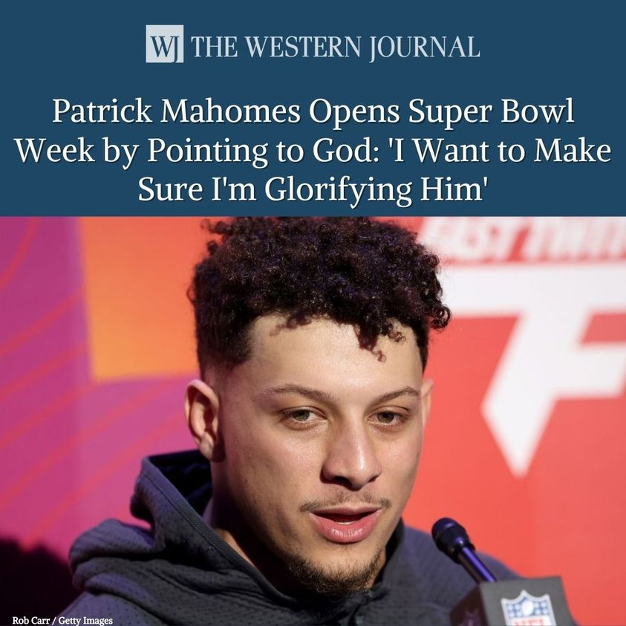
15 easy steps
Know Scripture.
  12. Let God write it on your heart.
  13. Practice measuring EVERYTHING by the Word.
  14. Theres a scripture for everything under the sun. And beyond.
Gratuitous plug: www.covingtonwacc.org/bible
This is Patrick,
Patrick knows who he is in Christ and why he's here.
Be Like Patrick.

Slide 30
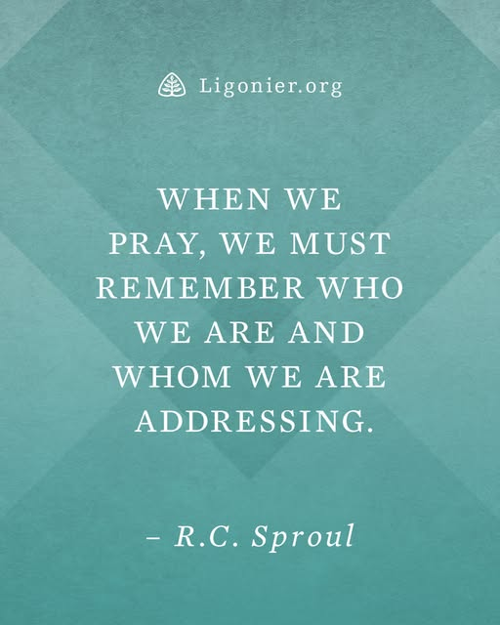
15 easy steps
For God's sake, Learn to Pray.
You are not Miss America, unless your name is Cassie Donegan…
World peace will have to wait until the after the tribulation.
Do Not do Performative prayer. (God was there with you in traffic, at the gas pump $5.49?? @$$%%^!!!! The prayer never ends.)
Resources:
The Prayer Project
The prayer series:
www.covingtonwacc.org/prayer
Out sing the angels (lyrics)

Slide 31
The 24/7 God
Know that the more you do the God Thing 24/7, the sicker this world looks.
Don’t try to enjoy the things of this world. That popular movie everyone is talking about is unappealing. That new hot streaming show runs a distant second to a hot cup of coffee and the book of Joshua.

Slide 32
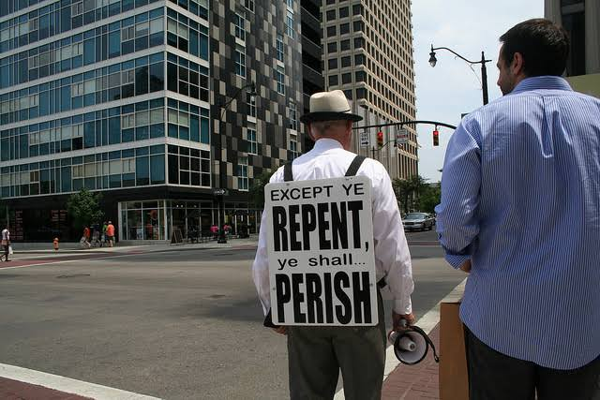
Join God in Action.
Do this NOT that
DO Bust out of the suburban lie factory. For starters, most of you live near a major metro.,
Do Volunteer. There are always plenty of charities who need your help, and always something going on . (food bank, missions, urban rescue) Enough Real-Life action to make the best streaming series seem boring.
DO be yourself. Once you figure out who you are and your strengths, don’t pretend to be something else. If you code, most churches have no web game at all.
Do apps. If you write apps, so be it. Theres an app in you that benefits the Kingdom of God. Partner with the Spirit to bring it to life. Write for Roku? Android? LG? Samsung? E-me bro.
You don’t have to dress in a flames shirt and go warn the populace. Or sell pencils at the airport or hand out flowers.

Slide 33
Embrace the Transformation.
You will want to hang onto your old habits at first, pay attention to when they turn. They will.
Change your music. 959 songs either Quoting scripture directly or expounding on a concept outlined in scripture. Everything from Michael w smith to Metallica.
Be Aware that whatever you put into your head will dominate you.
Walking Dead marathons? Demonic movies or TV? Top 40 “music”? Death Metal? Make sure you know the lyrics.
Dump the political garbage. It’s a distraction unless you’re running for something. Seek Peace instead.

Slide 34
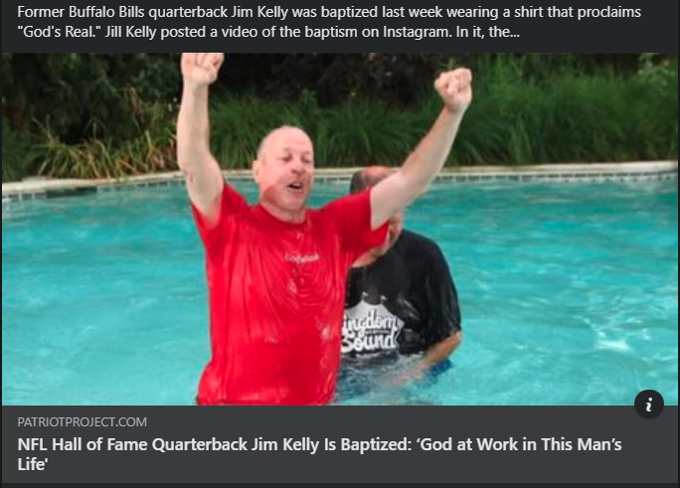
Follow the Trailblazers
Follow the Trailblazers. NOT the basketball team, the people who have gone before.
Let it bubble up inside, and overflow.
Live out your faith as much as any seahawks or mariners fans.
The second stage of claiming your identity, public proclamation.
Newsboys - Born Again (Lyric Video)

Slide 35
www.covingtonwacc.org/podcast
pocast38 playlist

Slide 36
Cutting room floor
Slides that didn’t make the cut.

Slide 37

It's not JUST the enemy.
People will try to SLIP you an ID Roofie every chance.
  The WORDS they use.
  The WAY they conduct themselves.
  The nonverbal statements They make
  Robot moment: thanks gemini. It's not Just me that sees it.
Non-verbal communication can often express disapproval, disrespect, or dismissal just as clearly as words. Here are some common non-verbal ways people show disrespect or rejection:
Eye Rolling: Signaling immediate annoyance, disbelief, or condescension.
The Cold Shoulder / Ignoring: Deliberately turning away, refusing to make eye contact, or acting as though someone isn't in the room.
Heavy Sighing: Exhaling loudly to display frustration, impatience, or the burden of dealing with someone.
Checking the Phone: Pulling out a device and looking at it while someone is speaking, which clearly communicates a lack of interest or value.
Sarcastic or Dismissive Gestures: Waving a hand dismissively, checking a watch repeatedly, or crossing arms tightly in a closed-off posture.
Invading Space or Looming: Standing too close or using body positioning to intimidate or dominate.

Slide 38
How much do YOU internalize and assent to being slighted?
I’m a brain damaged homeless guy I don’t play for the things of this world. I don’t CARE about status or prestige, or money. Nor do I care what the other person has. I will mouth off at those who need it. I can't be fired. Or kicked out.
The robot says that’s a bad idea and recommends this:
  Key strategies recommended by psychological professionals for dealing with intense friction or disruptive behavior include:
  Recognize and Pause (De-escalation): When a situation triggers a heavy physiological response—such as a racing heart, frustration, or a sense of dread—the primary recommendation is to pause and check your own emotional and physical state. Reacting in kind usually only escalates the tension.
  Maintain Emotional Detachment: Manipulative or high-conflict tactics often rely on provoking an emotional reaction to gain control. Staying calm and emotionally neutral helps cut off that dynamic, preventing you from becoming a willing participant in an unproductive argument.
  Set Clear and Firm Boundaries: Protecting your personal space and peace requires drawing explicit lines. If behavior crosses the line into disrespect, harassment, or threats, acknowledging the unacceptability of the conduct—while refusing to engage in cyclical arguments—is vital.
  Prioritize Objective Reality: High-conflict environments often distort facts or shift blame to induce confusion or self-doubt. Staying anchored to objective facts rather than defending yourself against baseless accusations keeps your perspective clear.

Slide 39
We asked the robot about it:
biometric data has been stolen in large-scale data breaches and used in cybercrimes,
though its application differs from standard stolen data like passwords.
Because fingerprints, facial geometries, and iris scans cannot simply be "reset" like a password, the theft of biometric data creates long-term security risks.
1. Real-World Biometric Breaches
Major breaches have exposed millions of raw or template-based biometric records:
The OPM Breach (2015): Hackers breached the U.S. Office of Personnel Management, stealing background check files that included the fingerprints of roughly 5.6 million individuals (later revised higher).
Suprema BioStar 2 Incident (2019): A widely used global biometric security platform left an open database exposed, leaking over 27 million records—including unencrypted fingerprint and facial recognition data belonging to over one million users across multiple countries.
National and State ID Databases: Massive government identity repositories worldwide (such as India's Aadhaar system leaks) have historically faced security incidents that exposed demographic and biometric linking data to malicious actors.
2. How Stolen Biometrics Are Used in Cybercrime
Unlike a leaked password which can be tested directly on a login page, stolen biometrics are typically weaponized in a few specific ways:
"Presentation Attacks" and Spoofing: Criminals use high-resolution images, video loops, or synthesized "master faces" (aggregated facial features designed to trick AI recognition algorithms) to bypass facial recognition on mobile devices or security kiosks.
Synthetic Fingerprints: Hackers have demonstrated techniques where stolen digital fingerprint templates are printed onto gelatin, specialized silicone, or via high-resolution inkjet printers to spoof physical biometric scanners on laptops, smartphones, or door-access systems.
Identity Fraud & Deepfakes: Cybercriminals combine stolen facial imagery and voiceprints with generative AI (deepfakes) to impersonate individuals for financial fraud, bypass remote Know-Your-Customer (KYC) verifications, or authorize unauthorized bank account access.
The Core Difference: Stolen Templates vs. Raw Data
In many modern security architectures, raw fingerprints or face images are not stored directly; instead, they are converted into a mathematical "template" (a hash or vector). However, if hackers gain access to the raw data streams or poorly encrypted databases, or if they leverage advanced AI to reconstruct images from compromised templates, the data can be successfully leveraged for targeted identity theft.

Slide 40
15 easy steps
Do these Daily
Third Day - Children of God - with Lyrics
You don’t get your identity from Sitting in a Building for an hour each week.
Know God
  Everyday active pursuit - seek his face.
1 Chronicles 16:11
Commands an active, continuous pursuit: "Look to the Lord and his strength; seek his face always."
Psalm 27:8
Reflects the heart's immediate response to God's call: "My heart says of you, 'Seek his face!' Your face, Lord, I will seek."
Jeremiah 29:13
Promises a rewarding outcome for intentional seeking: "You will seek me and find me when you seek me with all your heart."
Psalm 63:1
Expresses a daily, urgent spiritual thirst: "You, God, are my God, earnestly I seek you; I thirst for you, my whole being longs for you, in a dry and parched land where there is no water."
Matthew 6:33
Directs daily priorities toward an active pursuit of His kingdom and righteousness above all else.
  Learn and know scripture.
  Listen to the Spirit. "the voice" "the prompting" the “perceived conviction"
  Build an environment to welcome the Holy Spirit
  DAILY - if you're a Sunday warrior this all abstract.
  Build the relationship.
You get your identity from Christ living inside you.
Remember who it is we're into, and who is into us:
Phil Wickham - At Your Name
Christ the Lord! Here's a few more

Slide 41
15 easy steps
Do these Daily
Third Day - Children of God - with Lyrics
You don’t get your identity from Sitting in a Building for an hour each week.
Know God
  Everyday active pursuit - seek his face.
  Learn and know scripture.
2 Timothy 3:16–17
Highlights that all Scripture is God-breathed and useful for teaching, rebuking, correcting, and training in righteousness, so that a person may be thoroughly equipped for every good work.
Psalm 119:11
Encourages internalizing Scripture to protect against wrongdoing: "I have hidden your word in my heart that I might not sin against you."
Colossians 3:16
Advises letting the message of Christ dwell richly among believers as they teach and admonish one another with all wisdom.
Joshua 1:8
Commands keeping the Book of the Law always on one's lips, meditating on it day and night, to carefully follow everything written in it for ultimate success and prosperity.
Proverbs 2:1–5
Compares seeking wisdom and understanding of God's commands to searching for hidden silver and treasure.
  Listen to the Spirit. "the voice" "the prompting" the “perceived conviction"
  Build an environment to welcome the Holy Spirit
  DAILY - if you're a Sunday warrior this all abstract.
  Build the relationship.
You get your identity from Christ living inside you.
Remember who it is we're into, and who is into us:
Phil Wickham - At Your Name
Christ the Lord! Here's a few more

Slide 42
15 easy steps
Do these Daily
Third Day - Children of God - with Lyrics
You don’t get your identity from Sitting in a Building for an hour each week.
Know God
  Everyday active pursuit - seek his face.
  Learn and know scripture.
  Listen to the Spirit. "the voice" "the prompting" the “perceived conviction"
Galatians 5:16
Encourages walking by the Spirit so that you will not gratify the desires of the flesh.
John 16:13
Points out that when the Spirit of truth comes, He will guide believers into all the truth, speaking not on His own authority, but telling what He hears and declaring things to come.
Romans 8:14
States that those who are led by the Spirit of God are children of God.
Revelation 2:7
Repeats the refrain for anyone with ears to hear what the Spirit says to the churches.
Isaiah 30:21
Offers the promise of hearing a voice behind you saying, "This is the way; walk in it," whenever you turn to the right or the left.
  Build an environment to welcome the Holy Spirit
  DAILY - if you're a Sunday warrior this all abstract.
  Build the relationship.
You get your identity from Christ living inside you.
Remember who it is we're into, and who is into us:
Phil Wickham - At Your Name
Christ the Lord! Here's a few more

Slide 43
15 easy steps
Do these Daily
Third Day - Children of God - with Lyrics
You don’t get your identity from Sitting in a Building for an hour each week.
Know God
  Everyday active pursuit - seek his face.
  Learn and know scripture.
  Listen to the Spirit. "the voice" "the prompting" the “perceived conviction"
  Build an environment to welcome the Holy Spirit
Psalm 51:10
Focuses on internal preparation, praying, "Create in me a pure heart, O God, and renew a steadfast spirit within me."
Romans 12:1–2
Encourages offering your bodies as a living sacrifice, holy and pleasing to God, and not conforming to the pattern of this world, but being transformed by the renewing of your mind.
Ephesians 4:30–32
Advises getting rid of bitterness, rage, anger, brawling, and slander, and instead being kind and compassionate to one another, so as not to grieve the Holy Spirit of God.
2 Chronicles 7:14
Notes that when people who are called by God humble themselves, pray, seek His face, and turn from their wicked ways, He hears from heaven and dwells among them.
Habakkuk 2:20
Reminds believers of sacred reverence: "The Lord is in his holy temple; let all the earth be silent before him."
Would you like scriptural support for the n
  DAILY - if you're a Sunday warrior this all abstract.
  Build the relationship.
You get your identity from Christ living inside you.
Remember who it is we're into, and who is into us:
Phil Wickham - At Your Name
Christ the Lord! Here's a few more

Slide 44
15 easy steps
Do these Daily
Third Day - Children of God - with Lyrics
You don’t get your identity from Sitting in a Building for an hour each week.
Know God
  Everyday active pursuit - seek his face.
  Learn and know scripture.
  Listen to the Spirit. "the voice" "the prompting" the “perceived conviction"
  Build an environment to welcome the Holy Spirit
  DAILY - if you're a Sunday warrior this all abstract.
Psalm 119:147–148
Emphasizes daily devotion and study, noting, "I rise before dawn and cry for help; I have put my hope in your word. My eyes stay open through the watches of the night, that I may meditate on your promises."
Luke 9:23
Calls for a daily commitment to following Christ: "Then he said to them all: 'Whoever wants to be my disciple must deny themselves and take up their cross daily and follow me.'"
1 Thessalonians 5:16–19
Encourages a continuous, daily posture of spiritual attentiveness: "Rejoice always, pray continually, give thanks in all circumstances; for this is God’s will for you in Christ Jesus. Do not quench the Spirit."
Hebrews 3:13
Urges daily encouragement and cultivation of an environment receptive to God: "But encourage one another daily, as long as it is called 'Today,' so that none of you may be hardened by sin’s deceitfulness."
Lamentations 3:22–23
Reminds believers of God's daily renewal: "Because of the Lord’s great love we are not consumed, for his compassions never fail. They are new every morning; great is your faithfulness."
  Build the relationship.
You get your identity from Christ living inside you.
Remember who it is we're into, and who is into us:
Phil Wickham - At Your Name
Christ the Lord! Here's a few more

Slide 45
15 easy steps
Do these Daily
Third Day - Children of God - with Lyrics
You don’t get your identity from Sitting in a Building for an hour each week.
Know God
  Everyday active pursuit - seek his face.
  Learn and know scripture.
  Listen to the Spirit. "the voice" "the prompting" the “perceived conviction"
  Build an environment to welcome the Holy Spirit
  DAILY - if you're a Sunday warrior this all abstract.
  Build the relationship.
James 4:8
Emphasizes the relational closeness of drawing near to God: "Come near to God and he will come near to you. Wash your hands, you sinners, and purify your hearts, you double-minded."
John 15:4–5
Highlights the vital connection of abiding in Christ: "Remain in me, as I also remain in you. No branch can bear fruit by itself; it must remain in the vine. Neither can you bear fruit unless you remain in me."
Romans 8:15–16
Describes the intimate, familial relationship believers have through the Spirit: "The Spirit you received does not make you slaves, so that you live in fear; rather, the Spirit you received brought about your adoption to sonship. And by him we cry, 'Abba, Father.' The Spirit himself testifies with our spirit that we are God’s children."
Philippians 3:10
Expresses the ultimate heart's desire of knowing Christ deeply: "I want to know Christ—yes, to know the power of his resurrection and participation in his sufferings, becoming like him in his death."
Colossians 2:6–7
Urges believers to continue living their lives in Him, rooted and built up in Him, strengthened in the faith, and overflowing with thankfulness.
Mystery achievement - Pretenders (with Lyrics)
You get your identity from Christ living inside you.
Remember who it is we're into, and who is into us:
Phil Wickham - At Your Name
Christ the Lord! Here's a few more

Slide 46
15 easy steps
Know for a fact who YOU are
  7. Learn your new identity.
  8. Keep living your identity until it become reflex.
  9. Live out your new identity,
  10. Get your hands dirty!
  11. BE the difference in the life of someone who can't help you back.

Slide 47
15 easy steps
Know for a fact who YOU are
  Learn your new identity.
2 Corinthians 5:17
Declares the profound reality of spiritual rebirth: "Therefore, if anyone is in Christ, the new creation has come: The old has gone, the new is here!"
Galatians 2:20
Describes the exchanged life: "I have been crucified with Christ and I no longer live, but Christ lives in me. The life I now live in the body, I live by faith in the Son of God, who loved me and gave himself for me."
Ephesians 2:10
Defines our purposeful workmanship: "For we are God’s handiwork, created in Christ Jesus to do good works, which God prepared in advance for us to do."
1 Peter 2:9
Affirms your royal and chosen status: "But you are a chosen people, a royal priesthood, a holy nation, God’s special possession, that you may declare the praises of him who called you out of darkness into his wonderful light."
Colossians 3:3
Highlights your secure and hidden life in Him: "For you died, and your life is now hidden with Christ in God."
  8. Keep living your identity until it become reflex.
  9. Live out your new identity,
  10. Get your hands dirty!
  11. BE the difference in the life of someone who can't help you back.

Slide 48
15 easy steps
Know for a fact who YOU are
  8. Keep living your identity until it become reflex.
  9. Live out your new identity,
  10. Get your hands dirty!
  11. BE the difference in the life of someone who can't help you back.

Slide 49
15 easy steps
  12. Let God write it on your heart.
Key Scriptural References
Jeremiah 31:33
Prophesies the New Covenant, where God declares, "I will put my law in their minds and write it on their hearts. I will be their God, and they will be my people."
2 Corinthians 3:3
Describes believers as a letter from Christ written not with ink, but with the Spirit of the living God, not on tablets of stone but on tablets of human hearts.
Hebrews 8:10
Reiterates the promise of the New Covenant: "I will put my laws in their minds and write them on their hearts. I will be their God, and they will be my people."
Proverbs 3:1–3
Encourages keeping God's commands close: "My son, do not forget my teaching, but keep my commands in your heart... Let love and faithfulness never leave you; bind them around your neck, write them on the tablet of your heart."
Psalm 37:31
Describes the security of walking in God's truth: "The law of their God is in their hearts; their feet do not slip."
  13. Practice measuring EVERYTHING by the Word.
  14. Theres a scripture for everything under the sun. And beyond.
Gratuitous plug: www.covingtonwacc.org/bible
This is Patrick,
Patrick knows who he is in Christ and why he's here.
Be Like Patrick.

Slide 50
15 easy steps
Know Scripture.
  12. Let God write it on your heart.
  13. Practice measuring EVERYTHING by the Word.
Acts 17:11
Commends the Bereans for their daily diligence in examining the Scriptures to verify whether what they were being taught was truly aligned with God's truth.
2 Timothy 3:16–17
Affirms that all Scripture is God-breathed and serves as the ultimate benchmark for teaching, correcting, and training to ensure righteousness.
Hebrews 4:12
Describes the Word of God as living and active, sharper than any double-edged sword, capable of judging the thoughts and attitudes of the heart.
Psalm 119:105
Celebrates God's Word as the ultimate guide for life: "Your word is a lamp for my feet, a light on my path."
Romans 12:2
Urges believers not to conform to the patterns of this world, but to be transformed by the renewing of their minds so they can test and approve what God’s will is—His good, pleasing, and perfect will.
  14. Theres a scripture for everything under the sun. And beyond.
Gratuitous plug: www.covingtonwacc.org/bible
This is Patrick,
Patrick knows who he is in Christ and why he's here.
Be Like Patrick.

Slide 51
15 easy steps
Know Scripture.
  12. Let God write it on your heart.
  13. Practice measuring EVERYTHING by the Word
  14. Theres a scripture for everything under the sun. And beyond.
As the Apostle Paul writes in 2 Timothy 3:16–17, all Scripture is breathed out by God and completely equips us for every good work.
Whether you are looking at studying the Word, listening to the Spirit, cultivating daily habits, building an intimate relationship with God, learning to pray, actively seeking His face, or measuring life's decisions against His standard, His Word provides guidance for every single aspect of our walk.
Gratuitous plug: www.covingtonwacc.org/bible
This is Patrick,
Patrick knows who he is in Christ and why he's here.
Be Like Patrick.

Slide 52
15 easy steps
For God's sake, Learn to Pray.
You are not Miss America, unless your name is Cassie Donegan…
World peace will have to wait until the after the tribulation.
Resources:
The Prayer Project
The prayer series:
www.covingtonwacc.org/prayer

Slide 53
15 easy steps
Philippians 4:6
Encourages replacing anxiety with prayer, instructing believers not to worry about anything, but in every situation, through prayer and petition with thanksgiving, to present their requests to God.
Luke 11:1
Illustrates the desire to learn how to communicate with God, as one of the disciples explicitly asked Jesus, "Lord, teach us to pray, just as John taught his disciples."
1 Thessalonians 5:17
Calls for a constant, lifestyle approach to communication with God by urging believers to pray continually.
Matthew 6:5–6
Provides guidance from Jesus on cultivating an authentic, personal, and focused prayer life rather than seeking theatrical recognition.
James 5:16
Highlights the profound effectiveness and impact of a righteous person's fervent prayer.
For God's sake, Learn to Pray.
You are not Miss America, unless your name is Cassie Donegan…
World peace will have to wait until the after the tribulation.
Resources:
The Prayer Project
The prayer series:
www.covingtonwacc.org/prayer

