Slide 1




Slide 2

New Message Series:
Where are
we in time?

Slide 3
Today’s Message:
From the Cross
to the Crown
Key Scriptures:
Ephesians 3:1-6

Slide 4


Slide 5
Ephesians 3:1-6
1 For this reason I, Paul, the prisoner of Christ Jesus for the same of you Gentiles- 2 Surely you have heard about the administration of God’s grace that was given to you for me, 3 that is, the mystery made known to

Slide 6
me by revelation, as I have already written briefly. 4 In reading this, then, you will be able to understand my insight into the mystery of Christ, 5 which was not made known to people in other generations as it has now been revealed by the Spirit to God’s holy apostles and prophets. 6 This

Slide 7
mystery is that through the gospel the Gentiles are heirs together with Israel, members together of one body, and sharers together in the promise of Christ Jesus.

Slide 8
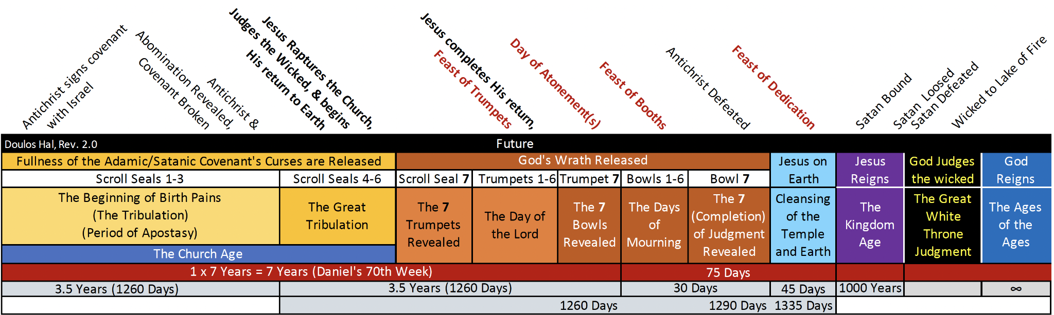

Slide 9
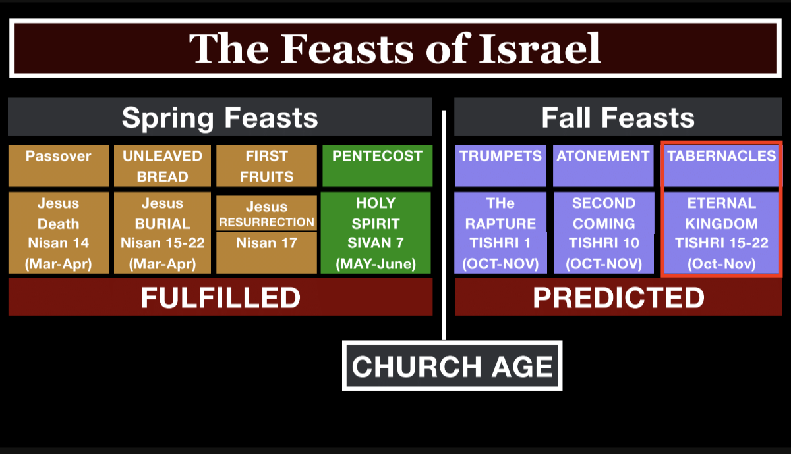

Slide 10
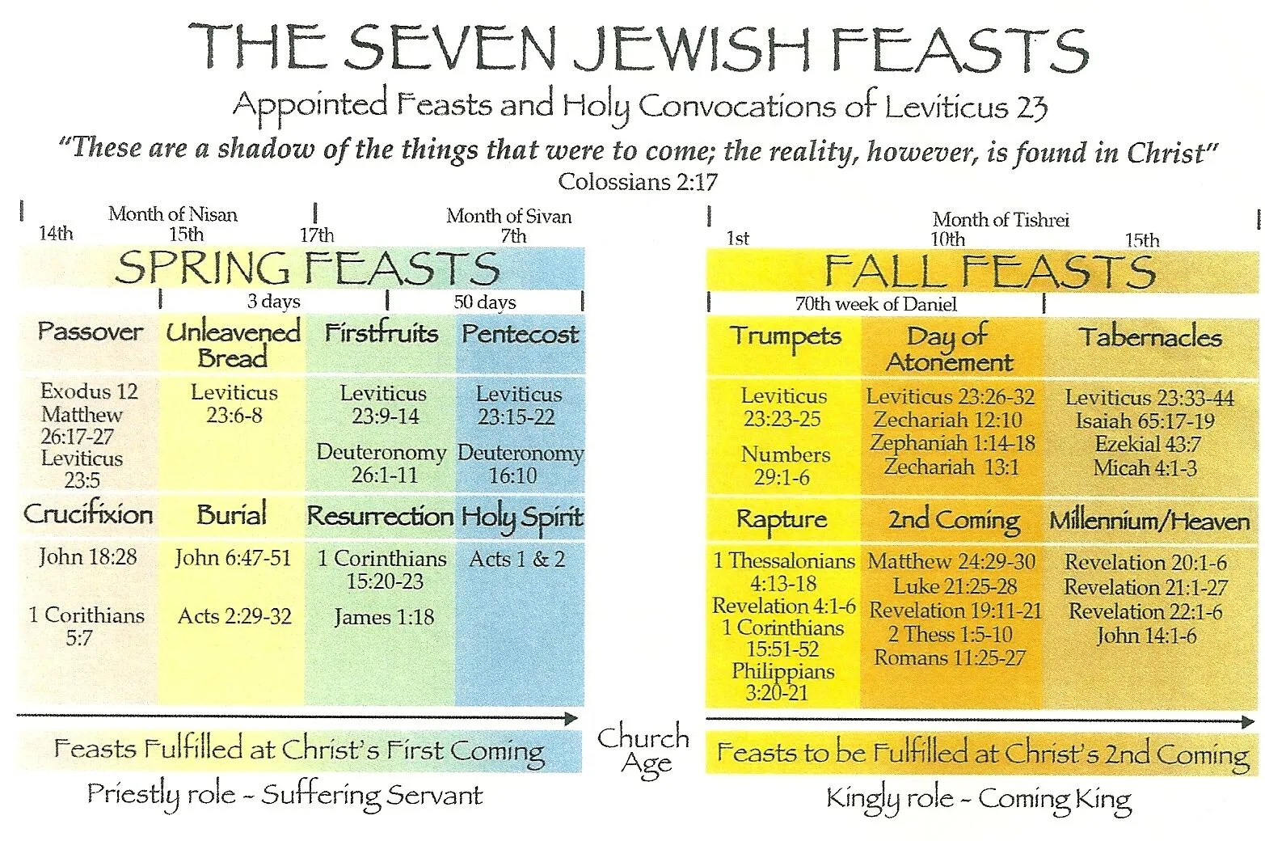

Slide 11
2 Peter 3:9
The Lord is not slow in keeping his promise, as some understand slowness. Instead he is patient with you, not wanting anyone to perish, but everyone to come to repentance.

Slide 12
1 Thessalonians 5:4-6
4 But you, brothers and sisters, are not in darkness so that this day should surprise you like a thief. 5 You are all children of the light and children of the day. We do not belong to the night or

Slide 13
6 So then, let us not be like others, who are asleep, but let us be awake and sober.

Slide 14
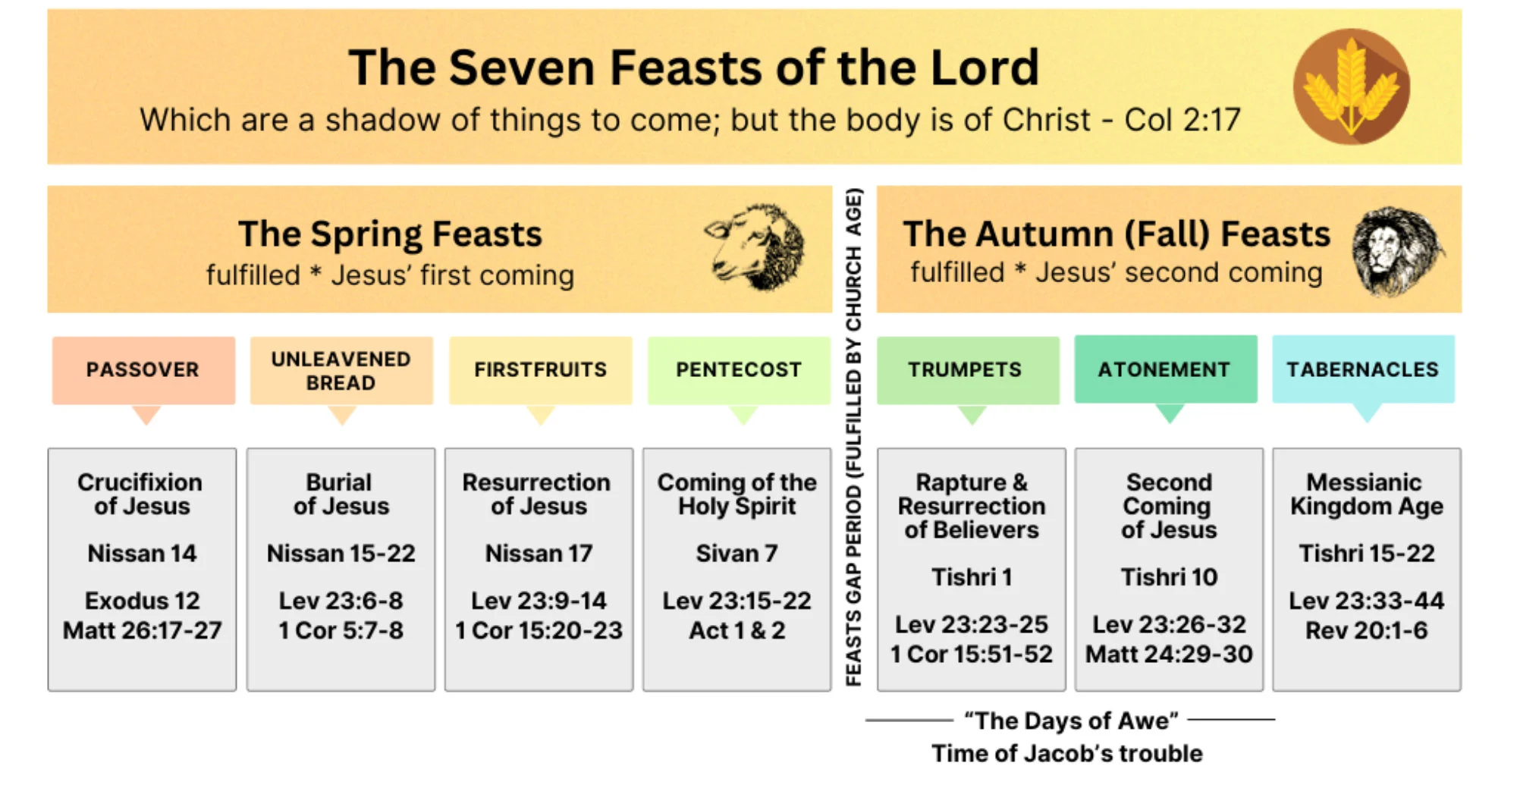

Slide 15
Looking Ahead:
Series At-A-Glance
Next Week-
Week 2- The Rapture: When Christ Call His Church Home

Slide 16
Week 3- The Tribulation: A World in Crisis
Week 4- The Bema Seat & The Marriage Supper of the Lamb
Week 5- The Return of the King
Week 6- The Millennial Reign of Christ

Slide 17
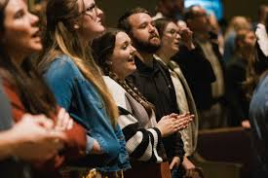

Slide 18


Slide 19



Slide 20
