Slide 1

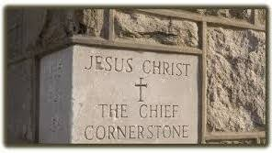

Community Greeting

Slide 2
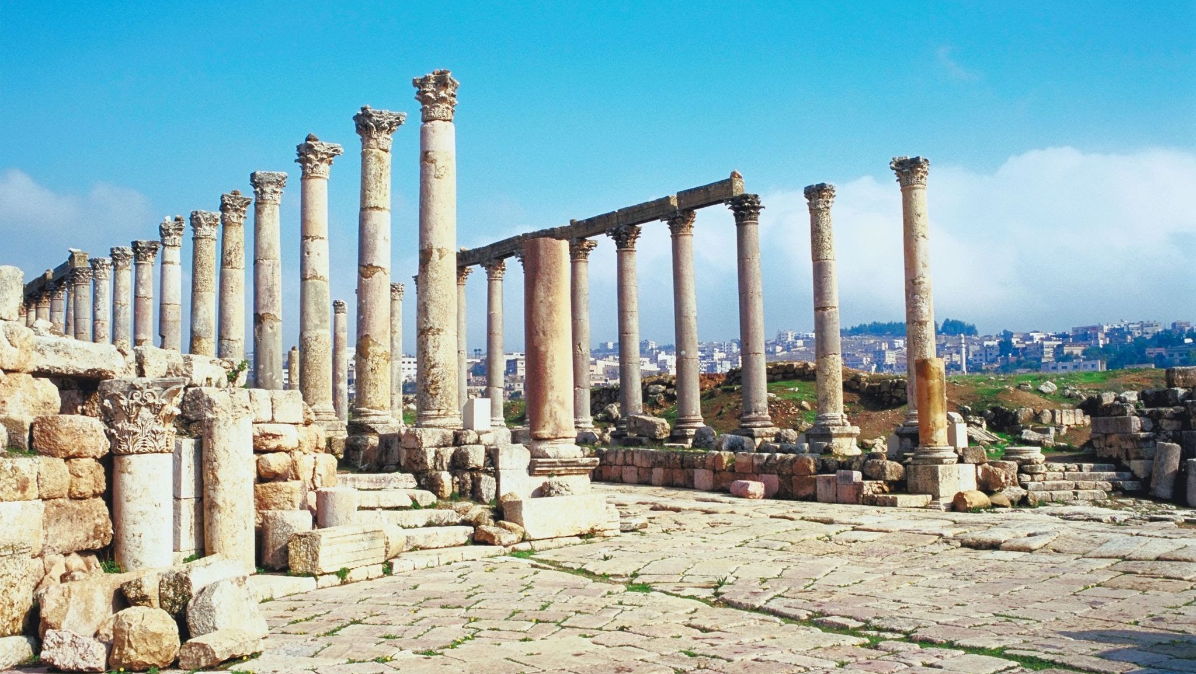
Community Greeting

Slide 3
THE SEVEN CHURCHES OF JESUS
Laodicea:
Temperature Matters
Part One · Revelation 3:14–18

Slide 4
HOT
COLD
LUKEWARM
Coffee
Soup
A good fire
Ice water
Lemonade
Ice cream
Too cool
to warm you.
Too warm
to refresh you.

Slide 5
“I know your deeds, that you are neither cold nor hot. I wish you were either one or the other! So, because you are lukewarm—neither hot nor cold—I am about to spit you out of my mouth.”
Revelation 3:15–16

Slide 6
The most dangerous place a believer or a church can reach:
When Jesus sees a problem that we can no longer see.

Slide 7
POINT 1
Jesus Knows the True Condition of His Church
“These are the words of the Amen, the faithful and true witness, the ruler of God’s creation.”
Revelation 3:14

Slide 8
What does Jesus see?
WE MEASURE
JESUS LOOKS AT
Attendance
Buildings
Programs
Reputation
Faithfulness
Obedience
Love
Spiritual life
Never confuse appearance with spiritual reality.

Slide 9
POINT 2
Lukewarm Faith Is a Faith That Has Lost Its Dependence
Hierapolis
Colossae
Laodicea
Hot springs
Healing
Cold water
Refreshing
Lukewarm
Useless

Slide 10
“You say, ‘I am rich; I have acquired wealth and
do not need a thing.’”
The danger was not that they had nothing. They had so much they believed they needed nothing.
Revelation 3:17a

Slide 11
One Degree at a Time
Prayer becomes optional
Scripture becomes familiar
Worship becomes routine
Conviction becomes quieter
Comfort outranks calling
…and slowly the fire cools.

Slide 12
POINT 3
Jesus Exposes What They Cannot See
“But you do not realize that you are wretched, pitiful, poor, blind and naked.”
Revelation 3:17b

Slide 13
THEY WERE KNOWN FOR
JESUS SAYS
JESUS OFFERS
Banking
Poor
Refined gold
Black wool
Naked
White clothes
Eye salve
Blind
Salve to see

Slide 14
“I counsel you to buy from me gold refined in the fire, so you can become rich; and white clothes to wear, so you can cover your shameful nakedness; and salve to put on your eyes, so you can see.”
The answer is not trying harder. The answer is returning to Jesus.
Revelation 3:18

Slide 15
What is your spiritual temperature?
Not ten years ago. Not what others think.
Today.
“Jesus, I need You.”
The opposite of lukewarm is dependence.

Slide 16
NEXT TIME · PART TWO
“Here I am! I stand at the door and knock.”
He is still at the door.
He is still speaking.
He is still calling.
He who has an ear, let him hear what the Spirit says to the churches. — Rev. 3:22

Slide 17
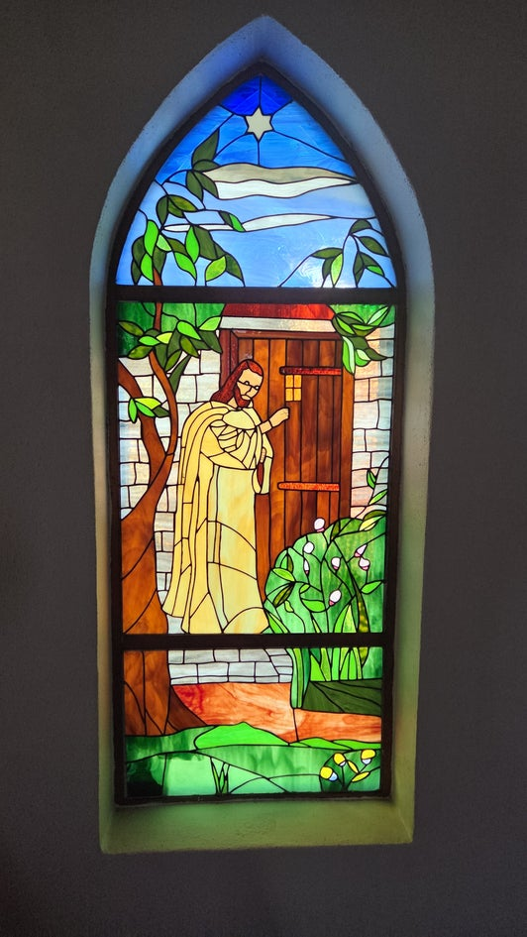
"The Glass"
Revelation 3:20 'Here, I’m standing at the door, knocking. If someone hears my voice and opens the door, I will come in to him and eat with him, and he will eat with me. '
www.covingtonwacc.org/7churches

