Slide 1
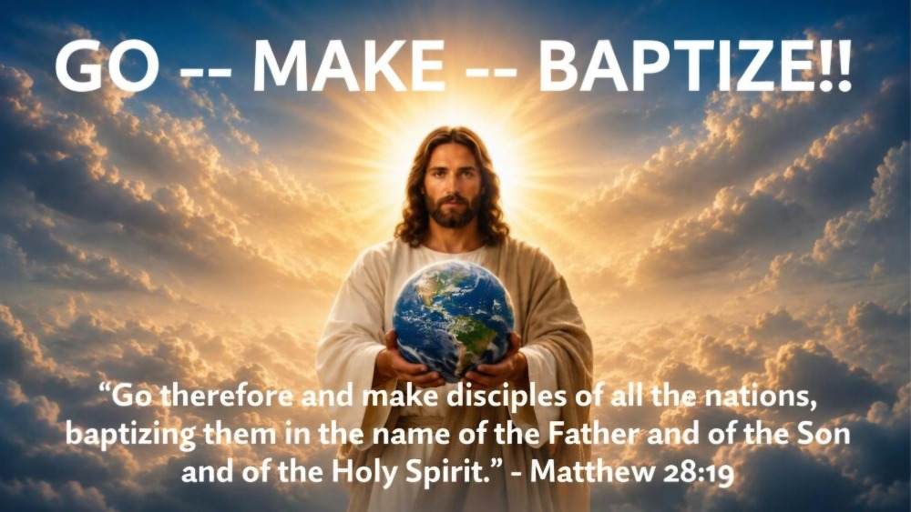
Week 1 · The Mission Is Still the Mission
Notes:
Up before the message begins. Advance on: "There are moments when the last thing somebody says matters more than everything else."

Slide 2
Week 1 · The Mission Is Still the Mission
Notes:
Up before the message begins. Advance on: "There are moments when the last thing somebody says matters more than everything else."

Slide 3
He Did Not Say…
Build impressive buildings
Develop great programs
Make sure everybody is comfortable
Become popular in your community
Those things may have their place — but they are not the mission.

Slide 4
MATTHEW 28:18–20 (NIV)
“All authority in heaven and on earth has been given to me. Therefore go and make disciples of all nations, baptizing them in the name of the Father and of the Son and of the Holy Spirit, and teaching them to obey everything I have commanded you. And surely I am with you always, to the very end of the age.”
Notes:
HOLD WHILE READ — leave up through the full reading.

Slide 5



The Great Commission
GO
MAKE
BAPTIZE
+ Teach them to obey.

Slide 6
GO
1
Faith was never meant to stay put
Abraham · Moses · Jonah · the disciples · Paul — and now the Church

Slide 7


Your Mission Field
Across an Ocean
Across the Street
Villages · cities · nations
Work · school · neighbors · the coffee shop
We receive the Gospel so that we can carry it.

Slide 8
MAKE
2
Make disciples, not just converts
“…and make disciples of all nations”

Slide 9

A Decision or a Disciple?
A DECISION
A DISCIPLE
happens in a moment
grows over a lifetime
Come follow Him.

Slide 10

Who are you walking with?
Encouraging · Teaching · Helping them see Jesus

Slide 11
Teaching Them to Obey
Teach them what I commanded.
Teach them to OBEY what I commanded.
Not simply information — transformation.

Slide 12
BAPTIZE
3
An opportunity to publicly belong to Jesus
“…in the name of the Father and of the Son and of the Holy Spirit”

Slide 13
Baptism Says…
My old life has been buried.
1
I have been raised to new life.
2
I belong to Christ — and to His people.
3
“I belong to Jesus.”

Slide 14

Somebody told somebody who told somebody…
…and eventually the Gospel reached you.
Your turn.

Slide 15

A Command Wrapped in a Promise
IT BEGINS WITH
EVERYTHING IN BETWEEN
IT ENDS WITH
“All authority belongs to Me.”
Go · Make · Baptize · Teach
“I am with you always.”
We do not go alone.

Slide 16
“Jesus, show me one person.”
To love · to encourage · to tell · to walk with · to disciple

Slide 17
The mission is still the mission.

Slide 18



Slide 19

www.covingtonwacc.org/go-make-baptize

