Slide 1




Slide 2

New Message Series:
Where are
we in time?

Slide 3
Today’s Message:
In the Twinkling of
An Eye-
The Rapture of
The Church
Key Scriptures:
1 Corinthians 15: 51-52

Slide 4
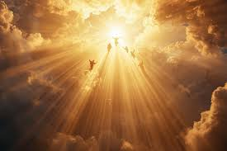

Slide 5
1 Corinthians 15:51-52
51 Listen, I tell you a mystery: We will not all sleep, but we will all be changed - 52 in a flash, in the twinkling of an eye, at the last trumpet. For the trumpet will sound, the dead will be raised imperishable and we will be changed.
Notes:
1 Corinthians 15:51-52

Slide 6
1 Thessalonians 4:16-17
16 “For the Lord Himself will descend from heaven with a shout, with the voice of an archangel, and with the trumpet call of God, and the dead in Christ shall rise first. 17 After that, we who are still alive and are left will be caught up
Notes:
1 Thessalonians 4:16-17

Slide 7
together with them in the clouds to meet the Lord in the air. And so we will be with the Lord forever.

Slide 8
1 Corinthians 15:51-52
51 Listen, I tell you a mystery: We will not all sleep, but we will all be changed - 52 in a flash, in the twinkling of an eye, at the last trumpet. For the trumpet will sound, the dead will be raised imperishable and we will be changed.
Notes:
1 Corinthians 15:51-52

Slide 9
Titus 2:13
while we wait for the blessed hope-the appearing of the glory of our great God and Savior, Jesus Christ.
Notes:
Titus 2:13

Slide 10
James 5:8
You too, be patient and stand firm, because the Lord’s coming is near.

Slide 11
1 Thessalonians 5:9
For God did not appoint us to suffer wrath but to receive salvation through our Lord Jesus Christ.
Notes:
1 Thessalonians 5:91 Thessalonians 5:9

Slide 12
Revelation 3:10
Since you have kept my command to endure patiently, I will also keep you from the hour of trial that is going to come on the whole world to test the inhabitants of the earth.
Notes:
Revelation 3:10

Slide 13
Daniel 9:27
He will confirm a covenant with many for one ‘seven.’ In the middle of the ‘seven’ he will put an end to sacrifice and offering. And at the temple he will set up an abomination that causes desolation until the end is decreed is poured out on him.

Slide 14
John 14:1-3
Do not let your hearts be troubled. You believe in God; believe also in me. 2 My Father’s house has many rooms; if that were not so, would I have told you that I am going there to prepare a place for you? 3 And if I go and

Slide 15
Live with urgency, NOT anxiety!

Slide 16
The blessed hope purifies us.

Slide 17
Make sure you’re in!

Slide 18
Engage the watching world.
Notes:
Engage the watching world

Slide 19
1 Corinthians 15:51-52
51 Listen, I tell you a mystery: We will not all sleep, but we will all be changed - 52 in a flash, in the twinkling of an eye, at the last trumpet. For the trumpet will sound, the dead will be raised imperishable and we will be changed.

Slide 20
Week 3- The Tribulation: A World in Crisis
Week 4- The Bema Seat & The Marriage Supper of the Lamb
Week 5- The Return of the King
Week 6- The Millennial Reign of Christ

Slide 21
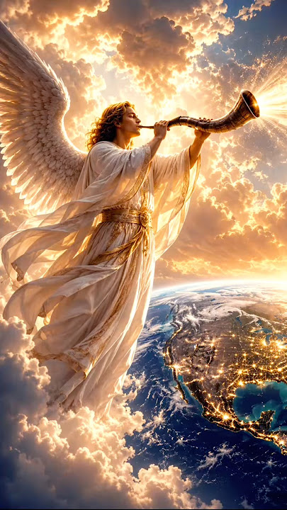

Slide 22

