Slide 1

Current Series!
It’s Hell….
but Heaven is coming!

Slide 2

This week
Created for Heaven
Key Scripture:Col. 1:16 and Gen. 1:1

Slide 3
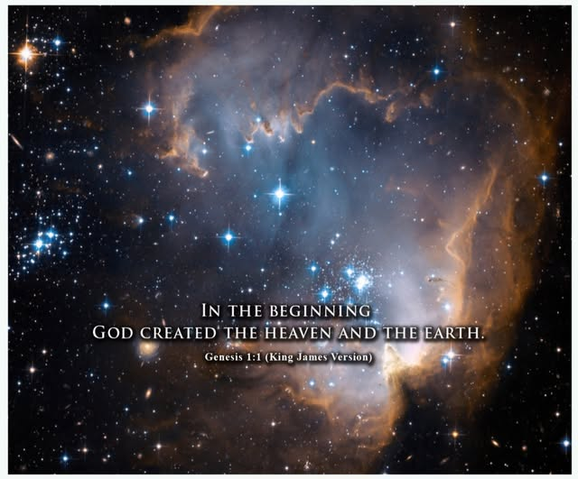

Slide 4
Colossians 1:16
For in him all things were created: things in heaven and on earth, visible and invisible, whether thrones or powers or rulers or authorities; all things have been created through him and for him.

Slide 5
