Slide 1
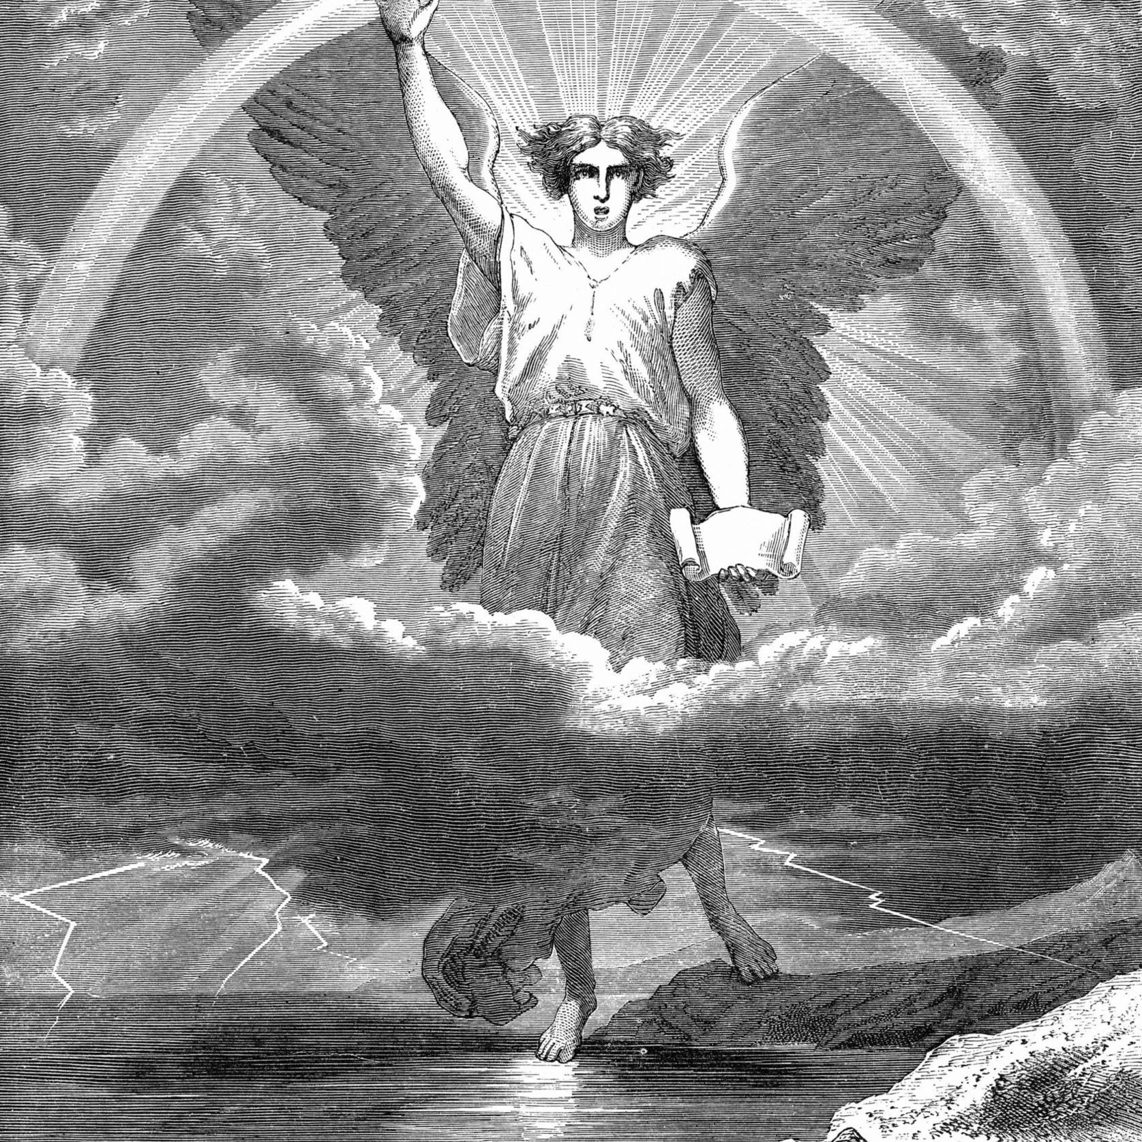
Angels:
Dark and Light
Today’s Scripture:
Ephesians 6:12

Slide 2
Ephesians 6:12
For our struggle is not against flesh and blood, but against the rulers, against the authorities, against the powers of this dark world and against the spiritual forces of evil in the heavenly realms.

Slide 3
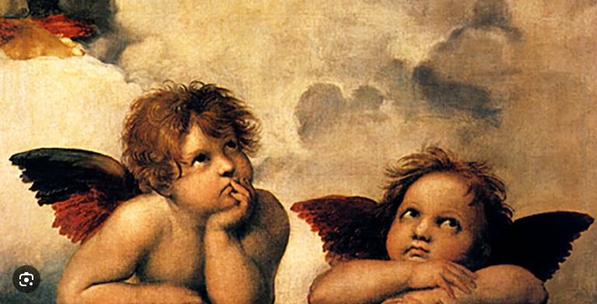
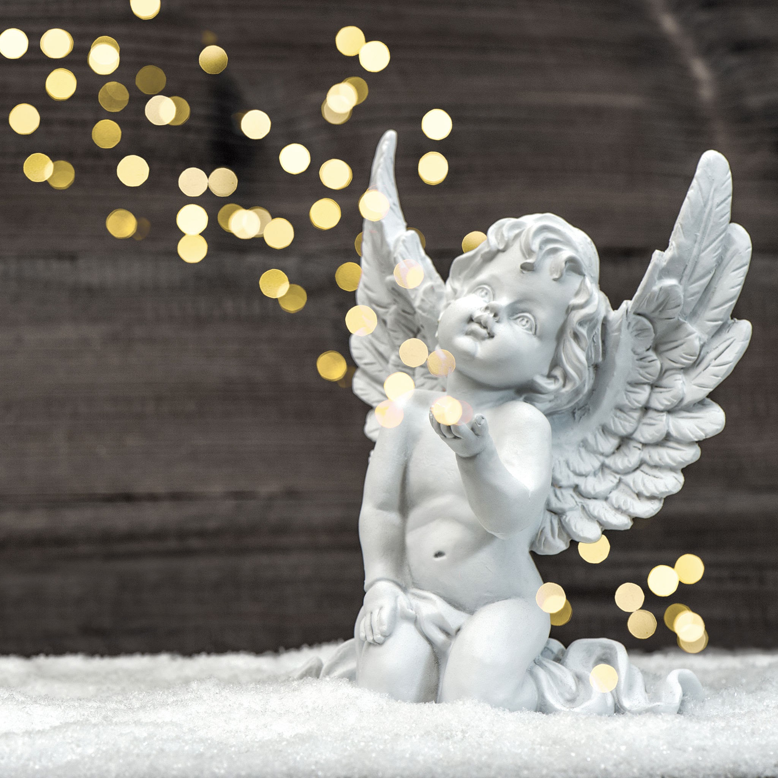
The angels
we imagine

Slide 4
Jude 6 & 14
6 And the angels who did not keep their positions of authority but abandoned their proper dwelling-these he has kept in darkness, bound with everlasting chains for judgment on the great Day.

Slide 5
14 Enoch, the seventh from Adam, prophesied about them: “See, the Lord is coming with thousands upon thousands of his holy ones

Slide 6
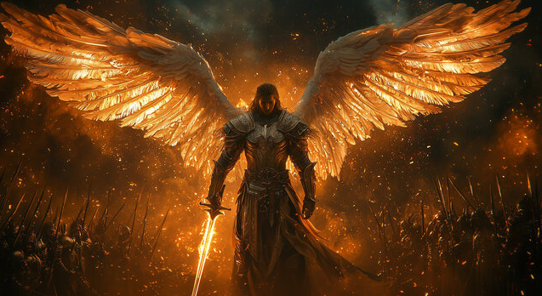

Slide 7
Ezekiel 28:11-19
11 The word of the Lord came to me:12 “Son of man, take up a lament concerning the king off Tyre and say to him:’This what the Sovereign Lord says: “You were the seal of perfection, full of wisdom and perfect in beauty.

Slide 8
13 You were in Eden, the garden of God; every precious stone adorned you: carnelian, chrysolite and emerald, topaz, onyx and jasper, lapis lazuli, turquoise and beryl. Your settings and mountings were made of gold; on the day you were created they were prepared.

Slide 9
14 You were anointed as a guardian cherub, for so I ordained you. You were on the holy mount of God; you walked among the fiery stones.
15 You were blameless in your ways from the day you were created till wickedness was found in you. 16 Through your widespread trade you

Slide 10
Were filled with violence, and you sinned. So I drove you in disgrace from the mount of God, and I expelled you, guardian cherub, from among the fiery stones. 17 Your heart became proud on account of your beauty, and you corrupted your wisdom because of your splendor.

Slide 11
So I threw you to the earth; I made a spectacle of you before kings. 18 By your many sins and dishonest trade you have desecrated your sanctuaries. So I made a fire come out from you, and it consumed you, and I reduced you to ashes on the ground in the sight of all who were watching.

Slide 12
watching.19 All the nations who knew you are appalled at you; you have come to a horrible end and will be no more.’”

Slide 13
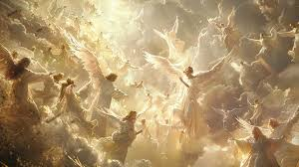

Slide 14
Genesis 6:1-4
1 When human beings began to increase in number on the earth and daughters were born to them, 2 the sons of God saw that the daughters of humans were beautiful, and they married any of them they chose.

Slide 15
3 Then the Lord said, “My Spirit will not contend with humans forever, for they are mortal; their days will be a hundred and twenty years.”
4 The Nephilim were on the earth in those days-and also afterward-when the sons of God went to the daughters of humans and had

Slide 16
Children by them. They were the heroes of old, men of renown.

Slide 17
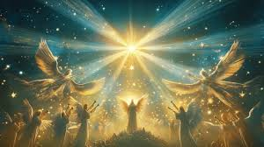

Slide 18


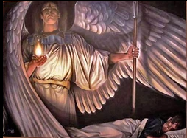
www.covingtonwacc.org/angels

