Slide 1
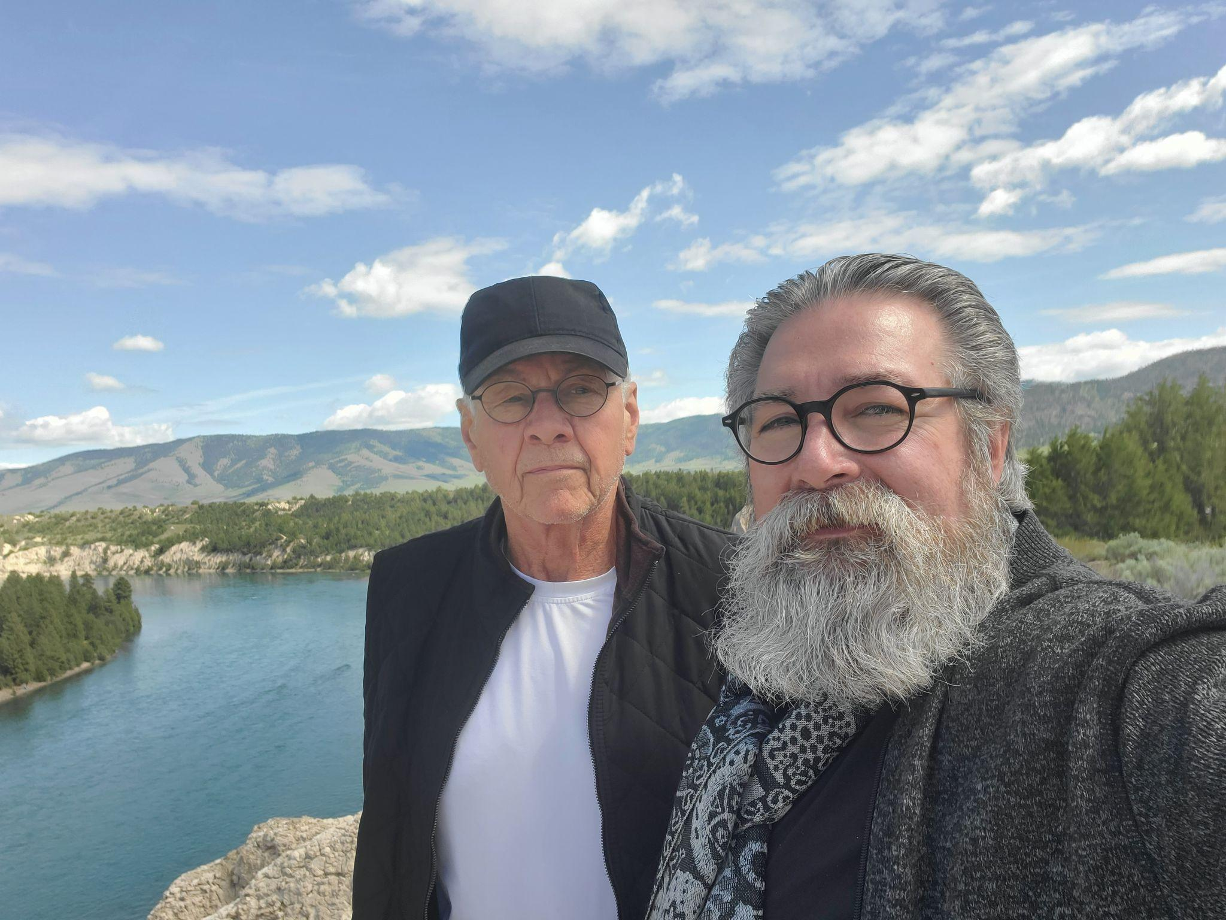

Slide 2
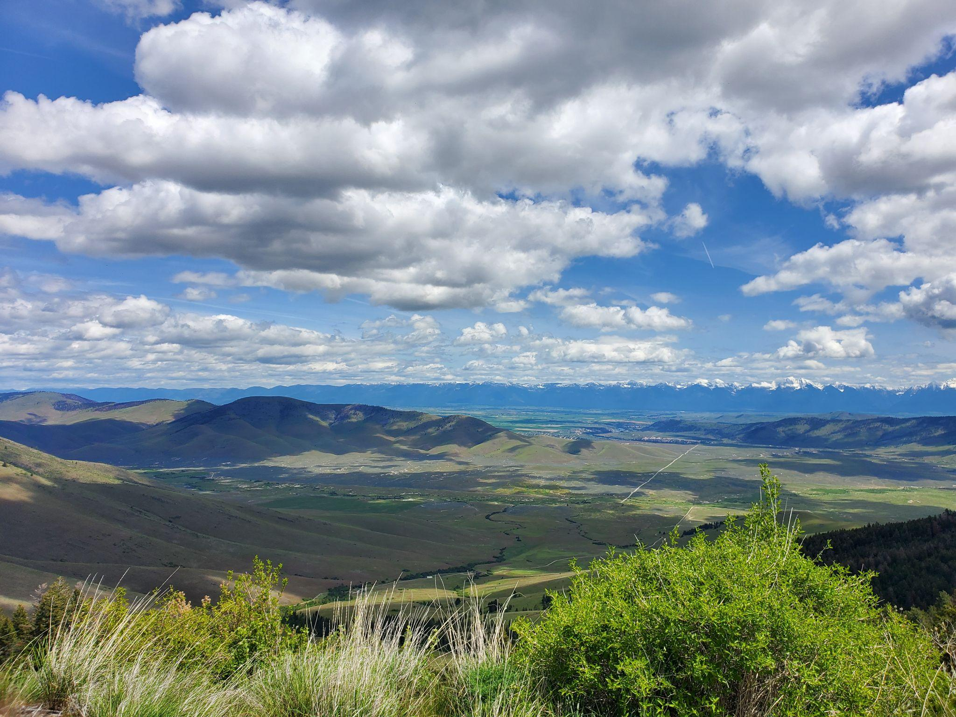

Slide 3
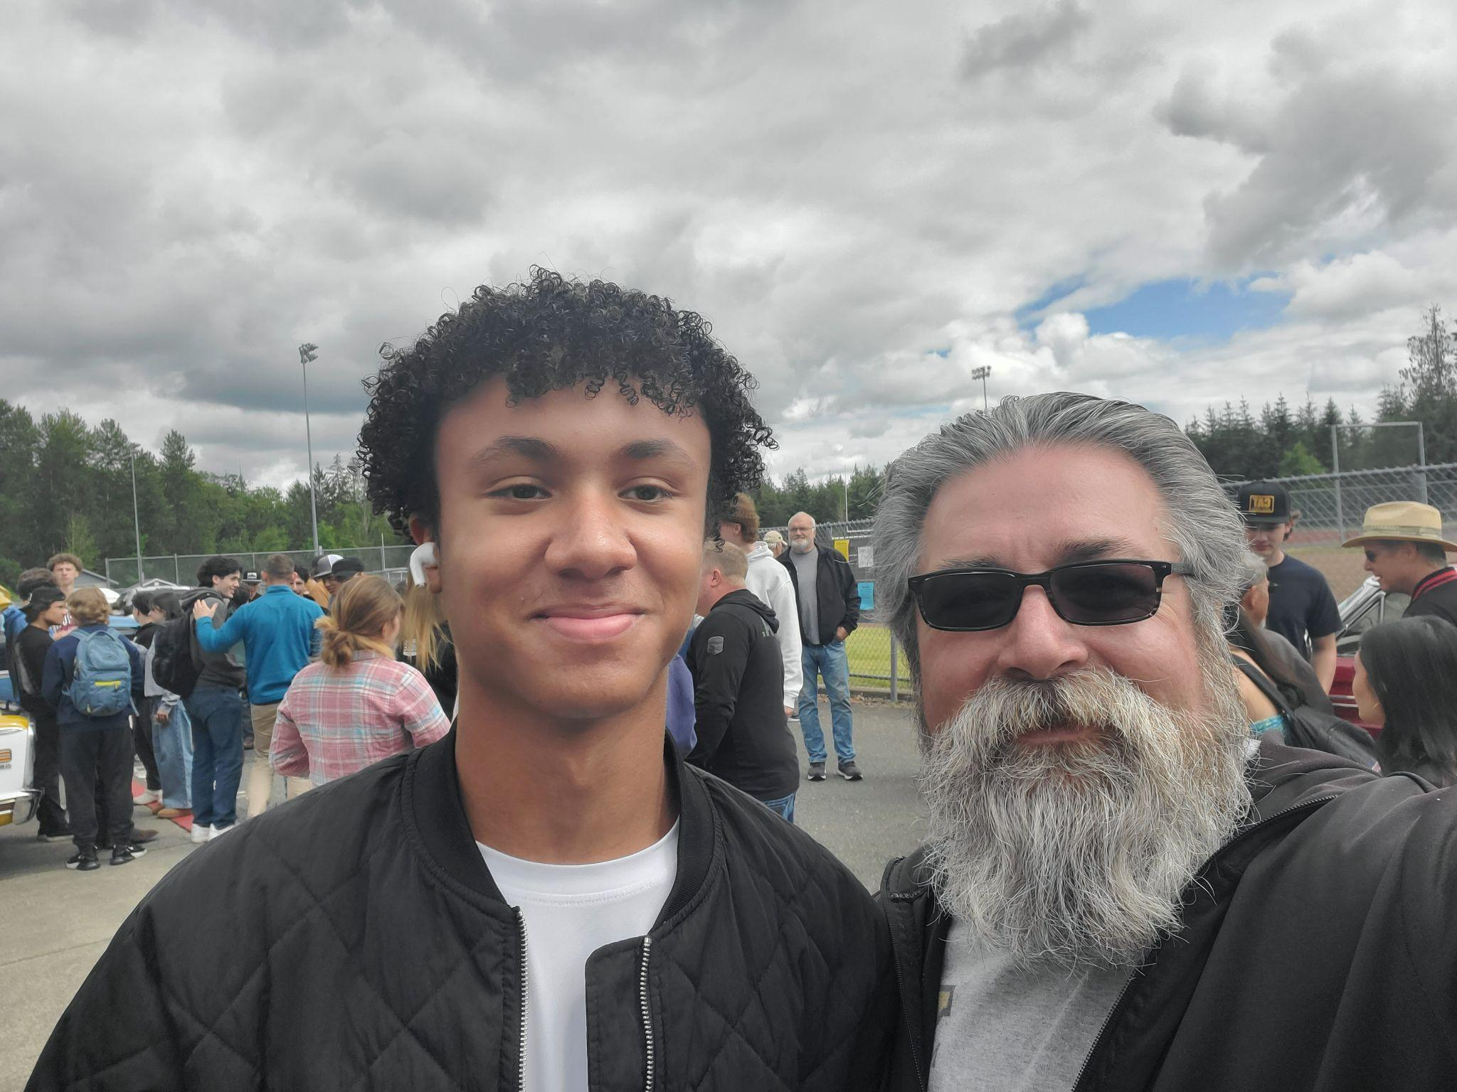
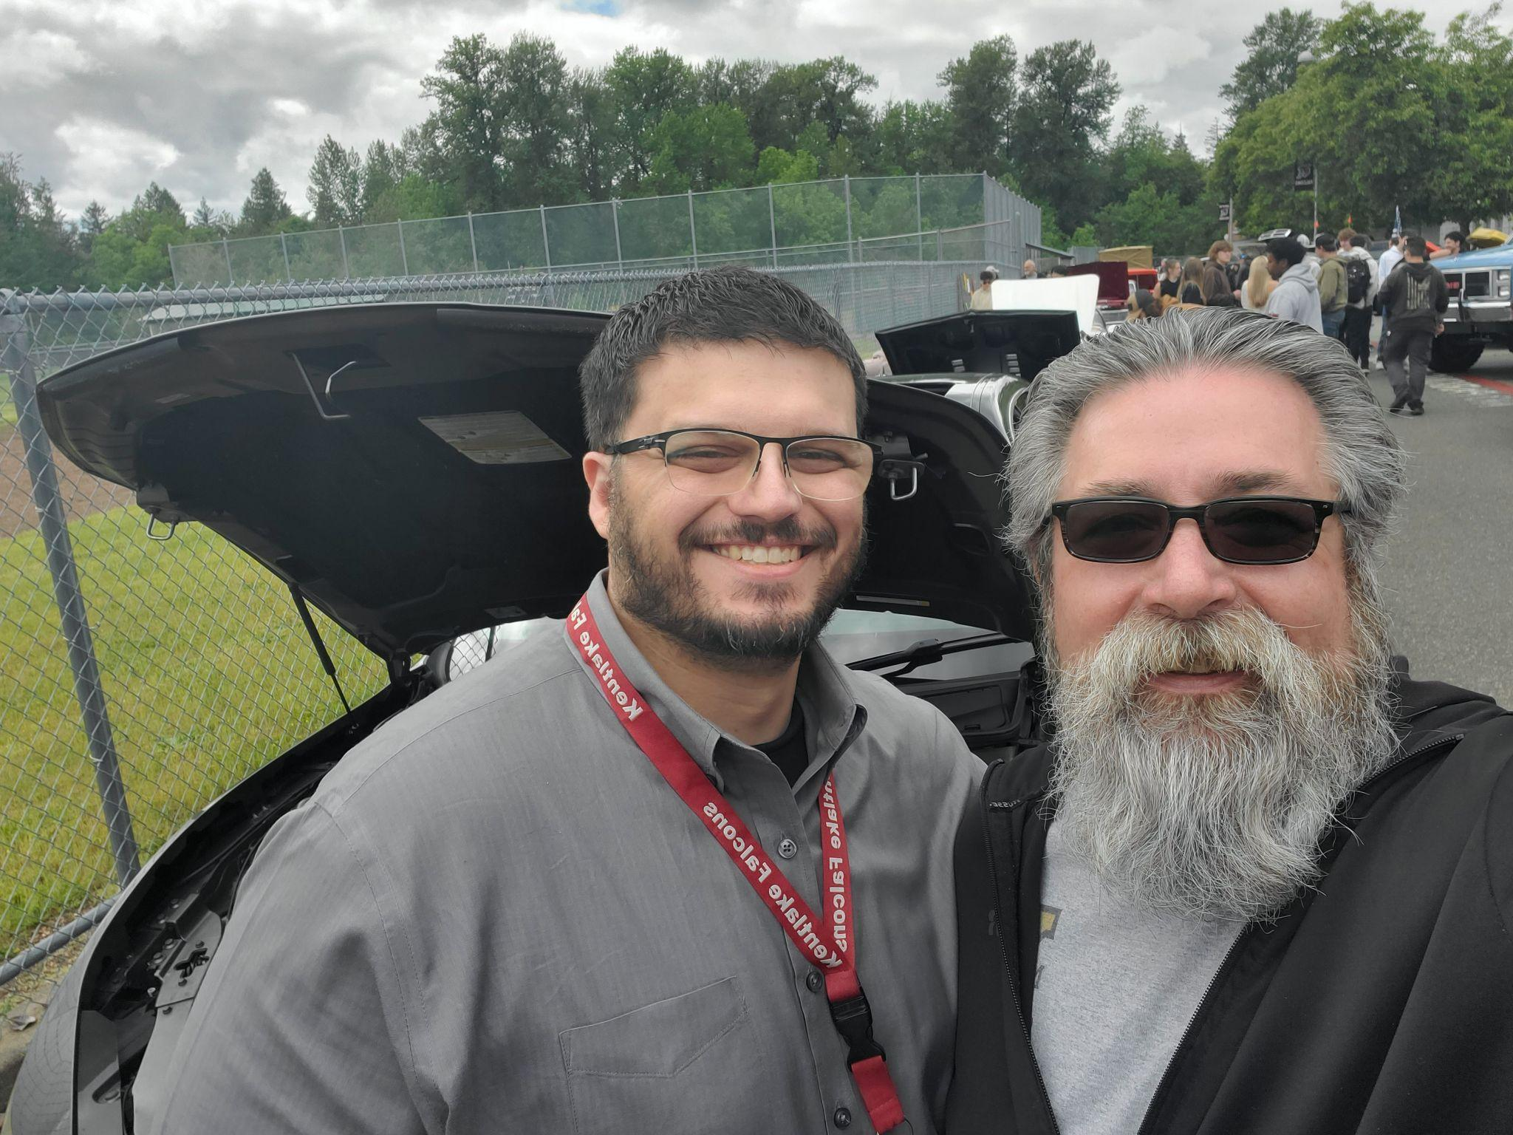

Slide 4
Today’s Message:
Prayer as Worship
Key Scripture: 1 Tim 2: 1-8,
Matt 21:13, Isa 56:7

Slide 5


Slide 6
1 Timothy 2:1-8
1 I urge, then, first of all, that petitions, prayers, intercession and thanksgiving be made for all people- 2for kings and all those in authority, that we may live peaceful and quiet lives in all godliness and holiness.

Slide 7
3 This is good, and pleases God our Savior, 4 who wants all people to be saved and to come to a knowledge of the truth. 5 For there is one God and one mediator between God and mankind, the man Christ Jesus,

Slide 8
6 who gave himself as a ransom for all people. This has now been witnessed to at the proper time. 7 And for this purpose I was appointed a herald and an apostle- I am telling the truth, I am not lying- and a true and faithful

Slide 9
teacher of the Gentiles.
8 Therefore I want the men everywhere to pray, lifting up holy hands without anger or disputing.

Slide 10
Matthew 21:15
But when the chief priests and the teachers of the law sw the wonderful things he did and the children shouting in the temple courts, “Hosanna to the Son of David,” they were indignant.

Slide 11
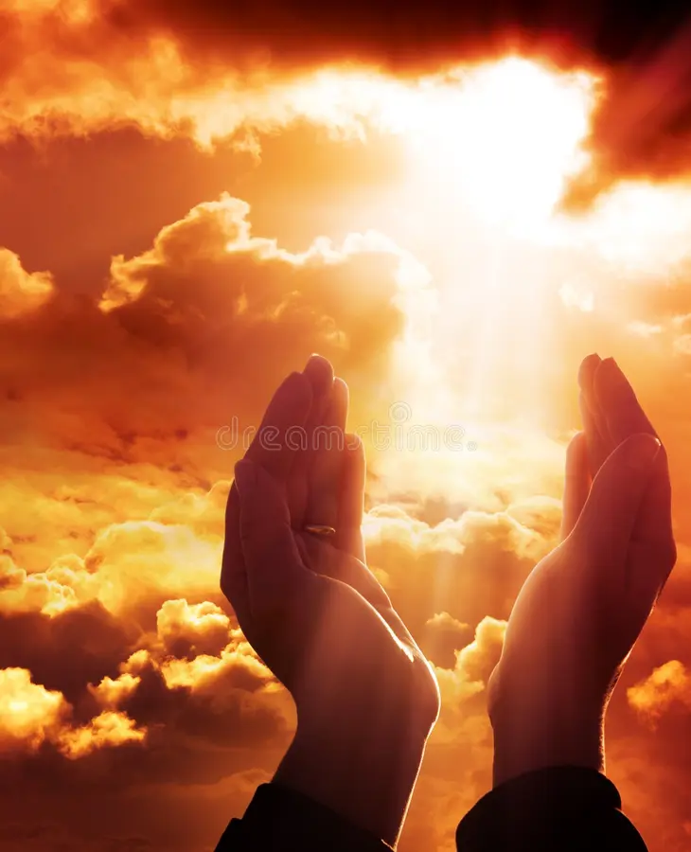
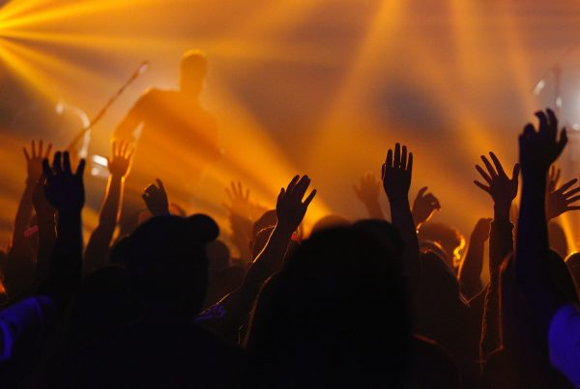

Slide 12
Isaiah 56:7
These I will bring to my holy mountain
And give them joy in my house of prayer.
Their burn offerings and sacrifices
Will be accepted on my altar;
For my house will be called
A house of prayer for all nations.”

Slide 13
