Slide 1
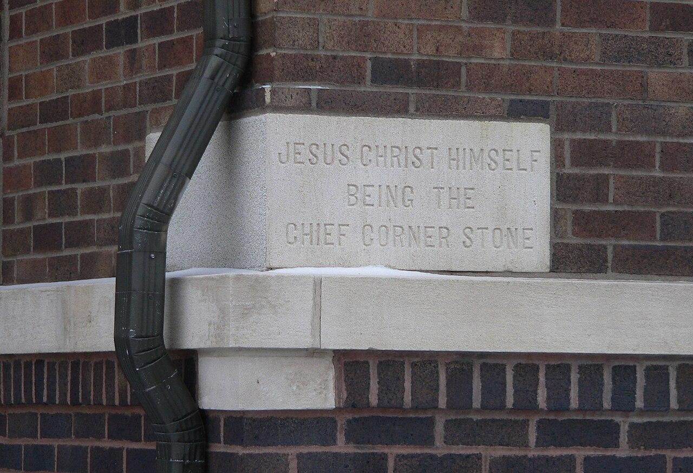
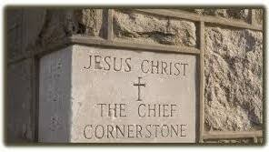

Covington Community Church
Welcomes You

Slide 2
SERMON SERIES • THE SEVEN CHURCHES OF JESUS
Jesus: The Cornerstone
of the Church
WEEK ONE
1 Corinthians 3:11
COVINGTON COMMUNITY CHURCH • THE SEVEN CHURCHES OF JESUS • WEEK ONE
Notes:
Opening slide. Bring up as the pastor welcomes the church and introduces the new series.

Slide 3

Community Greeting

Slide 4
PRIMARY TEXT
“For no one can lay any foundation
other than the one already laid,
which is Jesus Christ.”
1 CORINTHIANS 3:11 (NIV)
COVINGTON COMMUNITY CHURCH • THE SEVEN CHURCHES OF JESUS • WEEK ONE
Notes:
Hold on this verse after Paul's line is read aloud: “Paul answers that question with remarkable simplicity.”

Slide 5
Why does Jesus have
the right to speak
to His Church?
Three reasons Jesus alone has the right to speak to His Church
COVINGTON COMMUNITY CHURCH • THE SEVEN CHURCHES OF JESUS • WEEK ONE
Notes:
Bring up during the run of rhetorical questions in the introduction (“Why does Jesus have the right to say it?… Who gave Him that authority?”). Hold through the transition line into point one.

Slide 6
I
He Is the Founder
“I will build My church.”
MATTHEW 16:18
Not Peter. Not the apostles. Not pastors. Jesus said, “I will build My church.” The Church is Christ’s idea — He established it, and He alone defines its purpose.
COVINGTON COMMUNITY CHURCH • THE SEVEN CHURCHES OF JESUS • WEEK ONE
Notes:
Bring up at “Jesus said in Matthew 16:18…” Hold through the founder application (‘Is this what Jesus wants for His Church?’).

Slide 7
APPLICATION
“Is this what Jesus
wants for His Church?”
Every ministry. Every decision. Every program. Because before it’s our church — it’s His.
COVINGTON COMMUNITY CHURCH • THE SEVEN CHURCHES OF JESUS • WEEK ONE
Notes:
Use at the close of point one, on the line “because before it’s our church… it’s His.”

Slide 8
II
He Is the Foundation
“For no one can lay any foundation other than
the one already laid, which is Jesus Christ.”
1 CORINTHIANS 3:11
Not personalities.
Not traditions.
Not programs.
Not denominations.
Not politics.
Christ alone.
COVINGTON COMMUNITY CHURCH • THE SEVEN CHURCHES OF JESUS • WEEK ONE
Notes:
Bring up at “Paul says there is only one foundation upon which God builds His Church.” Advance through the list as each line is read.

Slide 9
APPLICATION
Every life is being
built on something.
Success. Wealth. Relationships. Achievement. Those things may be good, but they cannot carry the weight of your soul. Only Christ can.
When storms come — and they will — the foundation is revealed.
COVINGTON COMMUNITY CHURCH • THE SEVEN CHURCHES OF JESUS • WEEK ONE
Notes:
Use during the personal-application turn in point two, ending on “the foundation is revealed.”

Slide 10
III
He Is the Chief Cornerstone
“The stone the builders rejected
has become the cornerstone.”
“See, I lay a stone in Zion, a tested
stone, a precious cornerstone
for a sure foundation.”
PSALM 118:22
ISAIAH 28:16
He doesn’t merely support the Church. He determines its direction, defines its doctrine, establishes its mission, and measures its faithfulness.
COVINGTON COMMUNITY CHURCH • THE SEVEN CHURCHES OF JESUS • WEEK ONE
Notes:
Bring up as Psalm 118 and Isaiah 28 are read. Hold through “Peter brings both passages together and identifies Jesus as that Cornerstone.”

Slide 11
WORD STUDY
אֶבֶן פִֻּנַּה
Even Pinah — “the corner stone”
Laid first — before any other stone
Every wall, angle, and measurement aligned to it
If it was true, the building remained true
If ignored, every wall eventually drifted
COVINGTON COMMUNITY CHURCH • THE SEVEN CHURCHES OF JESUS • WEEK ONE
Notes:
Hold through the full word-study section, from “The Hebrew phrase is Even Pinah” through “every wall eventually drifted.”

Slide 12
“For no one can lay any foundation
other than the one already laid,
which is Jesus Christ.”
AMEN
Next Week: We join John on Patmos — Revelation 1
COVINGTON COMMUNITY CHURCH • THE SEVEN CHURCHES OF JESUS • WEEK ONE
Notes:
Final slide. Hold through the closing prayer / dismissal after “Amen.”

