Slide 1


Slide 2


Slide 3
Don’t read this unless you are truly
Humble
Teachable
If you're not, you'll shut down and go into defensive mode and mutter an " I don’t think … " trype statement.
Warning: NOT for the
X Proud
X Self sufficient
X Game Players
Contains brutal self honesty. You'll shut down and go into defensive mode and mutter an " I don’t think … " trype statement.

Slide 4

The culture of America is corrosive,
it implants garbage thoughts like:
I’ve got this
I am enough
I know enough

Slide 5
They say these garbage thoughts are a dime a dozen. I'm looking for the guy supplying the dimes.
Scripture takes these apart. If you're honest and self-critical enough….

Slide 6
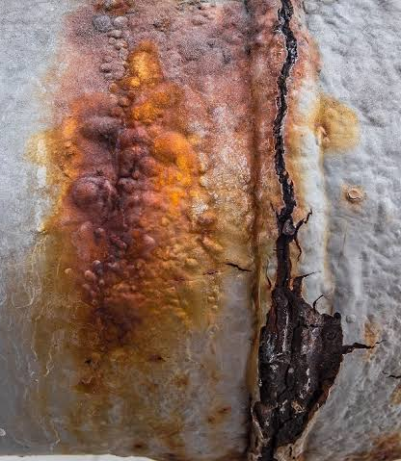
Corrosion #1 :
I've got this. the "competence fantasy"—the cultural desire to be self-reliant and cool under pressure
No, you don't.

Slide 7


Slide 8
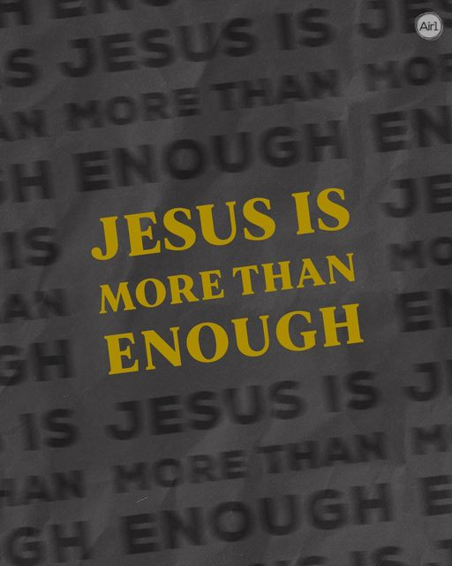

Slide 9
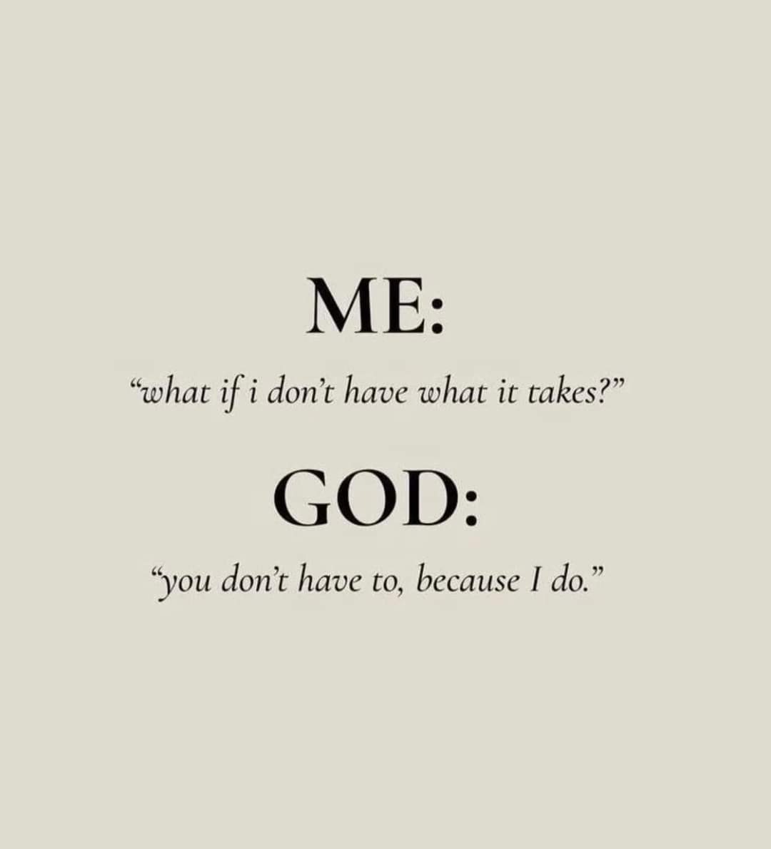


Slide 10
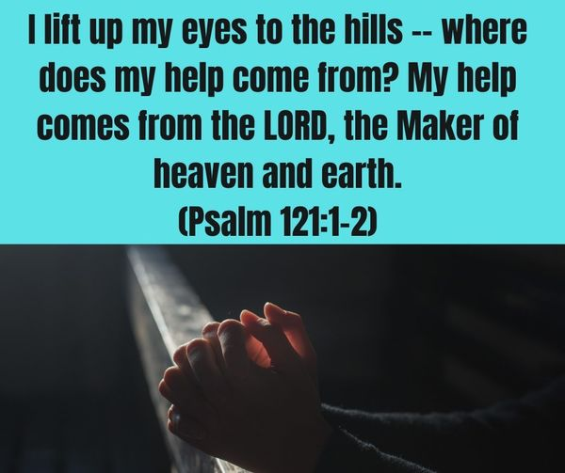

Slide 11
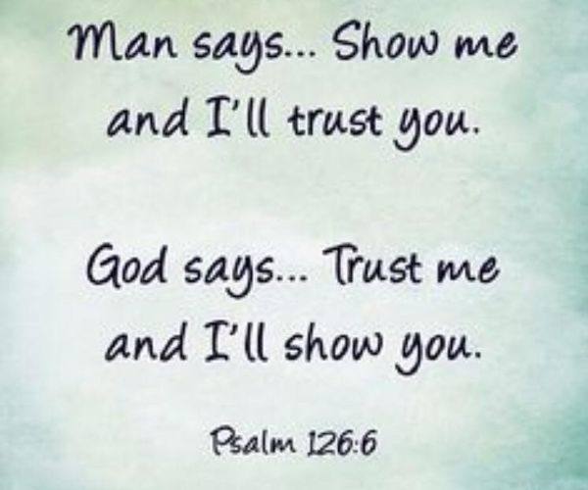
5Those who plant in tears
will harvest with shouts of joy.
6They weep as they go to plant their seed,
but they sing as they return with the harvest.
Psalm 126:5-6

Slide 12
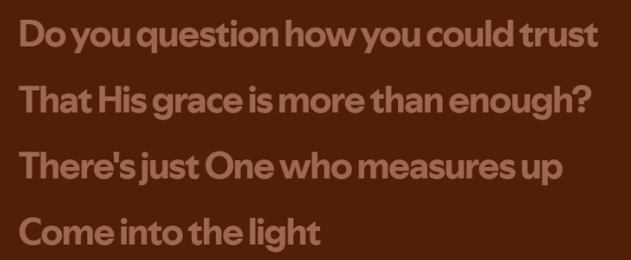
Youtube copyright limit.
We claim fair use.
https://www.youtube.com/watch?v=jKbhTxXZb60
YOU are NOT ENOUGH! NO ONE IS But Christ. You NEED Christ! HE is Enough.
Click the words or the link to come into the light
TAYA - Come Into The Light (Lyric Video)

Slide 13
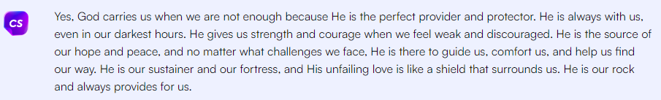
Even the Robot Agrees: It brought up Philippians 4:13
Philippians 4:13 (NLT)
For I can do everything through Christ, who gives me strength.
Proverbs 3:5 Your own understanding is also Not Enough.

Slide 14
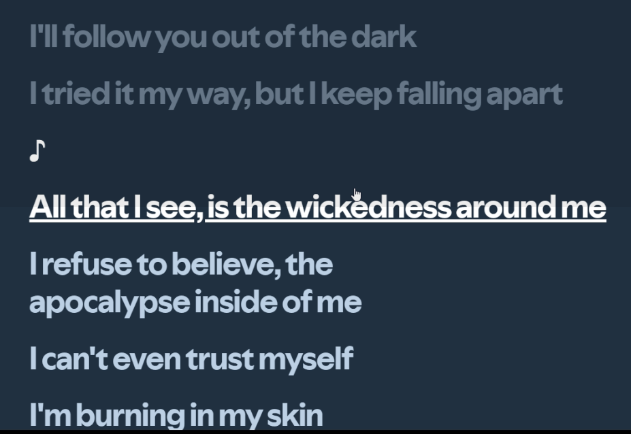
Youtube copyright limit.
Papa roach falling apart
We still claim fair use.
Click the words or the link, groove to the metal track by Papa Roach
https://www.youtube.com/watch?v=aqYnMSUTFGU&list=RDaqYnMSUTFGU&start_radio=1

Slide 15
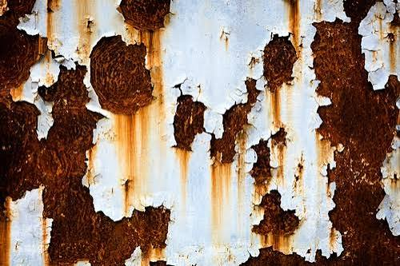
Youtube copyright limit.
Metallica – no leaf clover
We still claim fair use.
The phrase taps into the American cultural value of rugged individualism and self-sufficiency—the stubborn pride of refusing to ask for help or read the manual. It's instantly relatable because almost everyone has tried to fix something or learn a skill with just enough baseline knowledge to get themselves into trouble.
Corrosion #2
I know enough.
No, you don't

Slide 16
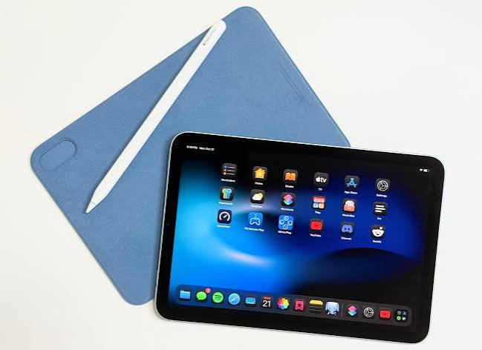
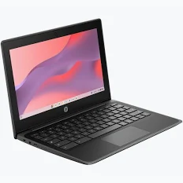
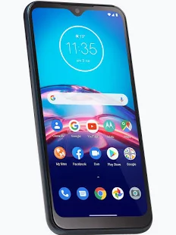
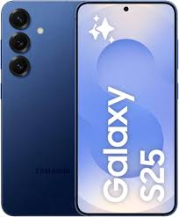
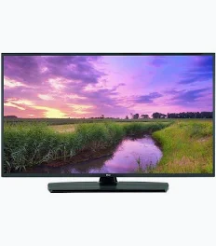
A Seahawks Riddle:
5 Screens all on the same G-moving home 5G wi-fi:
2 Screens have the game , 3 are blank. WHY?
You don’t get any hints, but the initials are RDP
Youtube copyright limit.
The Riddle – 5 for Fighting
We still claim fair use.

Slide 17
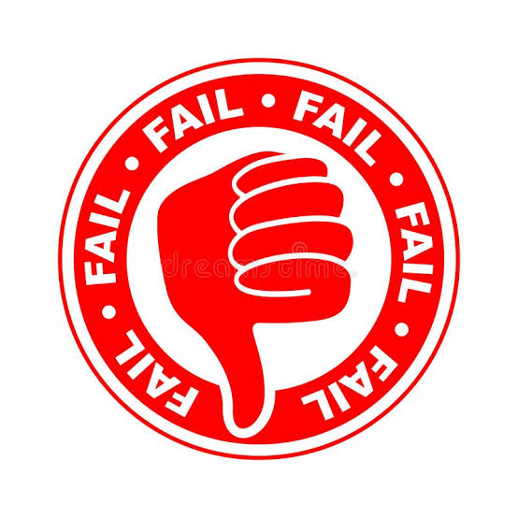
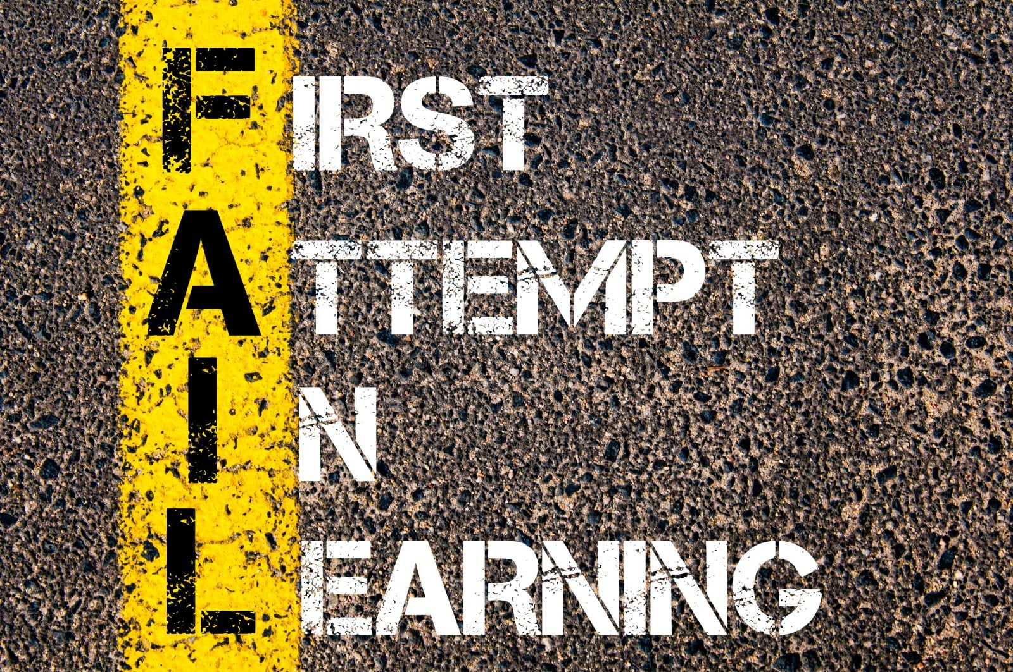
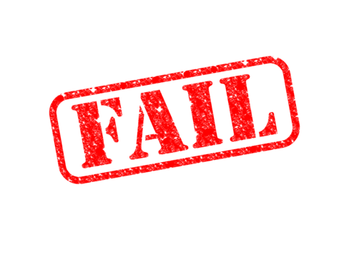
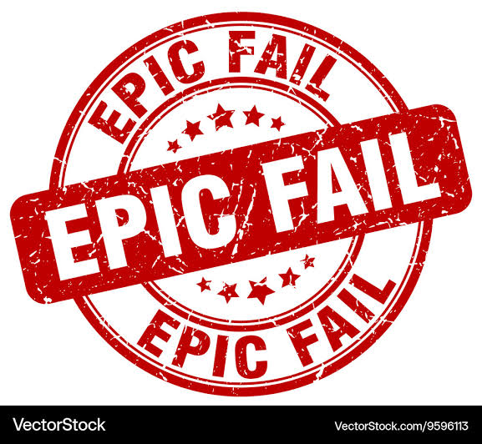
Has your “Sure thing” “easy fix” ever turned into a trainwreck?

Slide 18
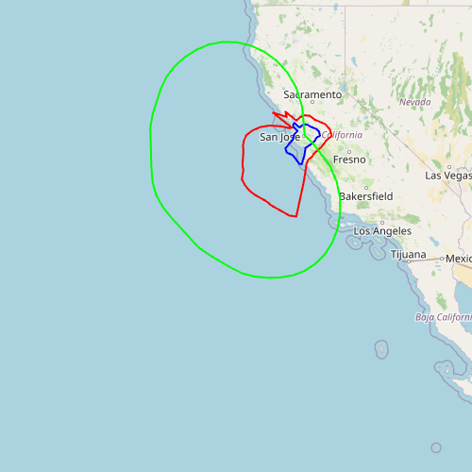
QUICK!
Calculate the phase angles and spacing
For a 4-tower array to make this radiation pattern.
And don’t disturb the Eggo plant or their parking lot.
I took this very real test in 1988- FAIL
But YOU know enough. What’s the answer?

Slide 19
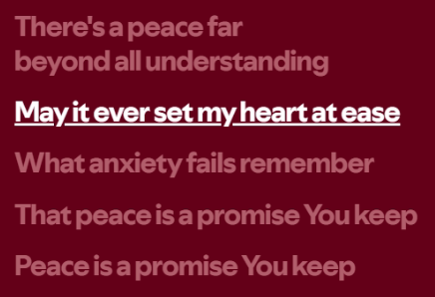
THE BIG SECRET. You cannot Acquire THIS
Knowledge in a worldly manner.
Youtube copyright limit.
P e a c e
We still claim fair use.

Slide 20
One of my jobs as a trainer was to identify teachable people,
They are VERY rare.
Proverbs 12:1 (NLT)
To learn, you must love discipline; it is stupid to hate correction.
Proverbs 17:10 (NLT)
A single rebuke does more for a person of understanding than a hundred lashes on the back of a fool.
Proverbs 21:11 (NLT)
If you punish a mocker, the simpleminded become wise; if you instruct the wise, they will be all the wiser.
James 3:16 (NLT)
For wherever there is jealousy and selfish ambition, there you will find disorder and evil of every kind.
James 3:17 (NLT)
But the wisdom from above is first of all pure. It is also peace loving, gentle at all times, and willing to yield to others. It is full of mercy and the fruit of good deeds. It shows no favoritism and is always sincere.
Proverbs 12:15 (NLT)
Fools think their own way is right, but the wise listen to others.
Proverbs 12:14 (NLT)
Wise words bring many benefits, and hard work brings rewards.
Mark 4:24 (NLT)
Then he added, “Pay close attention to what you hear. The closer you listen, the more understanding you will be given —and you will receive even more.
Psalms 119:124 (NLT)
I am your servant; deal with me in unfailing love, and teach me your decrees.
USE IT or LOSE IT
- Christ
Mark 4:25 (NLT)
To those who listen to my teaching, more understanding will be given. But for those who are not listening, even what little understanding they have will be taken away from them.”

Slide 21
USE IT or LOSE IT
- Christ
Mark 4:25 (NLT)
To those who listen to my teaching, more understanding will be given. But for those who are not listening, even what little understanding they have will be taken away from them.”

Slide 22
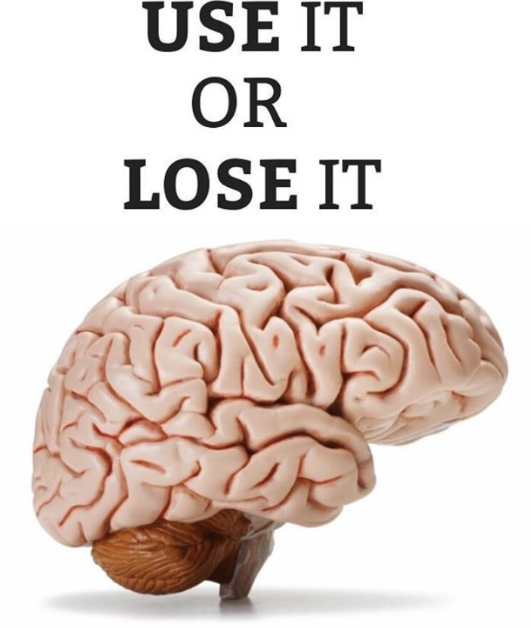
EVEN the neurologist knows:
Principles of Neuroplasticity:
Use it or Lose it
Principles of Neuroplasticity: Use it or Lose it — NeuroLab 360

Slide 23
Luke 8:18 (NLT)
“So pay attention to how you hear. To those who listen to my teaching, more understanding will be given. But for those who are not listening, even what they think they understand will be taken away from them.”
Proverbs 13:10 (NLT)
Pride leads to conflict; those who take advice are wise.

Slide 24

Corrosion #3
I'm never wrong
Yes you are
Subtitle:
Everything I think is right and good , if you have a problem with it , that’s on you.
Youtube copyright limit.
Incubus – Pardon me
We still claim fair use.

Slide 25
The phrase "I'm never wrong" (or variations like "I thought I was wrong once, but I was mistaken" and "I'm not wrong, you're just wrong" ) is a classic American cultural touchpoint. It embodies the ultimate peak of comedic arrogance, stubborn ego, and supreme self-delusion.
In media and pop culture, this attitude serves as a reliable shorthand for characters who are about to experience a massive, hilarious reality check.
Youtube copyright limit.
National Lampoon’s Deteriorata
We still claim fair use.
Notes:
https://www.youtube.com/watch?v=gVi0z83gIzo

Slide 26
That's called the Dunning-Kruger effect (referring to the cognitive bias where people with low ability or expertise at a task drastically overestimate their competence).
Other words or terms for someone who fits that description include:
Ultrazist / Know-it-all / Smart aleck: Everyday terms for someone acting like they know everything.
Sophist: Someone who uses clever, deceptive reasoning while pretending to have deep knowledge.
Charlatan: A person falsely claiming to have special knowledge or a skill.
Pondancer or Blowhard: Informal descriptors for someone full of empty, boastful pretense.
the give it to Ben effect (referring to the cognitive bias where people with low ability or expertise at a task drastically volunteer that Ben can do it.)

Slide 27

Corrosion #4
Just a few moments' shallow thought is enough.
NO, it is not.
Youtube copyright limit.
Linkin Park - Somewhere I Belong (Lyrics)
We still claim fair use.

Slide 28
:11.0pt;
color:#1A1A1A'>&nbsp;</p>
<p style=3D'margin-top:18pt;margin-bottom:10pt;font-family:Georgia;font-siz=
e:
15.0pt;color:#16294D'><span style=3D'font-weight:bold'>Word Study</span></p>
<div style=3D'direction:ltr'>
<table border=3D1 cellpadding=3D0 cellspacing=3D0 valign=3Dtop style=3D'dir=
ection:ltr;
border-collapse:collapse;border-style:solid;border-color:#A3A3A3;border-wi=
dth:
1pt' title=3D"" summary=3D"">
<tr>
<td style=3D'border-style:solid;border-color:#A3A3A3;border-width:1pt;
background-color:#16294D;vertical-align:top;width:7.5791in;padding:2.0pt =
3.0pt 2.0pt 3.0pt'>
<p style=3D'margin-top:0pt;margin-bottom:6pt;font-family:Georgia;font-siz=
e:
12.0pt;color:#E1D3B5'><span style=3D'font-weight:bold'>Key Terms</span></=
p>
<p style=3D'margin-top:0pt;margin-bottom:3pt'><span style=3D'font-weight:=
bold;
font-style:italic;font-family:Georgia;font-size:11.0pt;color:white'>Birth
Pains<span style=3D'mso-spacerun:yes'>=C2=A0 </span></span><span style=3D=
'font-style:
italic;font-family:Georgia;font-size:10.0pt;color:#F7F2E7'>(</span><span
style=3D'font-style:italic;font-family:"Times New Roman";font-size:10.0pt;
Quick: Read this
source code
and tell me
What it is,
what file it came
from,
And
What it’s for.
20-30 seconds Is
more than enough,
right?

Slide 29
These things require and demand long thoughts,
Couragous introspection! and bravery.
The hardest thing to face is yourself.
It won't be settled in minutes, more like months..

Slide 30
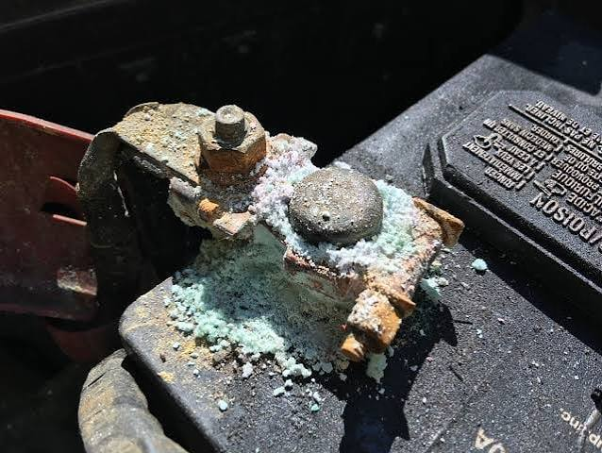
Youtube copyright limit.
Papa Roach - Falling Apart (Lyrics)
We still claim fair use.
Corrosion #5
This doesn’t affect me..
YES, it Does.

Slide 31
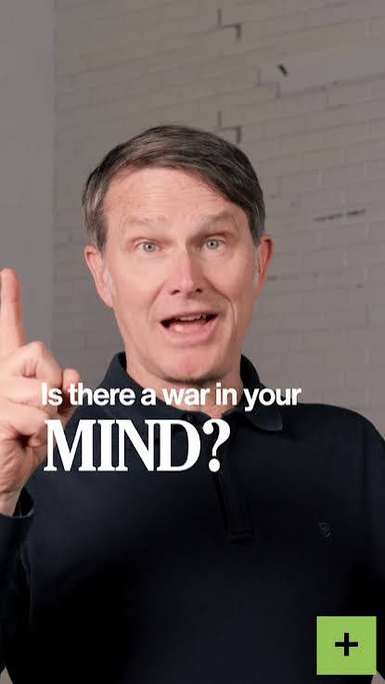
The enemy , the world, and the corrosive culture attack relentlessly. That’s why GOD gives you the Armor.
Ephesians 6:17 (NLT)
Put on salvation as your helmet, and take the sword of the Spirit, which is the word of God.

Slide 32
2 Corinthians 10:3 (NLT)
We are human, but we don’t wage war as humans do.
2 Corinthians 10:4 (NLT)
We use God’s mighty weapons, not worldly weapons, to knock down the strongholds of human reasoning and to destroy false arguments.
2 Corinthians 10:5 (NLT)
We destroy every proud obstacle that keeps people from knowing God. We capture their rebellious thoughts and teach them to obey Christ.

Slide 33
Romans 7:22 (NLT)
I love God’s law with all my heart.
Romans 7:23 (NLT)
But there is another power within me that is at war with my mind. This power makes me a slave to the sin that is still within me.
Choose Life !
Romans 8:6 (NLT)
So letting your sinful nature control your mind leads to death. But letting the Spirit control your mind leads to life and peace.

Slide 34
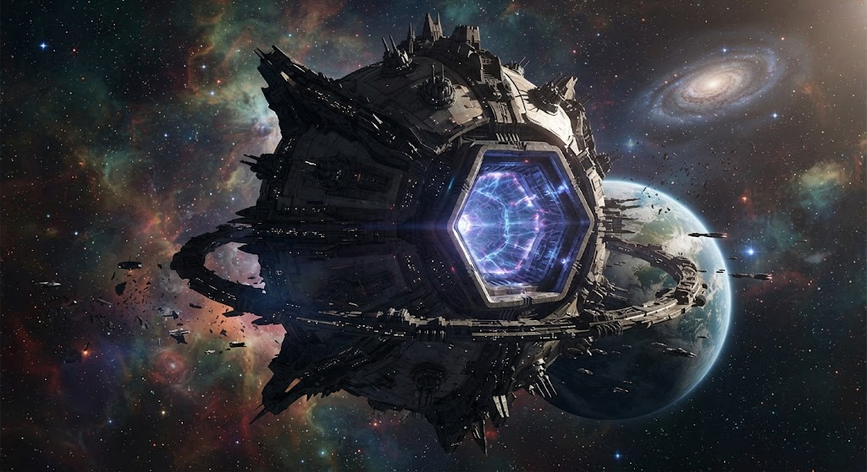
Build for combat
Fast the Corrosive Culture
and feast on freedom in ChrisT

Slide 35
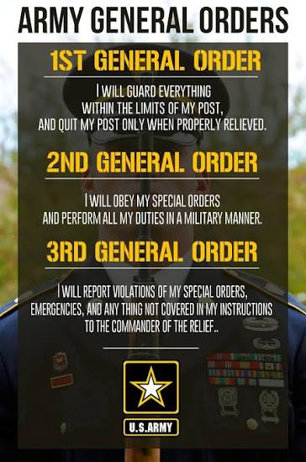
Marching Orders:
Romans 12:2 (NLT)
Don’t copy the behavior and customs of this world, but let God transform you into a new person by changing the way you think. Then you will learn to know God’s will for you, which is good and pleasing and perfect.

Slide 36
Build for combat – 5 Things you must do
Fast the Corrosive Culture
and feast on freedom in Christ
1. You have to get with God or the war's lost.
No games, no rationalizations: Total accountability.
He's the Super Weapon. You wouldn't want to walk out into a firefight unarmed, so goes this. .
This requires effort, energy, and the ability to get serious as a heart attack.
2 Chronicles 20:15 (NLT)
He said, “Listen, all you people of Judah and Jerusalem! Listen, King Jehoshaphat! This is what the Lord says: Do not be afraid! Don’t be discouraged by this mighty army, for the battle is not yours, but God’s.
From <https://www.bible.com/search/bible?query=the%20battle%20belongs>
Proverbs 21:31 (NLT)
The horse is prepared for the day of battle, but the victory belongs to the Lord .
From <https://www.bible.com/search/bible?query=the%20battle%20belongs>

Slide 37
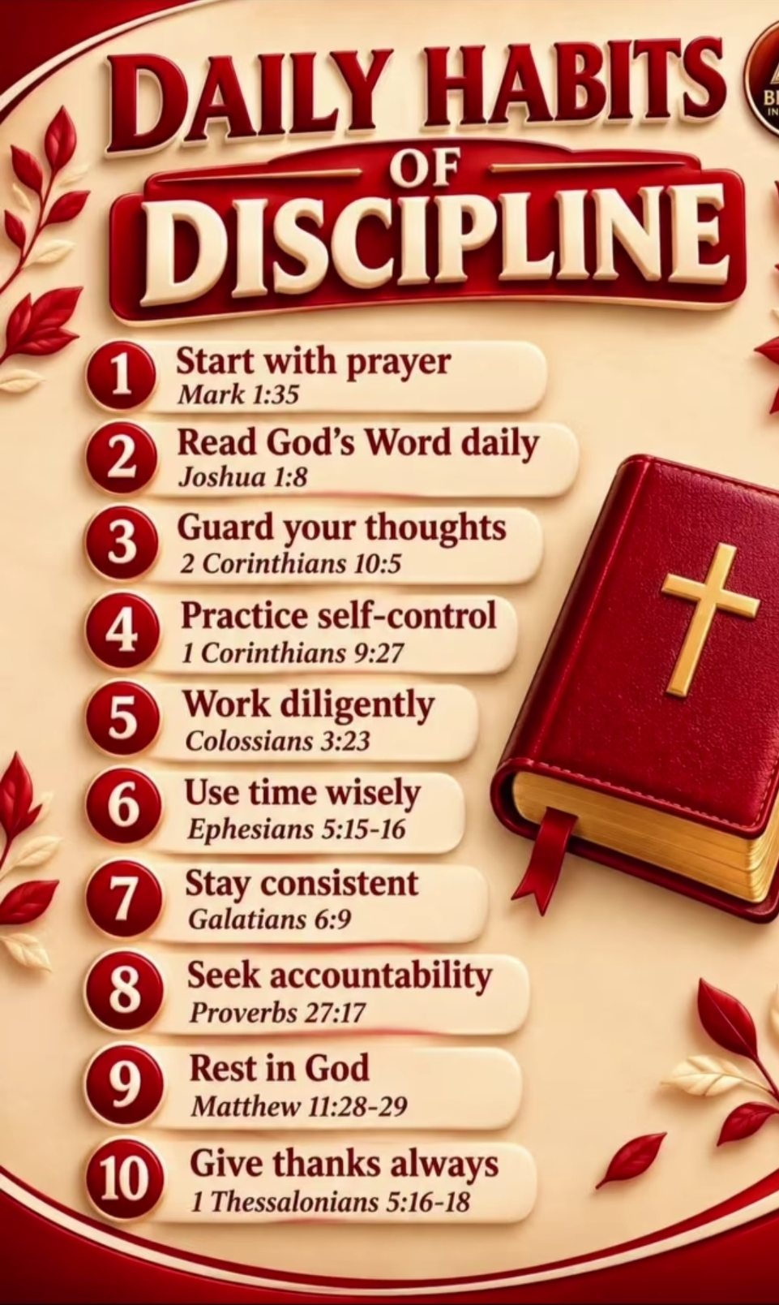
2
Build Discipline daily

Slide 38
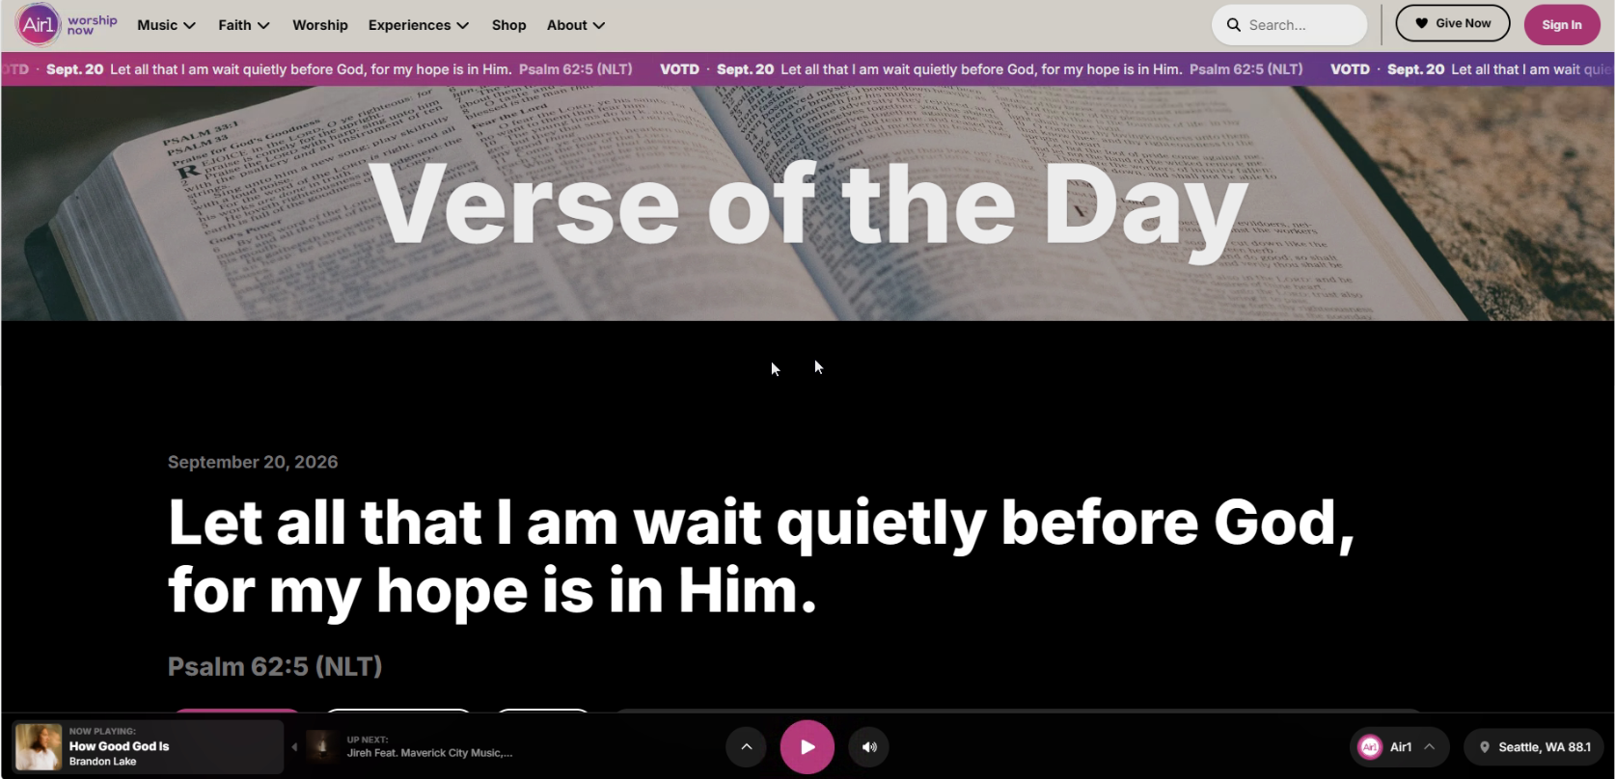
11 Practice Quietness.

Slide 39
11 Practice Quietness.
God doesn’t talk if you're talking. Listening to the Spirit is key.
Make a quiet place where you can be totally distraction free.
No phone/ no noise.
Stay there quietly for 15 minutes. No talking , no extraneous thoughts. You're there to meet with God. Intentionally., The enemy will bring 1000 distracting thoughts. Banish any that are not of God.
Once you have quieted the noise, Listen for the Spirit.

Slide 40
11 Practice Quietness.
Get Scriptural
Proverbs 11:12 (NLT)
It is foolish to belittle one’s neighbor; a sensible person keeps quiet.
Psalms 55:7 (NLT)
I would fly far away to the quiet of the wilderness. Interlude
Mark 1:25 (NLT)
But Jesus reprimanded him. “Be quiet! Come out of the man,” he ordered.
Mark 6:32 (NLT)
So they left by boat for a quiet place, where they could be alone.
Isaiah 14:7 (NLT)
But finally the earth is at rest and quiet. Now it can sing again!
Job 6:24 (NLT)
Teach me, and I will keep quiet. Show me what I have done wrong.
Luke 19:40 (NLT)
He replied, “If they kept quiet, the stones along the road would burst into cheers!”
Psalms 83:1 (NLT)
O God, do not be silent! Do not be deaf. Do not be quiet, O God.
Psalms 9:16 (NLT)
The Lord is known for his justice. The wicked are trapped by their own deeds. Quiet Interlude

Slide 41
11 Practice Quietness.
Get Scriptural
Ecclesiastes 9:17 (NLT)
Better to hear the quiet words of a wise person than the shouts of a foolish king.
Ecclesiastes 10:4 (NLT)
If your boss is angry at you, don’t quit! A quiet spirit can overcome even great mistakes.
Ecclesiastes 3:7 (NLT)
A time to tear and a time to mend. A time to be quiet and a time to speak.
Job 31:34 (NLT)
Have I feared the crowd or the contempt of the masses, so that I kept quiet and stayed indoors?
Matthew 20:31 (NLT)
“Be quiet!” the crowd yelled at them. But they only shouted louder, “Lord, Son of David, have mercy on us!”
Mark 10:48 (NLT)
“Be quiet!” many of the people yelled at him. But he only shouted louder, “Son of David, have mercy on me!”
Luke 18:39 (NLT)
“Be quiet!” the people in front yelled at him. But he only shouted louder, “Son of David, have mercy on me!”
1 Chronicles 4:40 (NLT)
They found lush pastures there, and the land was spacious, quiet, and peaceful. Some of Ham’s descendants had been living in that region.

Slide 42
11 Practice Quietness.
Get Scriptural
1 Thessalonians 4:11 (NLT)
Make it your goal to live a quiet life, minding your own business and working with your hands, just as we instructed you before.
1 Timothy 2:2 (NLT)
Pray this way for kings and all who are in authority so that we can live peaceful and quiet lives marked by godliness and dignity.
Acts of the Apostles 13:16 (NLT)
So Paul stood, lifted his hand to quiet them, and started speaking. “Men of Israel,” he said, “and you God-fearing Gentiles, listen to me.
Genesis 25:27 (NLT)
As the boys grew up, Esau became a skillful hunter. He was an outdoorsman, but Jacob had a quiet temperament, preferring to stay at home.
1 Peter 3:4 (NLT)
You should clothe yourselves instead with the beauty that comes from within, the unfading beauty of a gentle and quiet spirit, which is so precious to God.
Job 34:29 (NLT)
But if he chooses to remain quiet, who can criticize him? When he hides his face, no one can find him, whether an individual or a nation.

Slide 43
11 Practice Quietness.
Get Scriptural
Numbers 13:30 (NLT)
But Caleb tried to quiet the people as they stood before Moses. “Let’s go at once to take the land,” he said. “We can certainly conquer it!”
Isaiah 28:12 (NLT)
God has told his people, “Here is a place of rest; let the weary rest here. This is a place of quiet rest.” But they would not listen.

Slide 44
11 Practice Quietness.
What We Hope For: Across psychological research and surveys, human hopes are frequently tied to stability, connection, and the belief that circumstances will improve. However, when life feels difficult and we cannot see "the light at the end of the tunnel," our hope often wavers.
Misplaced Expectations: We often look to jobs, communities, or other people to provide a sense of stability and connection that only God can truly sustain. People and circumstances can falter or change, but God remains constant.
The Challenge of Waiting Quietly: It is human nature to want to rush ahead, look at the "watch of life," and try to force solutions when things are moving too slowly.
The Power of Silent Presence: Drawing from an analogy of a close friendship—where true intimacy allows two people to simply sit together without needing to constantly talk—Scripture encourages taking intentional time to sit quietly in God’s presence without pressure, routines, or demands.
Stop Seeking your own prestige and comfort. The Bible calls it “Selfish Ambition”
We all like comfort and esteem, especially survivors. But things go sideways when we take our eyes off God.
Youtube copyright limit.
Linkin Park - Somewhere I Belong (Lyrics)
We still claim fair use.

Slide 45

11 Practice Quietness.
It’s not a race.
Patience is a thing.
Govern your thoughts. Think though them deeply, carefully.
I can go from 0 - Grace in 4.3 seconds!
I got a 5 second quarter Psalm!
As they say: Long ago Somebody left with the cup.
Youtube copyright limit.
Cake - The Distance (lyrics)
We still claim fair use.

Slide 46
Hyper focus on right now.
When I was off - planet, they were very confused when I offered the concepts of "back", "yesterday", and "before.". I might as well have been speaking Martian. (eep orrp op opp) IYKYK. They were all hyper focused on right now. Of course, with no time weighing on you, you can spend an earthly lifetime exploring a single second of time. 2:46:17 might have ticked by you unnoticed, but to them it’s a world unto itself...
I hate to call it "mindfulness" but it's close.
Where are you RIGHT NOW?
What are you doing RIGHT NOW?
And WHY are you doing it?
Youtube copyright limit.
(I feel a Kim Walker Smith song 9 ½ minutes of fun. )
We still claim fair use.

Slide 47
Workout:
Go outside and find a flower. Or maybe go outside and find something sticking out of the snow,
Notice whatever it is. REALLY Notice. Quiet your mind. Look at it.
See it for what's there without baggage or judgement. Any stray thoughts or inner monologue, push it out of your head. Become fully present in the moment, in the experience.
STOP TALKING. Blah blah blah blah blah . You're not delivering the beatitudes to 5000, quiet.
Look again at the selected object, Any thoughts not on the object or the moment get quashed right now. (for the pearl polishers, God is God of this Moment. He is the supreme ruler of 2:46:17 and every second before and after)

Slide 48
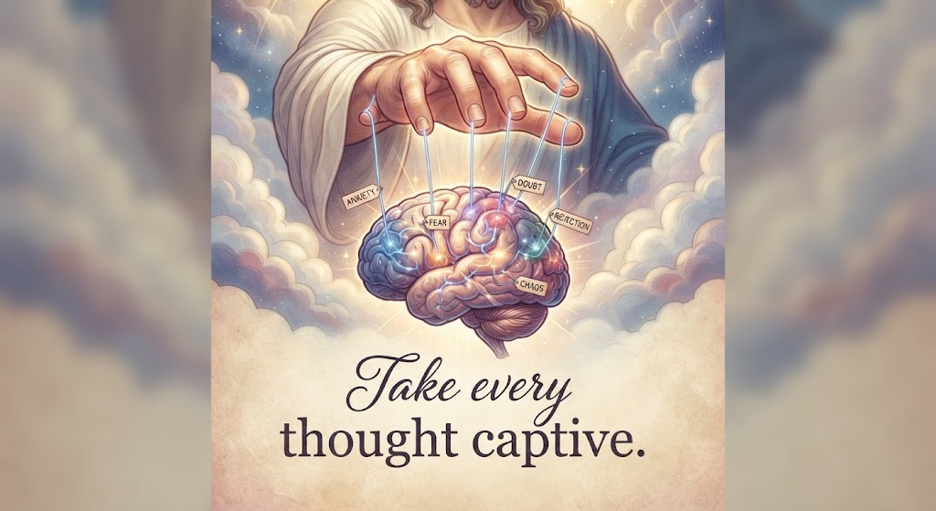
4. Take your thoughts Captive
2 Corinthians 10:5 (NLT)
We destroy every proud obstacle that keeps people from knowing God. We capture their rebellious thoughts and teach them to obey Christ.
2 Corinthians 10:4 (NLT)
We use God’s mighty weapons, not worldly weapons, to knock down the strongholds of human reasoning and to destroy false arguments.
Proverbs 4:23 (NLT)
Guard your heart above all else, for it determines the course of your life.

Slide 49
2 strategies to Victory:
1) gate keep each Thought.
The next generation has lots of experience in gatekeeping. Come to think of it, Gate Keeping is as old as the Temple itself. Gate Keep every thought. Work it FIRST. Throw away the trash thoughts.
James 4:7 (NLT)
So humble yourselves before God. Resist the devil, and he will flee from you.
1 Peter 5:8 (NLT)
Stay alert! Watch out for your great enemy, the devil. He prowls around like a roaring lion, looking for someone to devour.
1 Peter 5:9 (NLT)
Stand firm against him, and be strong in your faith. Remember that your family of believers all over the world is going through the same kind of suffering you are.
Ephesians 6:11 (NLT)
Put on all of God’s armor so that you will be able to stand firm against all strategies of the devil.
(Gratuitus plug: https://covingtonwacc.org/armor )
Ephesians 6:12 (NLT)
For we are not fighting against flesh-and-blood enemies, but against evil rulers and authorities of the unseen world, against mighty powers in this dark world, and against evil spirits in the heavenly places.

Slide 50
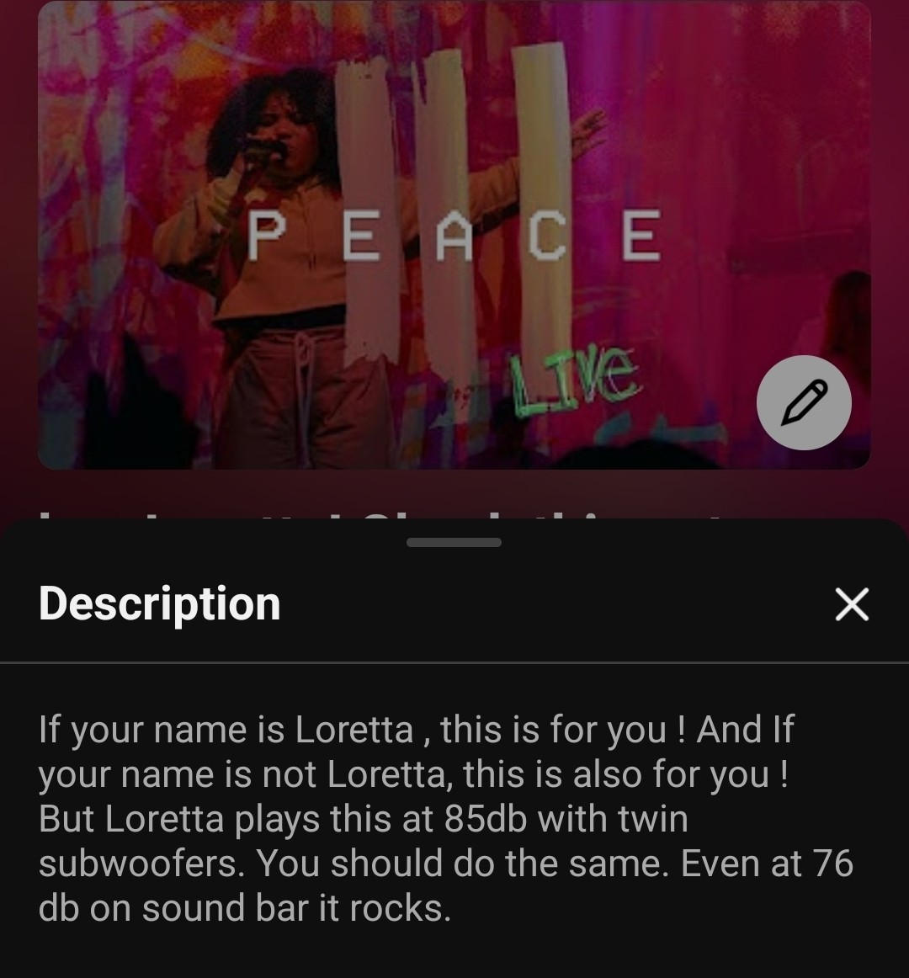
2) The Genner method:
Blast worship music at at least 85 db. For about 45 minutes or until someone calls the cops. If you can swing a live band, do it.
[(Our little Church goes to 109) i built it up with her in mind. She said our place wasn't LOUD enough. (We keep it at a nice quiet 74db.Quieter than a conversation) ]
You wanna think? Think about God.
I challenge you to keep your earthly baggage and worldly concerns top of mind when you can't hear yourself think.
Starter pack:
Youtube copyright limit.
https://m.youtube.com/playlist?list=PLHy7ArvlotU8LNamiI1G7ntxRP8oIZ06c
We Still Claim Fair Use.
Loretta was Genner's right-hand woman.

Slide 51
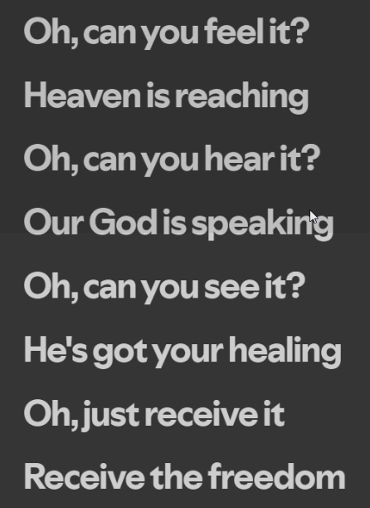
Your destination: freedom in Christ
Youtube copyright limit.
Patrick Mayberry - Holy Spirit Come (with lyrics)(2021)
We still claim fair use.

Slide 52
2 Corinthians 3:17 (NLT)
For the Lord is the Spirit, and wherever the Spirit of the Lord is, there is freedom.
Galatians 5:1 (NLT)
So Christ has truly set us free. Now make sure that you stay free, and don’t get tied up again in slavery to the law.
Romans 8:1 (NLT)
So now there is no condemnation for those who belong to Christ Jesus.
Romans 8:2 (NLT)
And because you belong to him, the power of the life-giving Spirit has freed you from the power of sin that leads to death.
John 8:36 (NLT)
So if the Son sets you free, you are truly free.
Galatians 5:13 (NLT)
For you have been called to live in freedom, my brothers and sisters. But don’t use your freedom to satisfy your sinful nature. Instead, use your freedom to serve one another in love.
1 Peter 2:16 (NLT)
For you are free, yet you are God’s slaves, so don’t use your freedom as an excuse to do evil.
Romans 6:14 (NLT)
Sin is no longer your master, for you no longer live under the requirements of the law. Instead, you live under the freedom of God’s grace.
Romans 6:18 (NLT)
Now you are free from your slavery to sin, and you have become slaves to righteous living.
2 Corinthians 3:18 (NLT)
So all of us who have had that veil removed can see and reflect the glory of the Lord. And the Lord—who is the Spirit—makes us more and more like him as we are changed into his glorious image.
Your destination: freedom in Christ

Slide 53
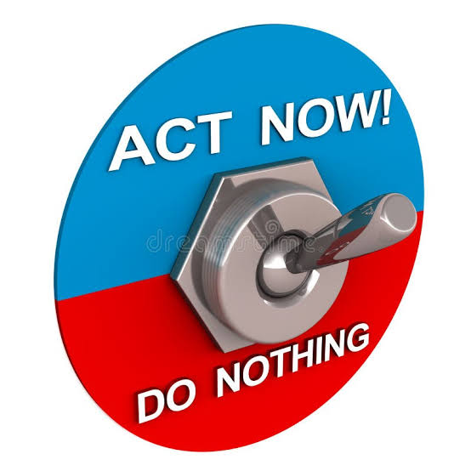

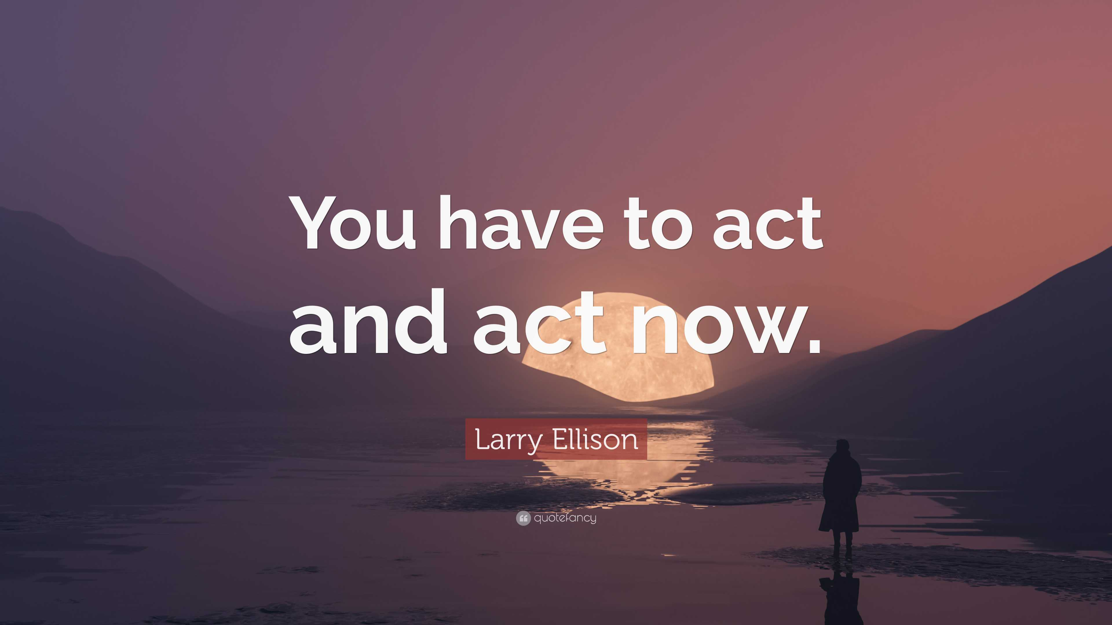
6. Wheels up In 5
Youtube copyright limit.
Right Now – Van halen
We still claim fair use.
Youtube copyright limit.
Right Now – Van halen
We still claim fair use.

Slide 54
Get it at
https://www.covingtonwacc.org/podcast
Podcast37 playlist

