Slide 1
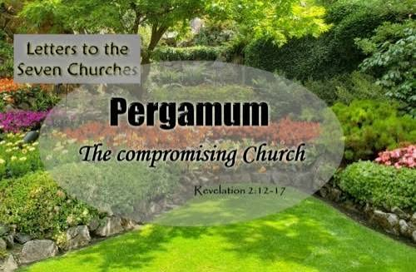
THE SEVEN CHURCHES OF JESUS
Week 3
SMYRNA
The Persecuted Church
Revelation 2:8–11

Slide 2

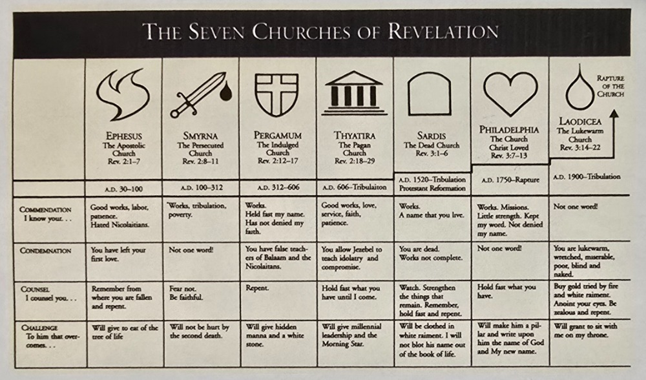

Slide 3
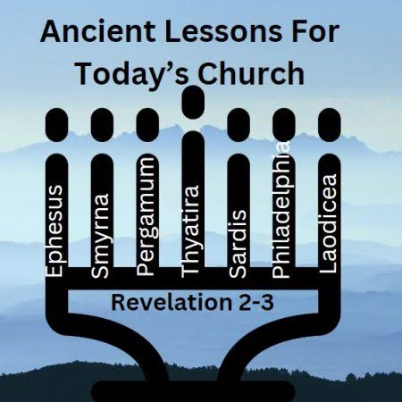
THE SEVEN CHURCHES OF JESUS
Pergamum
Revelation 2:12-17
Where You Live — Where Satan Has His Throne

Slide 4
THE SEVEN CHURCHES OF JESUS
Pergamum
Revelation 2:12-17
Where You Live — Where Satan Has His Throne

Slide 5
THE CITY
A City of Compromise
Political capital
Seat of Roman provincial power in Asia Minor
Religious center
Home to the great altar of Zeus and the imperial cult of Caesar worship
“Satan’s throne”
Jesus’ own description of the spiritual climate believers lived in daily

Slide 6
REV. 2:12-13
Christ's Identity & His Commendation
“To the angel of the church in Pergamum write: These are the words of him who has the sharp, double-edged sword. I know where you live—where Satan has his throne. Yet you remain true to my name. You did not renounce your faith in me, not even in the days of Antipas, my faithful witness, who was put to death in your city—where Satan lives.”
New International Version

Slide 7
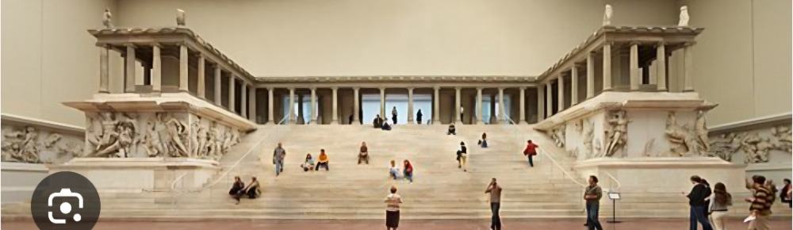

Slide 8
THE COMMENDATION
Faithful in the Hardest Place
The Sword
The Setting
The Witness
Jesus holds “the sharp, double-edged sword” (v.12) — His word is His weapon, not Rome’s
“Where Satan has his throne” (v.13) — believers stood their ground in the seat of pagan power
Antipas was “put to death” for his faith, yet the church did not renounce Christ’s name

Slide 9
REV. 2:14-15
The Correction: Compromise Within
“Nevertheless, I have a few things against you: There are some among you who hold to the teaching of Balaam, who taught Balak to entice the Israelites to sin so that they ate food sacrificed to idols and committed sexual immorality. Likewise, you also have those who hold to the teaching of the Nicolaitans.”
New International Version

Slide 10
THE COMPROMISE
Two Doctrines, One Danger
The Way of Balaam
The Nicolaitans
Numbers 22–25 — Balaam could not curse Israel directly, so he taught Balak to seduce them into idolatry and sexual sin from the inside. Pergamum tolerated teachers doing the same: blending worship of Christ with the culture’s idols and immorality.
A group within the church whose teaching produced the same fruit as Balaam’s: compromise with idolatry and immorality made comfortable and acceptable inside the fellowship itself.

Slide 11
REV. 2:16
The Call to Repent
“Repent therefore! Otherwise, I will soon come to you and will fight against them with the sword of my mouth.”
New International Version

Slide 12
REV. 2:17
The Promise to the One Who Overcomes
“Whoever has ears, let them hear what the Spirit says to the churches. To the one who is victorious, I will give some of the hidden manna. I will also give that person a white stone with a new name written on it, known only to the one who receives it.”
New International Version

Slide 13
THE PROMISE
What the Overcomer Receives
Hidden Manna
Unlike the feasts of idols in Pergamum, Christ offers a hidden, spiritual sustenance the world cannot see or supply — intimate provision from His own presence.
A White Stone
In the ancient world a white stone could mean acquittal, admission, or honor. Christ gives His overcomer both — a verdict of “not guilty” and a new identity.
A New Name
“Known only to the one who receives it” — a personal, secure identity in Christ that no cultural pressure in Pergamum, or today, can take away.

Slide 14
LIVING IT OUT
Where Do You Live?
1
Faithfulness is possible even in a culture hostile to Christ — Pergamum proves it.
2
Small compromises tolerated in the church become the church’s undoing — examine what you’ve made peace with.
3
Christ’s hidden provision and secure new name outweigh anything the culture offers in trade for compromise.
Next Week: Thyatira — Revelation 2:18-29

Slide 15
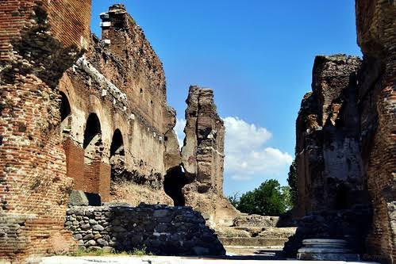

Slide 16

It Is Well
CCLI #11300910
When peace like a river
attendeth my way,
When sorrows like
sea billows roll –

Slide 17
Whatever my lot,
Thou hast taught me to say,
“It is well,
it is well with my soul.”

Slide 18
It is well
with my soul.
It is well,
it is well with my soul.

Slide 19
Though Satan should buffet, though trials should come
Let this blessed
assurance control,

Slide 20
That Christ has regarded
my helpless estate
And has shed His
own blood for my soul.

Slide 21
It is well
with my soul.
It is well,
it is well with my soul.

Slide 22
And, Lord, haste the day when my faith shall be sight,
The clouds be rolled back
as a scroll;

Slide 23
The trump shall resound
and the Lord shall descend,
“Even so” – it is well
with my soul.

Slide 24
It is well
with my soul.
It is well,
it is well with my soul.

Slide 25



Slide 26

Closing Prayer
& Benediction

