Slide 1
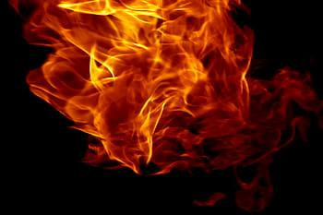
Current Series!
It’s Hell….
but Heaven is coming!

Slide 2
This week
Hell…it’s no party
Key Scripture: Luke 19-31

Slide 3
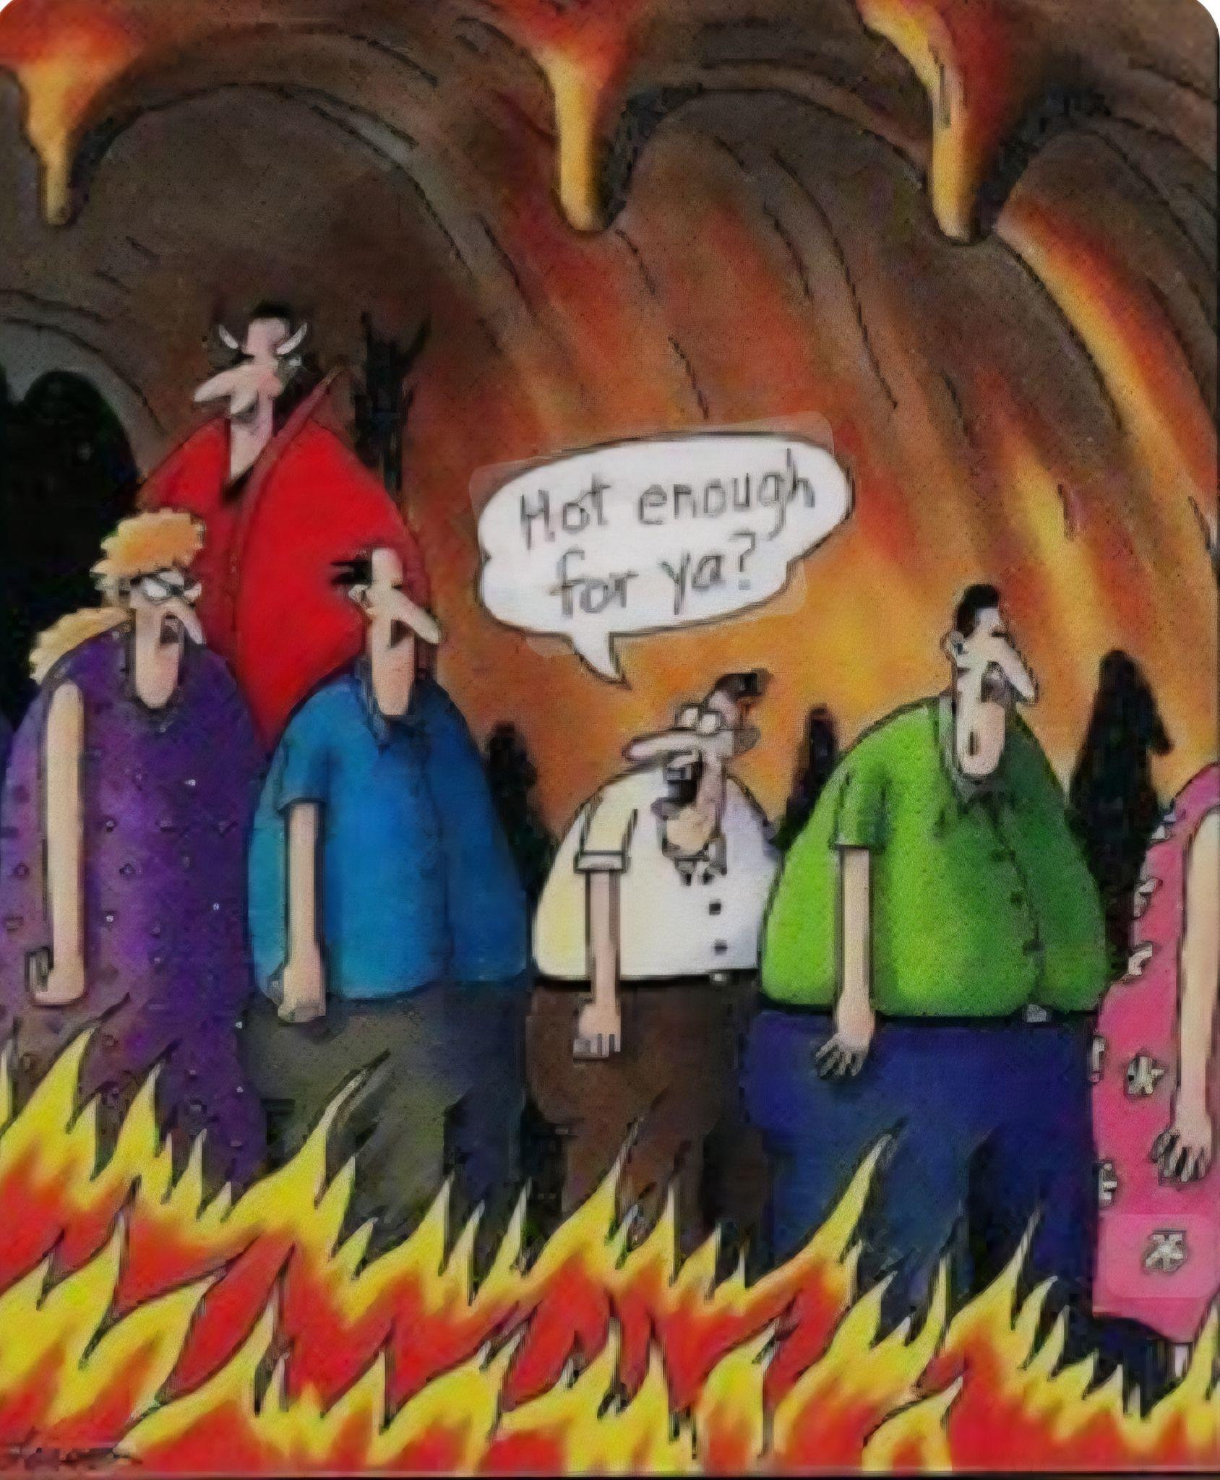

Slide 4
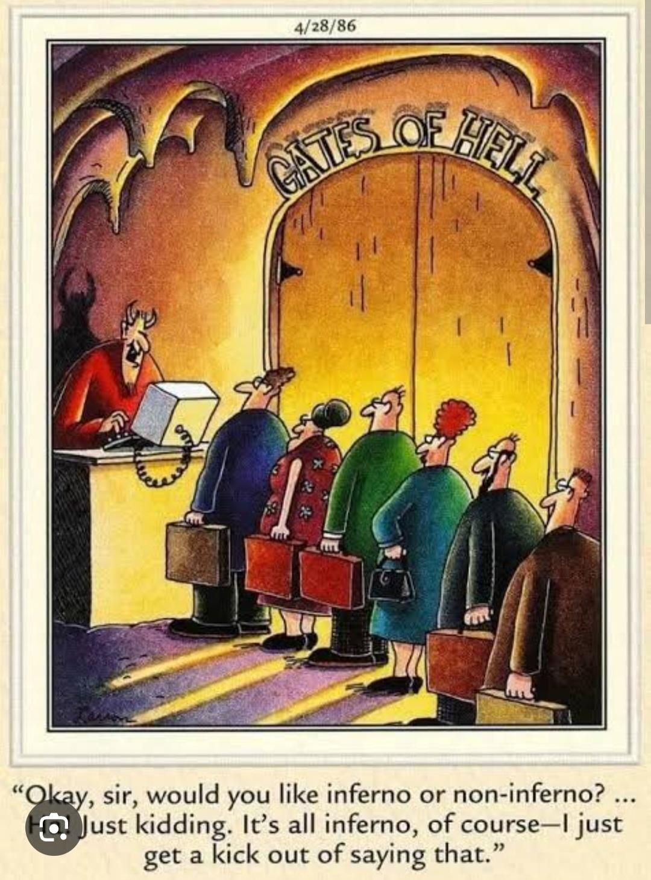

Slide 5
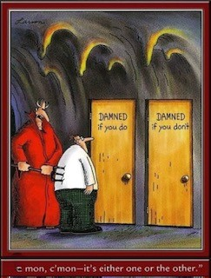

Slide 6
Biblical Names for Hell
Sheol- Psalm 16:10
Hades- Acts 2:27
Gehenna- Mark 9:43
Tatares- 2 Peter 2:4
Lake of Fire- Revelation 20:14-15

Slide 7
Luke 16:19-31
19 “There was a rich man who was clothed in purple and fine linen and who feasted sumptuously every day. 20 And at his gate was laid a poor man named Lazarus, covered with sores, 21 who desired to be fed with what fell

Slide 8
from the rich man’s table. Moreover, even the dogs came and licked his sores. 22 The poor man died and was carried by the angels to Abraham’s side. The rich man also died and was buried, 23 and in Hades, being in torment he lifted up his eyes and saw

Slide 9
Abraham far off and Lazarus at his side. 24 And he called out,’Father Abraham, have mercy on me, and send Lazarus to dip the end of his finger in water and cool my tongue, for I am in anguish in this flame.’ 25 But
Abraham said, ‘Child, remember that

Slide 10
you in your lifetime received your good things, and Lazarus in like manner bad things; but now he is comforted here, and you are in anguish. 26 And besides all this, between us and you a great chasm has been fixed, in order that those

Slide 11
who would pass from here to you may not be able, and none may cross from there to us.’ 27 And he said, ‘Then I beg you, father, to send him to my father’s house- 28 for I have five brothers-so that he may warn them, lest they also come into this place of

Slide 12
torment.’ 29 But Abraham said, ‘They have Moses and the Prophets; let them hear them.’ 30 And he said, ‘No, father Abraham, but if someone goes to them from the dead, they will repent.’ 31 He said to him, ‘If they do not hear Moses and the Prophets,

Slide 13
neither will they be convinced if someone should rise from the dead.’”

Slide 14
