Slide 1
Today’s Message:
Prayer:
A Conversation with God
Key Scripture: Genesis 18:16-23, Numbers 11:4-15, 1 Thess.5:16-18

Slide 2
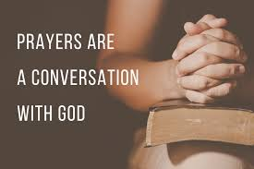

Slide 3
Genesis 18: 16-23, NIV

Slide 4
16 When the men got up to leave, they looked down toward Sodom, and Abraham walked along with them to see them on their way. 17 Then the Lord said,

Slide 5
“Shall I hide from Abraham what I am about to do? 18 Abraham will surely become a great and powerful nation, and all nations on earth will be blessed through him.

Slide 6
19 For I have chosen him, so that he will direct his children and his household after him to keep the way of the Lord by doing what is right and just, so that the Lord will bring about for

Slide 7
Abraham what he has promised him.”
20 Then the Lord said, “The outcry against Sodom and Gomorrah is so great and their sin so grievous 21 that I will go down and see if what they have

Slide 8
done is as bad as the outcry that has reached me. If not, I will know.”
22 The men turned away and went toward Sodom, but Abraham remained standing before the Lord.

Slide 9
23 Then Abraham approached him and said: “will you sweep away the righteous with the wicked?

Slide 10
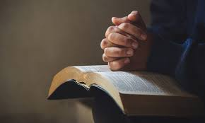
P- Praise
R-Remembering
A- Asking
Y-Yielding
E-Expecting
R-Receiving

Slide 11
Numbers 11: 4-15, NIV

Slide 12
4 The rabble with them began to crave other food, and again the Israelites started wailing and said, “If only we had meat to eat! 5 We remember the fish we ate in Egypt at no cost- also the cucumbers, melons, leeks,

Slide 13
onions and garlic. 6 But now we have lost our appetite; we never see anything but this manna!”
7 The manna was like coriander seed and looked like resin. 8 The people went around gathering it, and then ground it in a hand

Slide 14
Mill or crushed it in a mortar. They cooked it in a pot or made it into loaves. And it tasted like something made with olive oil. 9 When the dew settled on the camp at night, the manna also came down.
7 The manna was like coriander seed and looked like resin. 8 The people went around gathering it, and then ground it in a hand

Slide 15
10 Moses heard the people of every family wailing at the entrance to their tents. The Lord became exceedingly angy, and Moses was troubled. 11 He asked the Lord, “Why have you brought this trouble on your

Slide 16
servant? What have I done to displease you that you put the burden of all these people on me? 12 Did I conceive all these people? Did I give them birth? Why do you tell me to carry them in my arms, as a nurse

Slide 17
carries an infant, to the land you promised on oath to their ancestors? 13 Where can I get meat for all these people? They keep wailing to me, ‘Give us meat to eat!’ 14 I cannot carry all these people by myself; the

Slide 18
burden is too heavy for me. 15 If this is how you are going to treat me, please go ahead and kill me-if I have found favor in your eyes-and do not let me face my own ruin.”

Slide 19
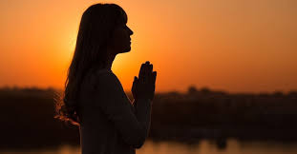
*Listen
*Journal
*Read
*Ask Questions
*Wait

Slide 20
1 Thessalonians 5: 16-18, NIV
16 Rejoice always, 17 pray without ceasing, 18 give thanks in all circumstances; for this is the will of God in Christ Jesus for you.

Slide 21


Slide 22
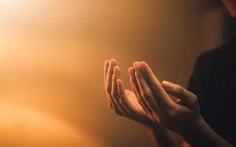
An Example of Prayer
in Action

