Slide 1
Fasting & Feasting
Sermon Series:
Foundational Scripture: Philippians 4:8

Slide 2
Fasting Grumbling
This Week:
Feasting on Gratitude

Slide 3
Phil. 4:8
Finally, brothers and sisters, whatever is true, whatever is noble, whatever is right, whatever is pure, whatever is lovely, whatever is admirable-If anything is excellent or praiseworthy-think about such things.

Slide 4
Phil. 2:14-15 amp
Do everything without murmuring or questioning [the providence of God], so that you may prove yourselves to be blameless and guileless, innocent and uncontaminated, children of God without blemish in the midst of a [morally] crooked and [spiritually]

Slide 5
perverted generation, among whom you are seen as bright lights [beacons shining out clearly] in the world [of darkness],

Slide 6
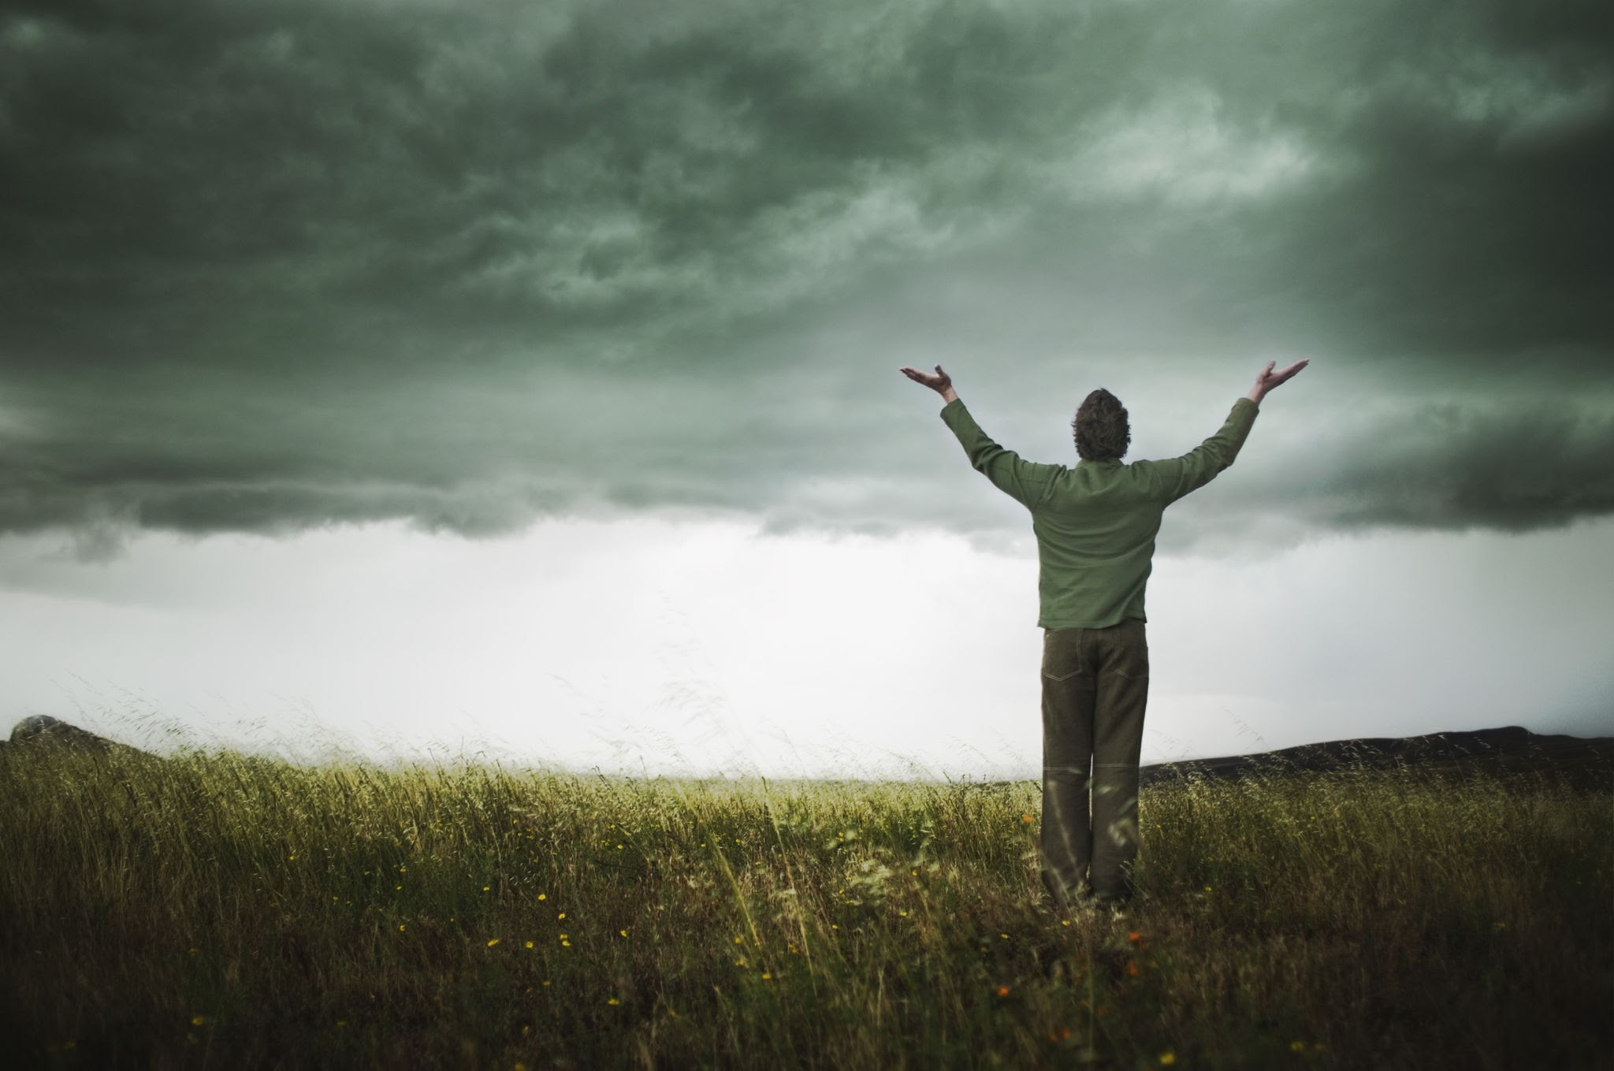
Thess. 5:16-18 says “Rejoice always,
pray continually,
give thanks in all
circumstances;
for this is God’s
will for you
in Christ Jesus.”

Slide 7
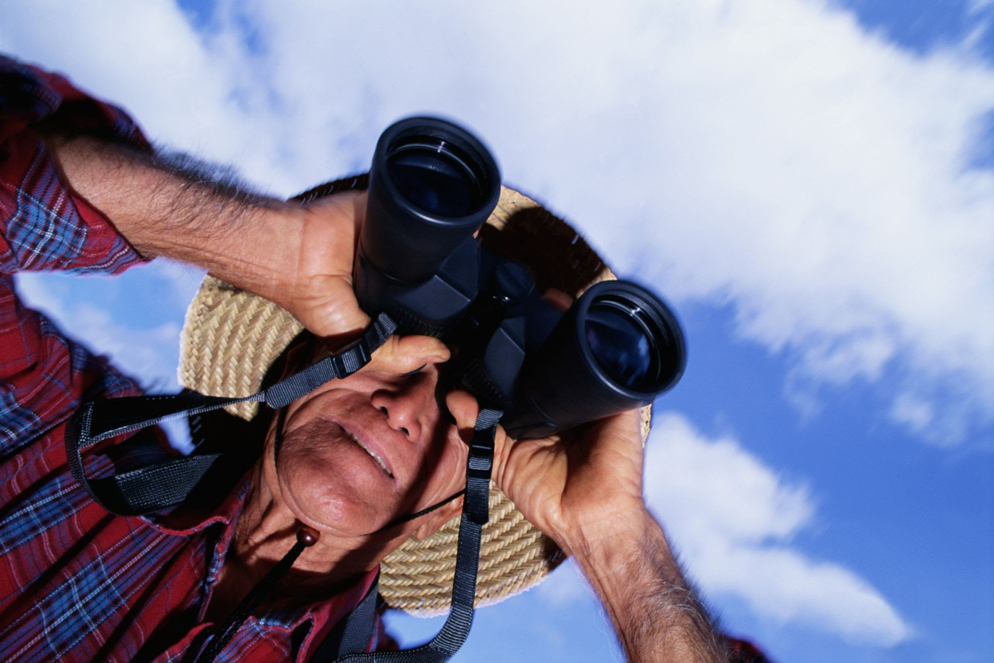
Grumbling Focuses on
What Is Missing

Slide 8
I Corinthians 10:10-“And do not grumble, as some of them did-and were killed by the destroying angel.”
James 5:9 says “Don’t grumble against one another, brothers and sisters, or you will be judged. The Judge is standing at the door!”

Slide 9

Gratitude Reveals What God Is Already Doing

Slide 10
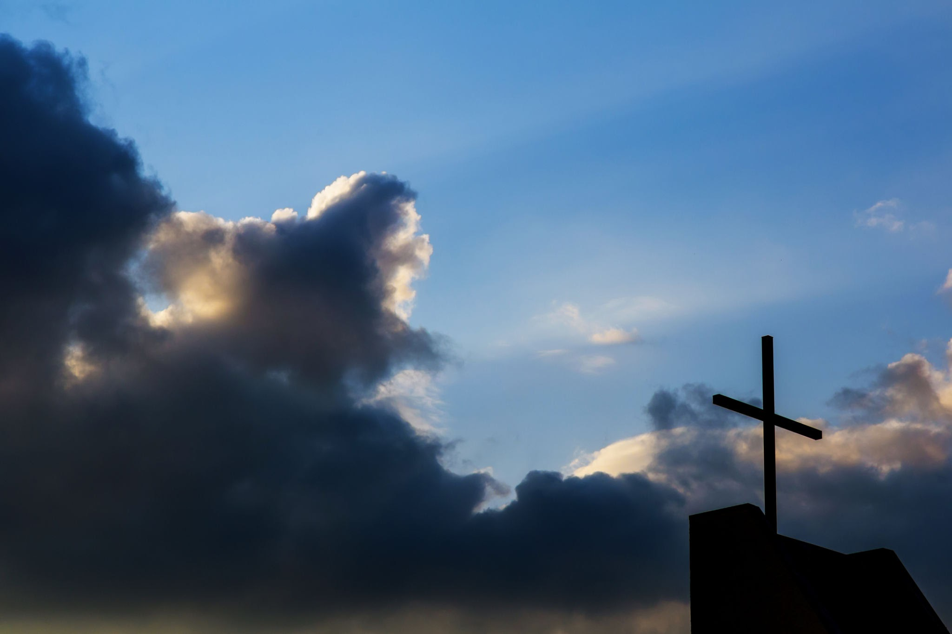
Gratitude Changes Our
Spiritual Atmosphere

Slide 11
This week:
1.Start the day with 3 thank-yous
2. Replace grumbling with prayer
3. End the day with reflection

Slide 12
Psalm 100:4
Enter his gates with thanksgiving and his courts with praise;
Give thanks to him and praise his name.

Slide 13
Phil. 4:8
Finally, brothers and sisters, whatever is true, whatever is noble, whatever is right, whatever is pure, whatever is lovely, whatever is admirable-If anything is excellent or praiseworthy-think about such things.

Slide 14
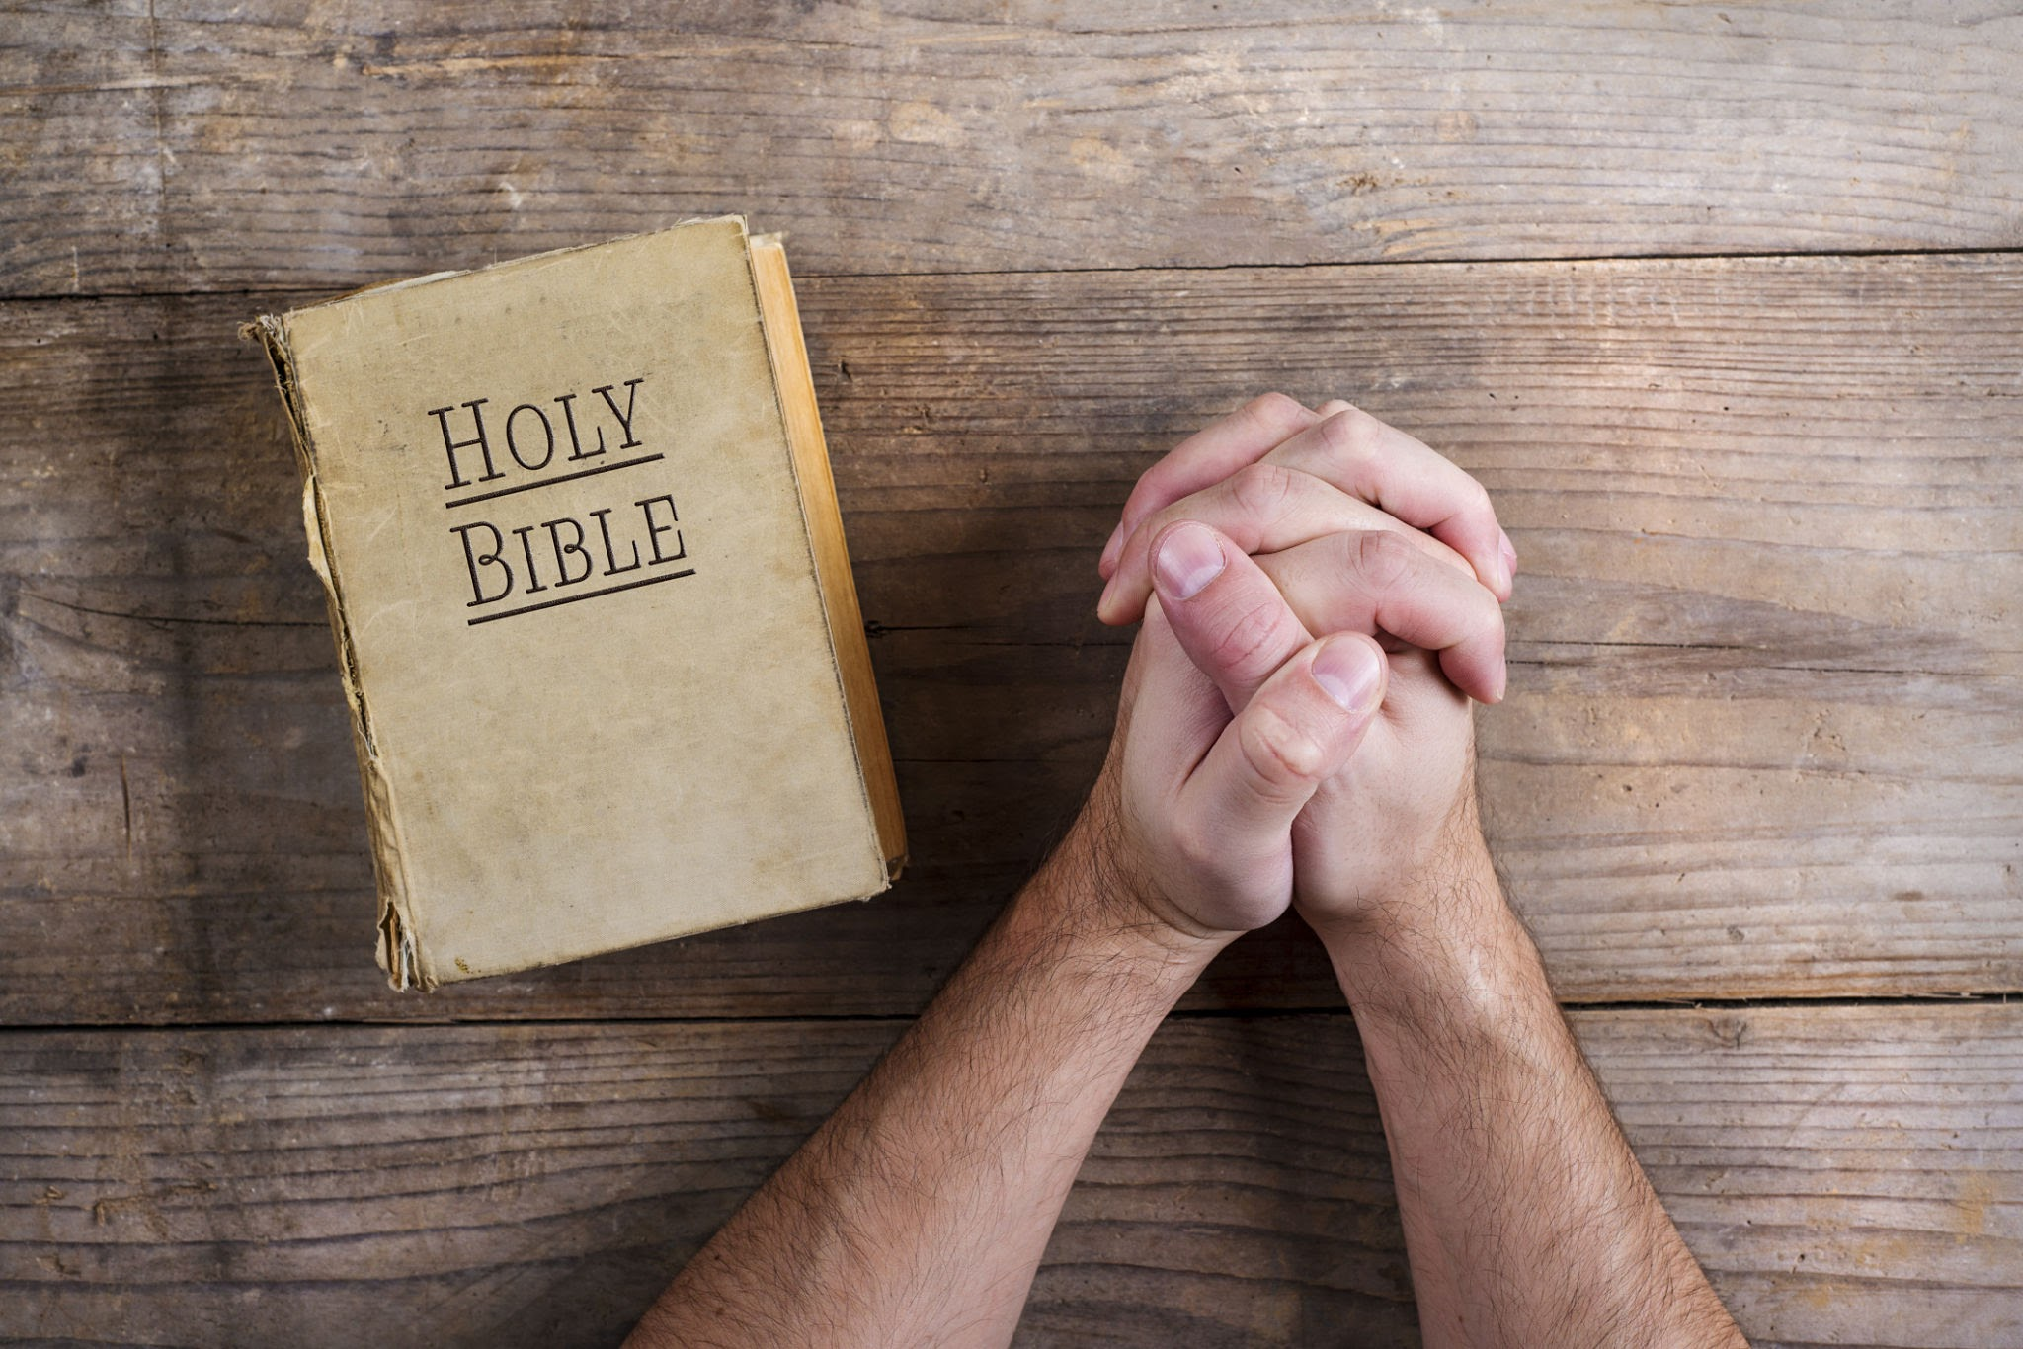
Fast Grumbling & Feast on Gratitude

