Slide 1
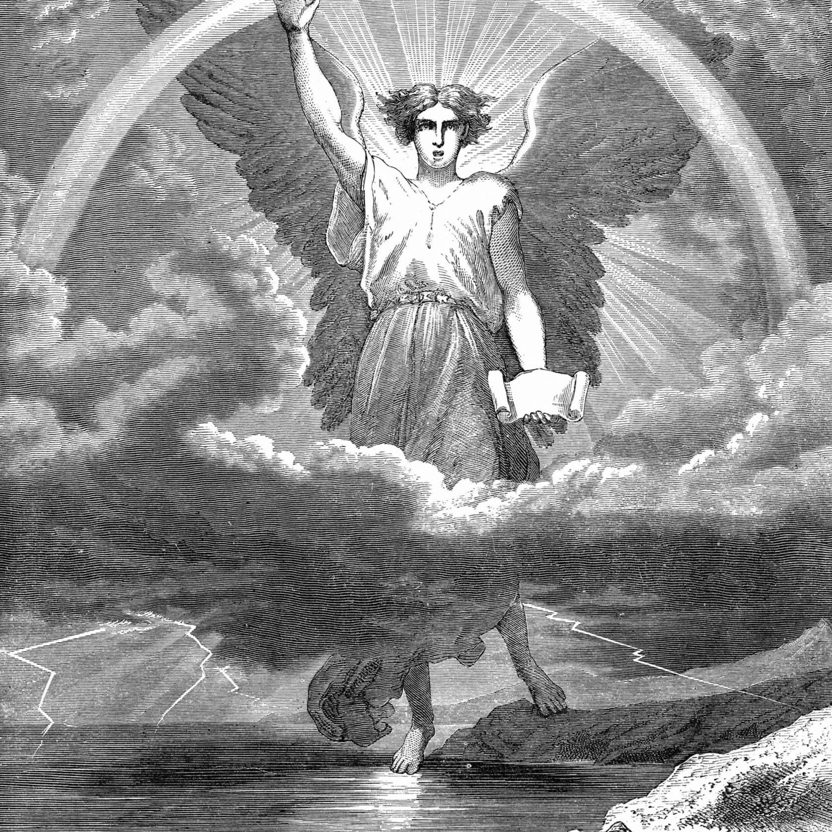
Angels:
The Mighty Ones
Today’s Scripture:
Psalms 103:20

Slide 2
Psalm 103:20
Praise the Lord, you his angels, you mighty ones who do his bidding, who obey his word.

Slide 3
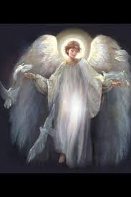
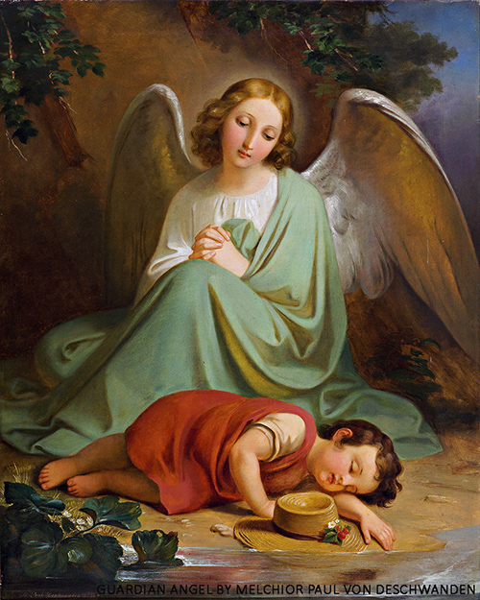
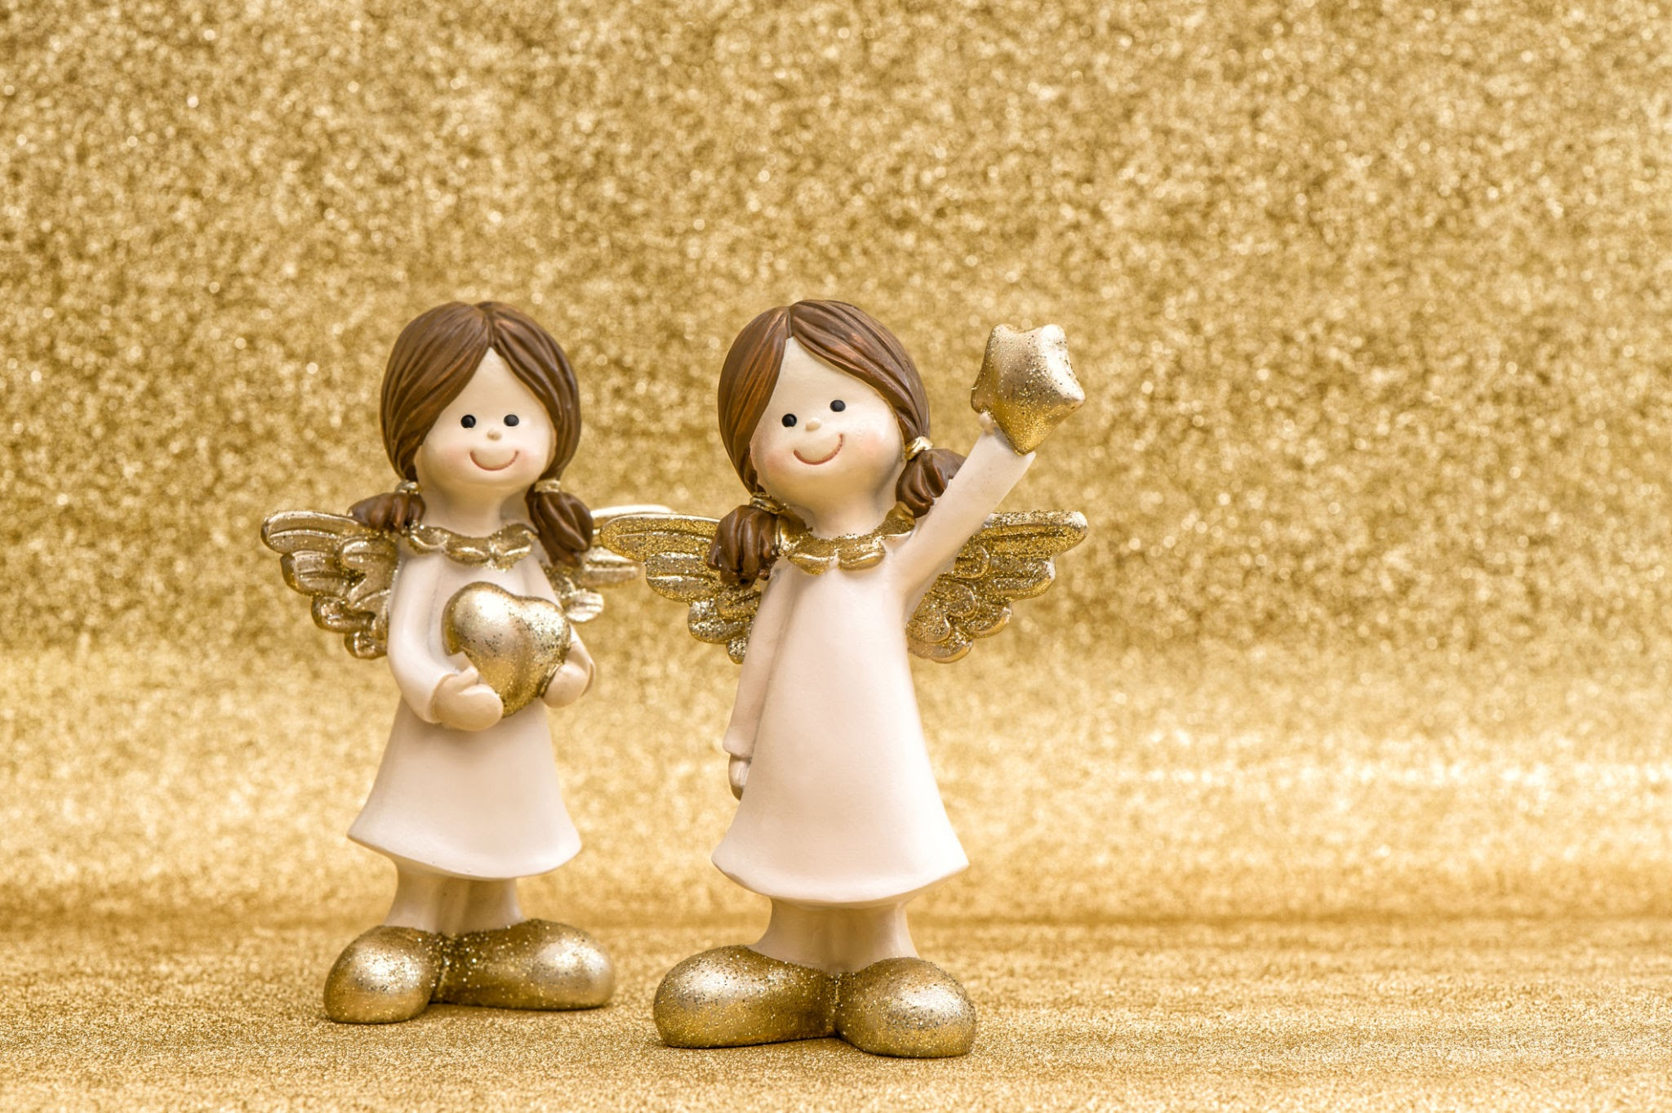
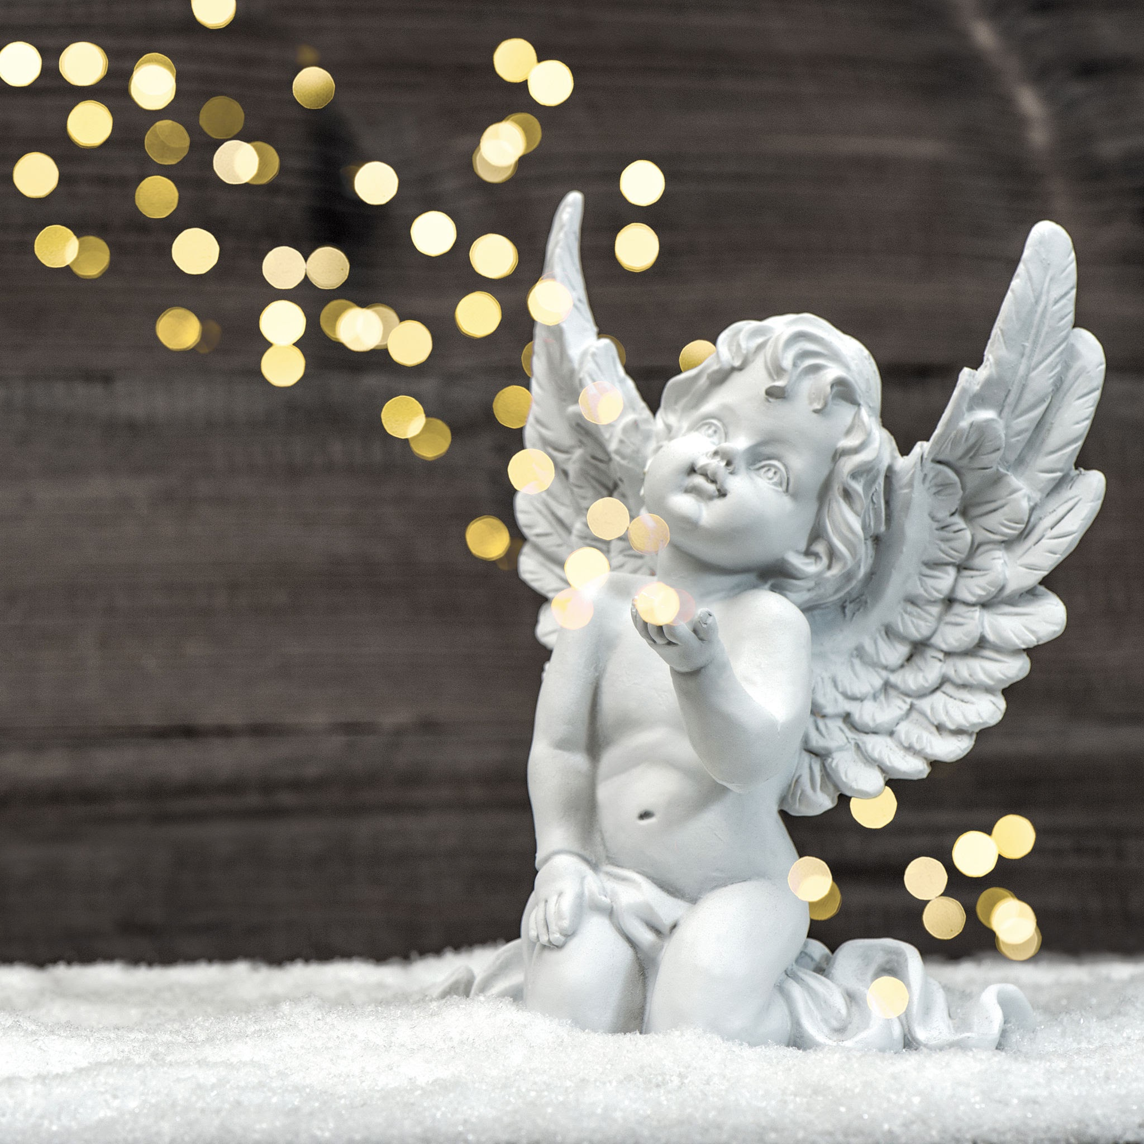
The angels
we imagine

Slide 4
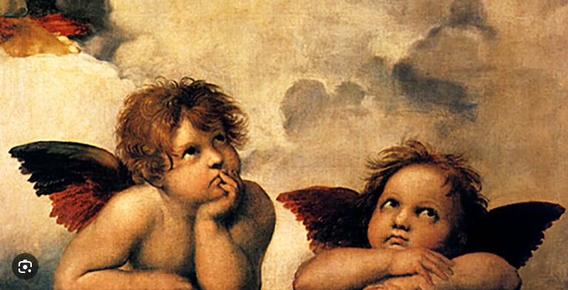
The angels
we imagine

Slide 5
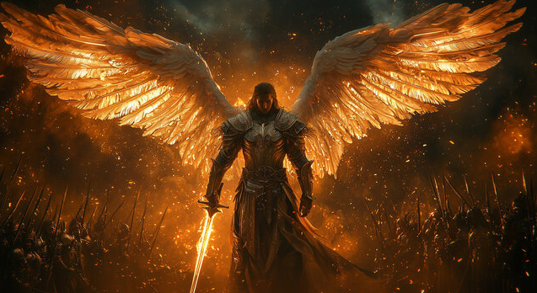

Slide 6
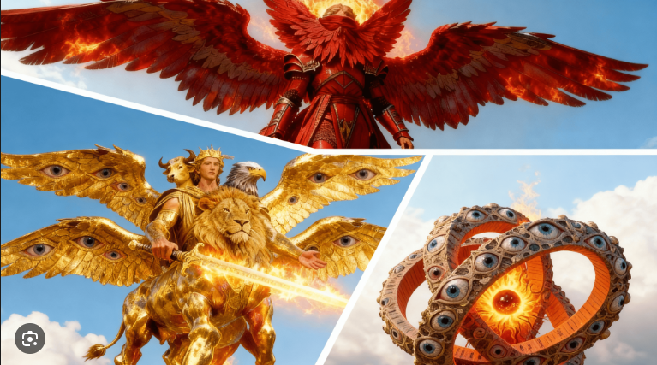

Slide 7
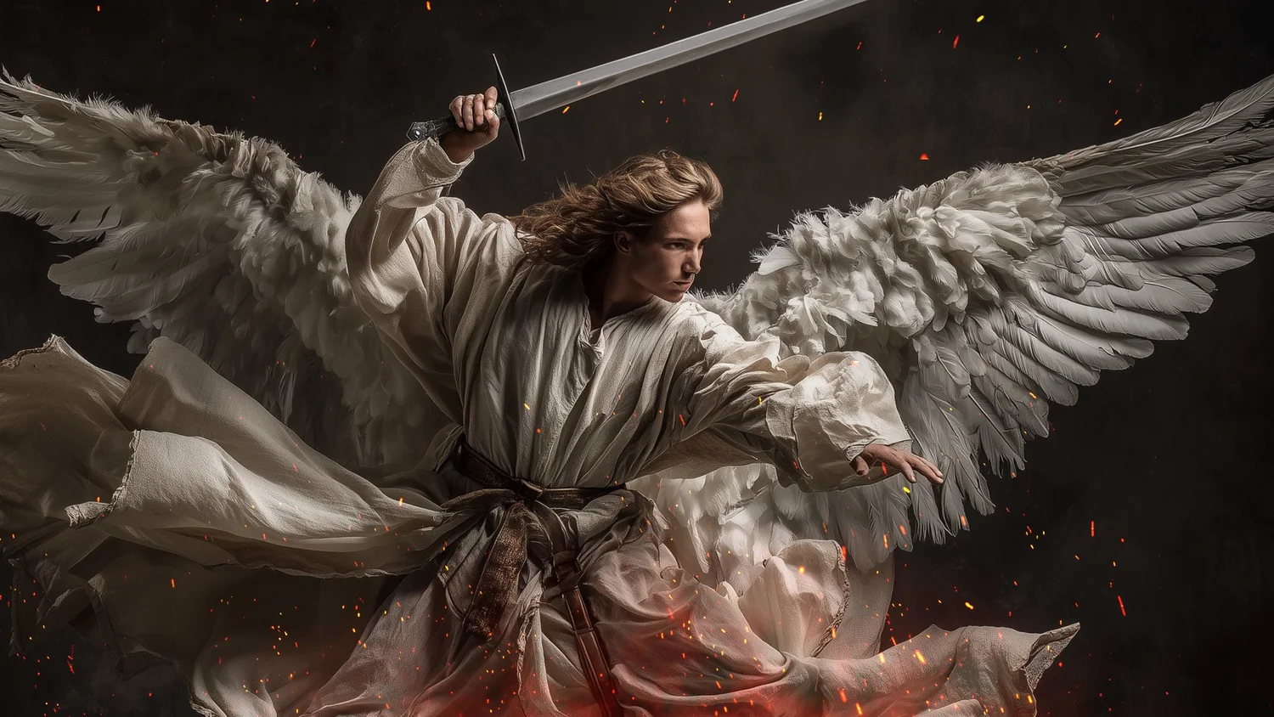

Slide 8
Psalm 91:11
For He will command His angels concerning you to guard you in all your ways.

Slide 9
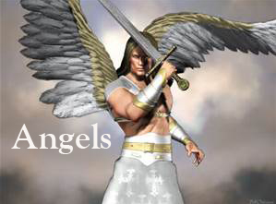

Slide 10
Hebrews 1:14
Are not all angels ministering spirits sent to serve those who will inherit salvation?

Slide 11
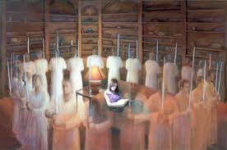

Slide 12
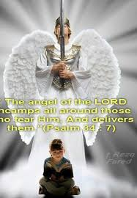

Slide 13
Living in Alignment with Heaven
Colossians 3:13
Proverbs 3:5-6
Luke 16:10

Slide 14

Align with Heaven:
Immediate. Trusting. Aligned.

Slide 15

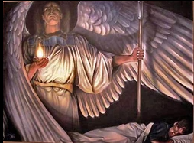

www.covingtonwacc.org/angels

