Slide 1
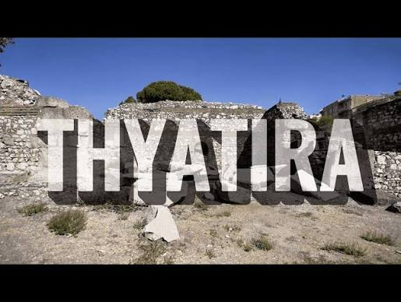
THE SEVEN CHURCHES OF JESUS
Thyatira
The Tolerant Church
Revelation 2:18–29
Notes:
Title

Slide 2

THE SEVEN CHURCHES OF JESUS
Thyatira
The Tolerant Church
Revelation 2:18–29
Notes:
Title

Slide 3
THE SEVEN CHURCHES OF JESUS
Thyatira
The Tolerant Church
Revelation 2:18–29
Notes:
Title

Slide 4
“
I know your deeds, your love and faith, your service and perseverance, and that you are now doing more than you did at first.
Revelation 2:19
Notes:
Rev 2:19

Slide 5
Nevertheless, I have this against you:
You tolerate…
What have we allowed to stay because confronting it is difficult?
Revelation 2:20
Notes:
Nevertheless — Rev 2:20a

Slide 6
Love without discernment can become permission.
1
Celebrate what is good.
2
Confront what is harmful.
3
Hold on to what is faithful.
Notes:
Theme and roadmap

Slide 7
1
Jesus Sees and Commends Their Growth
Love
Faith
Service
Perseverance
Growth
Not whether we have arrived, but:
Are we growing?
Notes:
Point 1 — Jesus sees and commends their growth

Slide 8
Jesus celebrates our progress without ignoring what still needs His attention.
Notes:
Point 1 takeaway

Slide 9
2
Jesus Confronts What They Allowed to Remain
“You tolerate that woman Jezebel, who calls herself a prophet.”
What we repeatedly permit eventually begins to shape us.
Revelation 2:20
Notes:
Point 2 — Jesus confronts what they allowed to remain

Slide 10
“I have given her time to repent…”
Correction is not rejection.
Jesus is firm, but patient. He confronts, but He also gives opportunity. His goal is restoration.
Revelation 2:21
Notes:
Rev 2:21 — Correction is not rejection

Slide 11
3
Jesus to the Faithful: Hold On
“I will not impose any other burden on you, except to hold on to what you have until I come.” (Rev. 2:24–25)
Do not let someone else’s unfaithfulness make you unfaithful.
Notes:
Point 3 — Hold on

Slide 12
“I will also give that one the morning star.”
The greatest gift He promises is Himself.
It appears while it is still dark. Morning is coming.
Revelation 2:26–28; 22:16
Notes:
The Morning Star

Slide 13
What have I given room to that Jesus is asking me to address?
Lord, show me what does not belong.
Give me courage to release it.
And help me hold on to what is good.
The Morning Star is coming.
Notes:
Close — What have I given room to?

Slide 14
Whoever has ears, let them hear what the Spirit says to the churches.
Revelation 2:29
Amen.
Notes:
Rev 2:29 — Amen

Slide 15
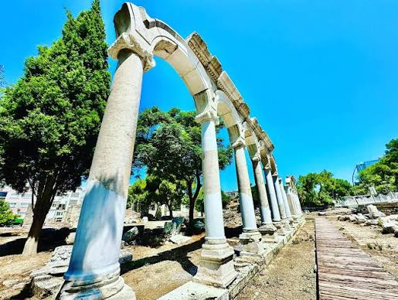
Notes:
Title

Slide 16
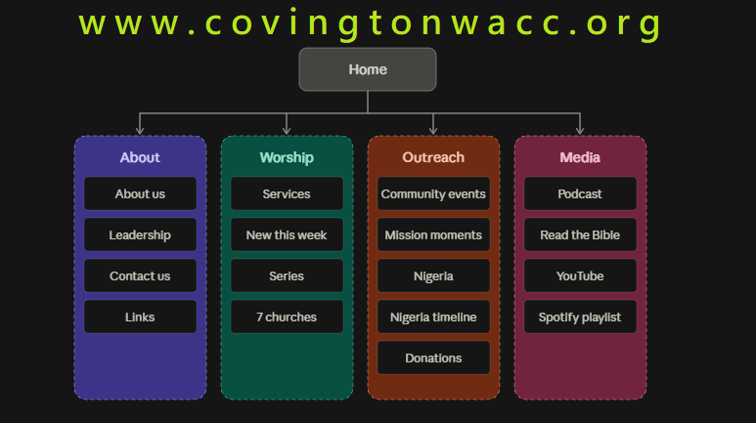
Notes:
Title

