Slide 1
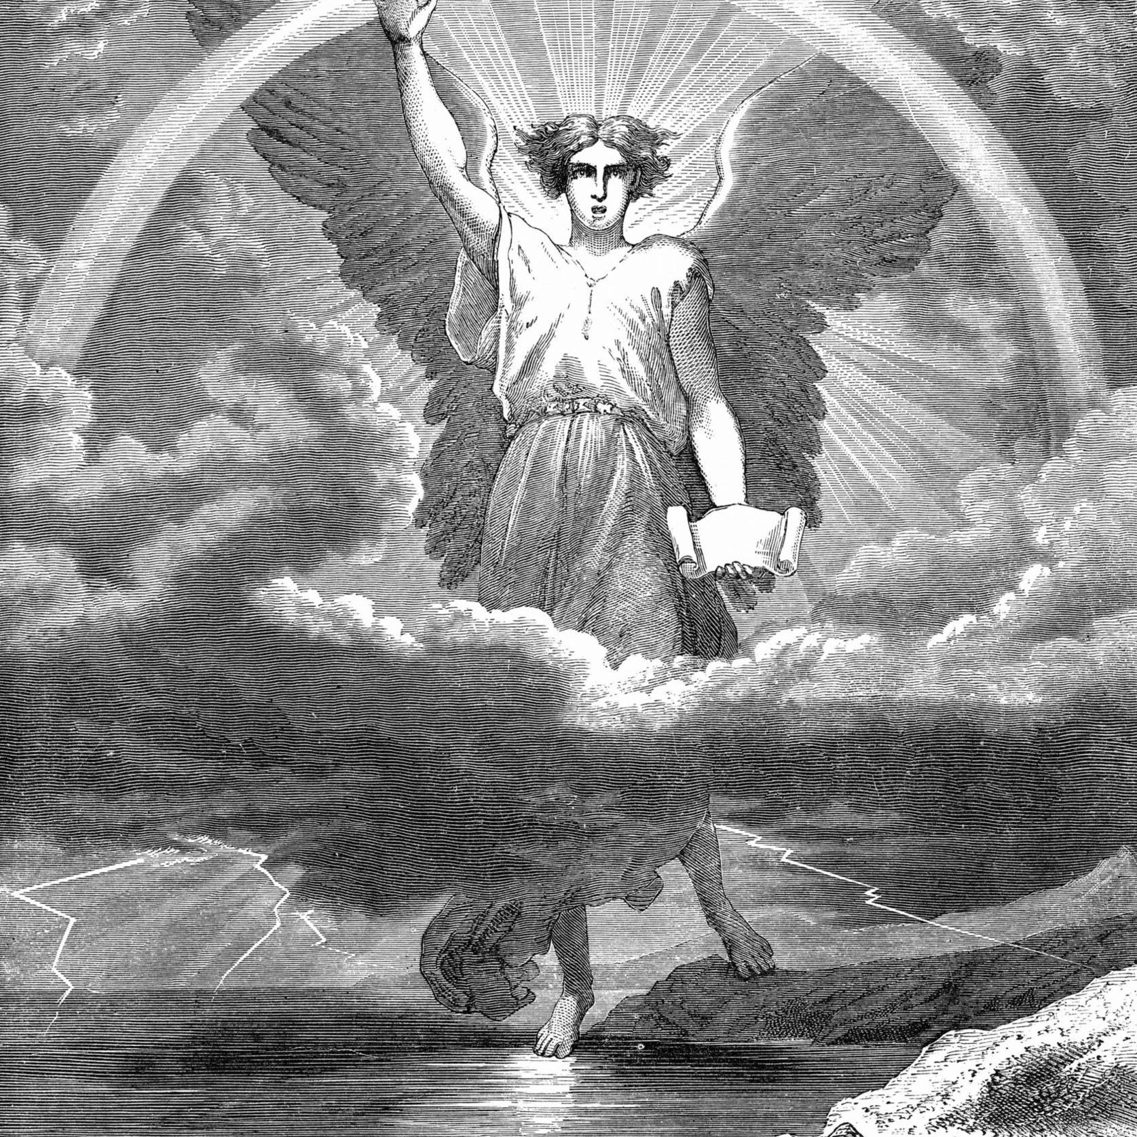
Angels:
Prophecy and the end of our Journey
Today’s Scripture:
Luke 16:22, Ps. 91:11, Heb 1:14

Slide 2
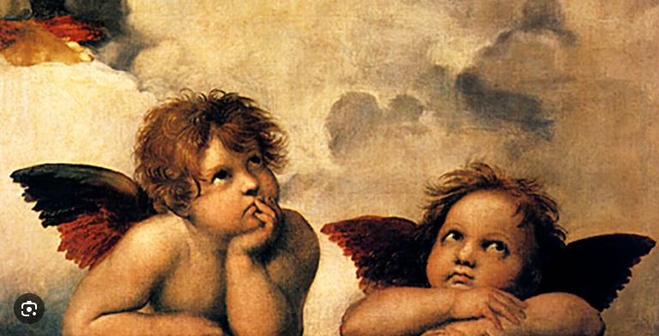
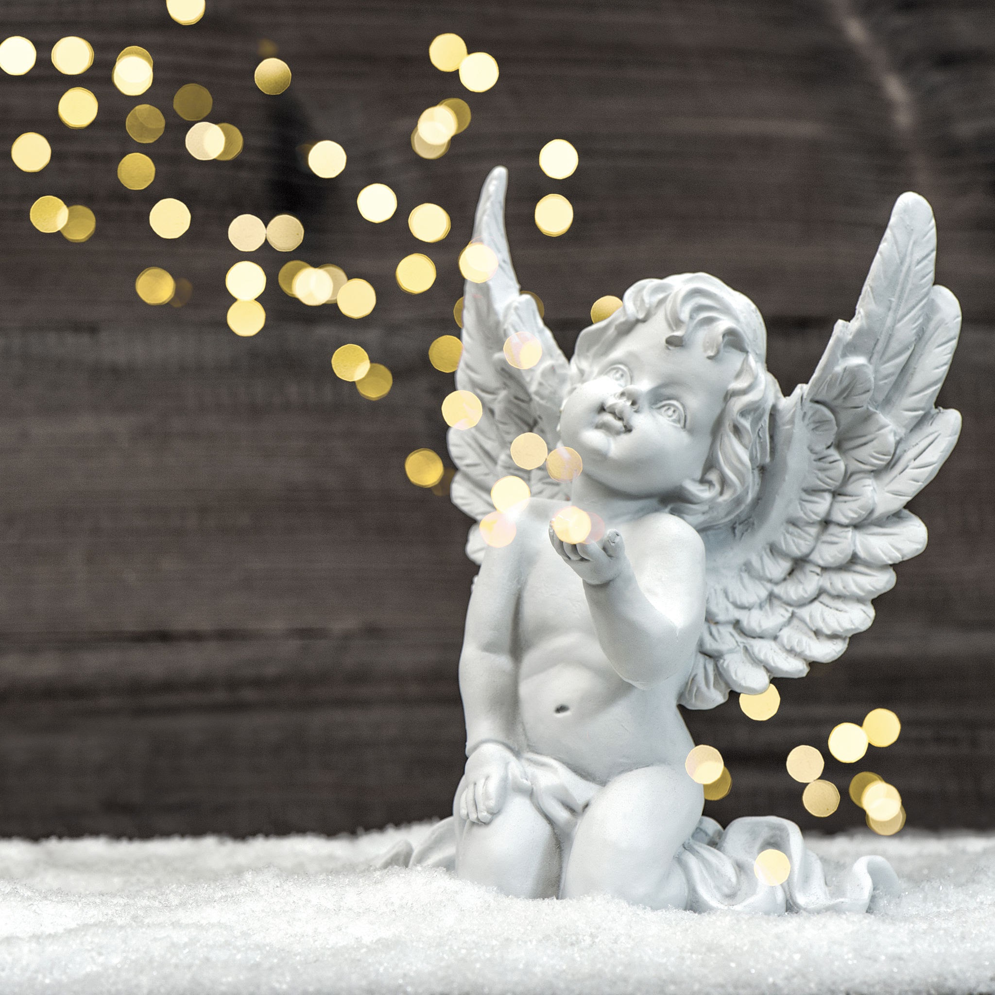
The angels
we imagine

Slide 3
Luke 16:22
The time came when the beggar died and the angels carried him to Abraham’s side.

Slide 4
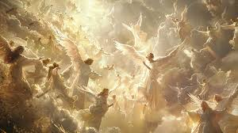

Slide 5


Slide 6
Psalm 91:11
For he will command his angels concerning you to guard you in all your ways;

Slide 7


Slide 8
Hebrews 1:14
Are not all angels ministering spirits sent to serve those who will inherit salvation?

Slide 9
