Slide 1




Slide 2

New Message Series:
Where are
we in time?

Slide 3
Today’s Message:
The Great
Tribulation
Key Scriptures:
Daniel 9: 24-27

Slide 4

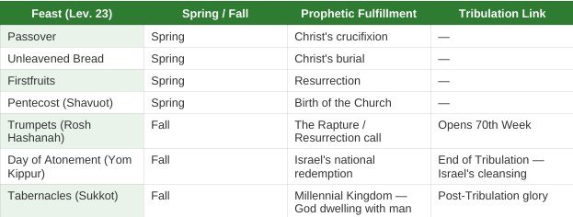

Slide 5
Daniel 9:24-27
24 “Seventy ‘sevens’ are decreed for your people and your holy city to finish transgressions, to put an end to sin, to atone for wickedness, to bring in everlasting righteousness, to seal up vision and prophecy and to anoint the Most Holy Place.
Notes:
1 Corinthians 15:51-52

Slide 6
25 “Know and understand this: From the time the word goes out to restore and rebuild Jerusalem until the Anointed One, the ruler, comes, there will be seven ‘sevens,’ and sixty-two ‘sevens.’ It will be rebuilt with streets and a trench, but in times of trouble.

Slide 7
26 After the sixty-two ‘sevens,’ the Anointed One will be put to death and will have nothing. The people of the ruler who will come will destroy the city and the sanctuary. The end will come like a flood: War will continue until the end, and desolations have been decreed.

Slide 8
27 He will confirm a covenant with many for one ‘seven.’ In the middle of the ‘seven’ he will put an end to sacrifice and offering. And at the temple he will set up an abomination that causes desolation, until the end that is decreed is poured out on him.

Slide 9
Jeremiah 30:7
“How awful that day will be! No other will be like it. It will be a time of trouble for Jacob, but he will be saved out of it.”
Notes:
1 Thessalonians 4:16-17

Slide 10
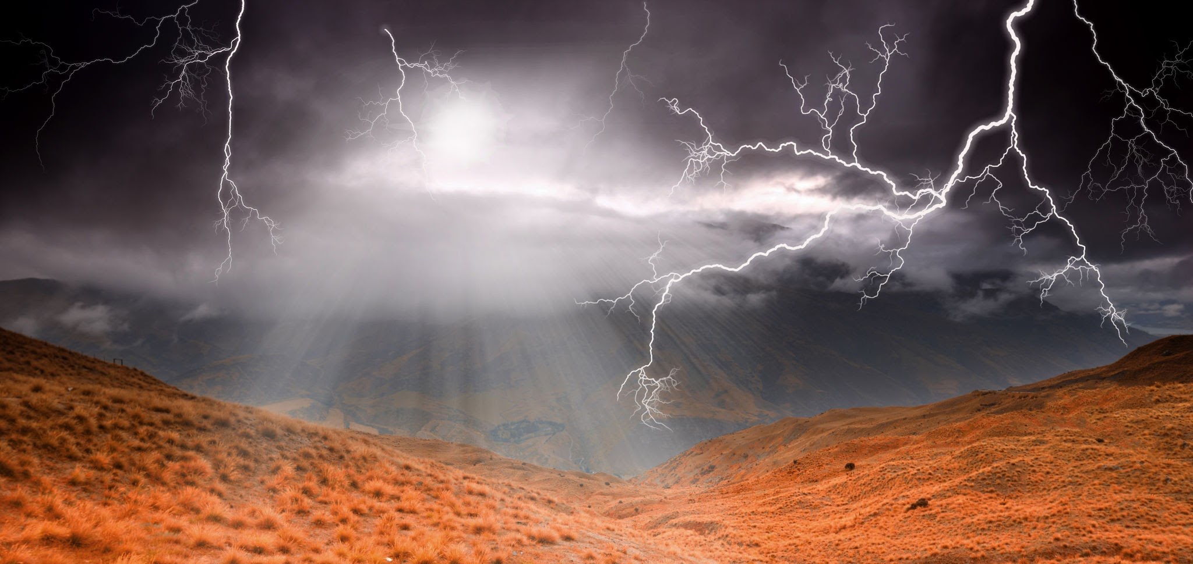

Slide 11
Isaiah 2:12
The Lord Almighty has a day in store for all the proud and lofty, for all that is exalted (and they will be humbled).
Notes:
1 Corinthians 15:51-52

Slide 12

1 Thessalonians 5:2
for you know very well that the day of the Lord will come like a thief in the night.
Notes:
1 Thessalonians 5:91 Thessalonians 5:9

Slide 13
Deuteronomy 4:30
When you are in distress and all these things have happened to you, then in later days you will return to the Lord your God and obey him.
Notes:
Titus 2:13

Slide 14
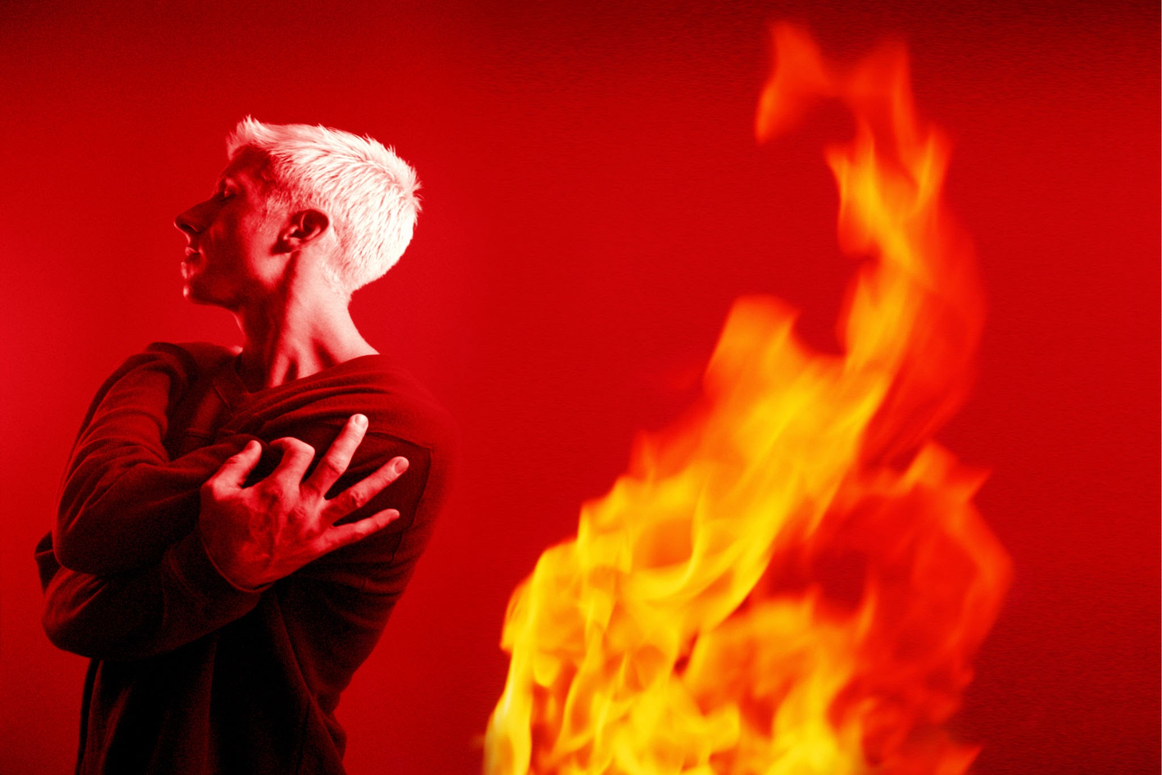
James 5:8
You too, be patient and stand firm, because the Lord’s coming is near.

Slide 15
Mark 13:19-20
Because those will be days of distress unequaled from the beginning, when God created the world, until now-and never to be equaled again. If the Lord had not cut short those days, no one would

Slide 16
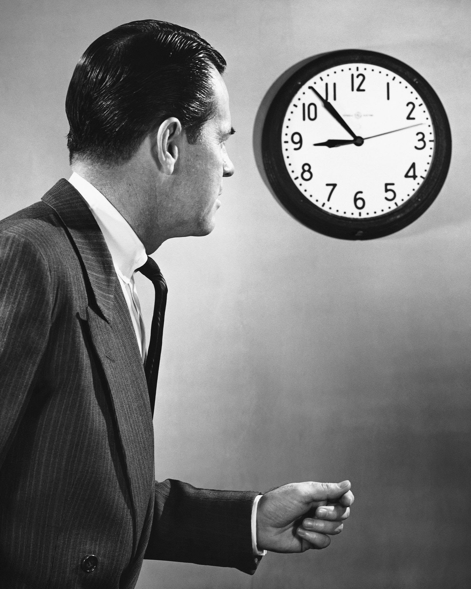
survive. But for the sake of the elect, whom he has chosen, he has shortened them.

Slide 17
2 Thessalonians 2:3-4
…the man of lawlessness is revealed, the man doomed to destruction. He will oppose and will exalt himself over everything that is called God or is worshipped, so that he sets himself up in God’s temple, proclaiming himself to be God.
Notes:
Revelation 3:10

Slide 18
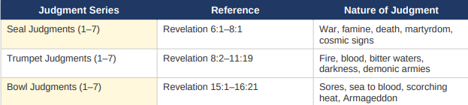
The Judgements
Revelation 6-16

Slide 19
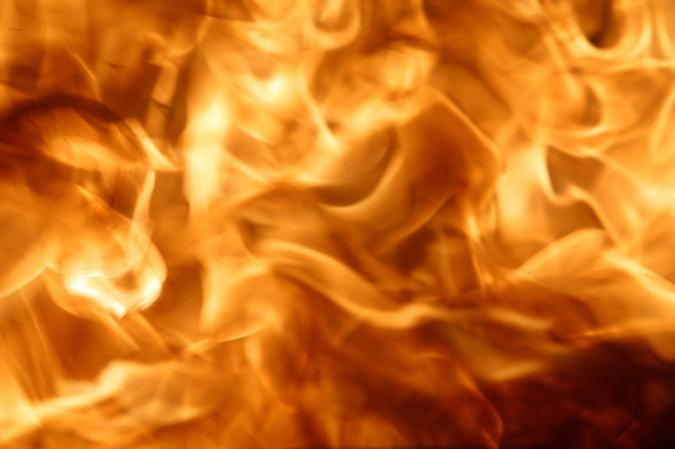
Revelation 16:9
They were seared by the intense heat and they cursed the name of God, who had control over these plagues, but they refused to repent and glorify him.

Slide 20
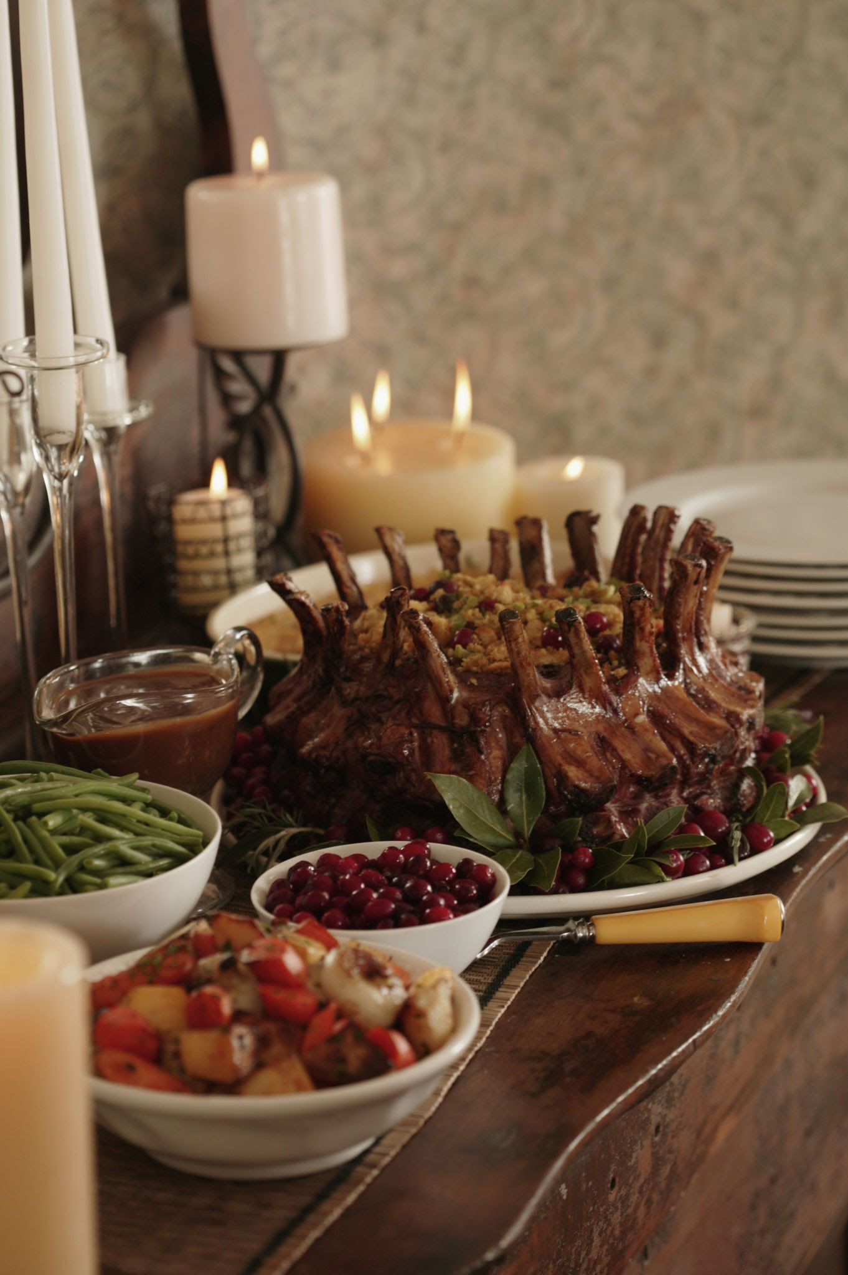
The Wedding Feast
Tribulation

Slide 21
Revelation 19:7-9
Let us rejoice and be glad and give him glory! For the wedding of the Lamb has come, and his bride has made herself ready. Fine linen, bright and clean, was given her to wear…Blessed are those who are invited to the wedding supper of the Lamb!

Slide 22
Revelation 22:20
He who testifies to these things says,
‘Yes, I am coming soon.’
Amen. Come, Lord Jesus.

Slide 23
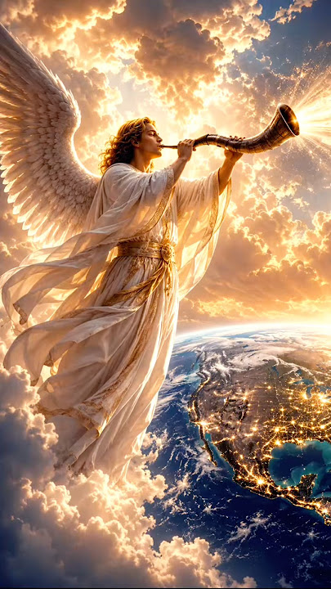

Slide 24
Revelation 19:7-9
Let us rejoice and be glad and give him glory! For the wedding of the Lamb has come, and his bride has made herself ready. Fine linen, bright and clean, was given her to wear…Blessed are those who are invited to the wedding supper of the Lamb!

Slide 25
Revelation 22:20
He who testifies to these things says,
‘Yes, I am coming soon.’
Amen. Come, Lord Jesus.

