Slide 1

https://music.youtube.com/watch?v=dCU0IP5ioa8&list=PLrXXV5ap7yJ5bEwos_Y_MZiI2OXafEOqf

Slide 2


Slide 3

Today’s Message
Keeping Step
with the Spirit
Key Scripture
Galatians 5:22-23

Slide 4
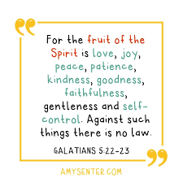

Slide 5


Slide 6

8 Ways to spot a good man (person)

Slide 7
1. Eye Contact
2. Respect for boundaries
3. Positive body language
4. Active listening
5. Kindness to others
6. Honesty from the start
7. Good communication
8. Consistency

Slide 8


Slide 9
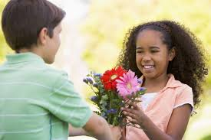

Kind deeds reflect a good heart
~Rabbi Rod

