Slide 1

https://music.youtube.com/watch?v=dCU0IP5ioa8&list=PLrXXV5ap7yJ5bEwos_Y_MZiI2OXafEOqf

Slide 2


Slide 3


Slide 4
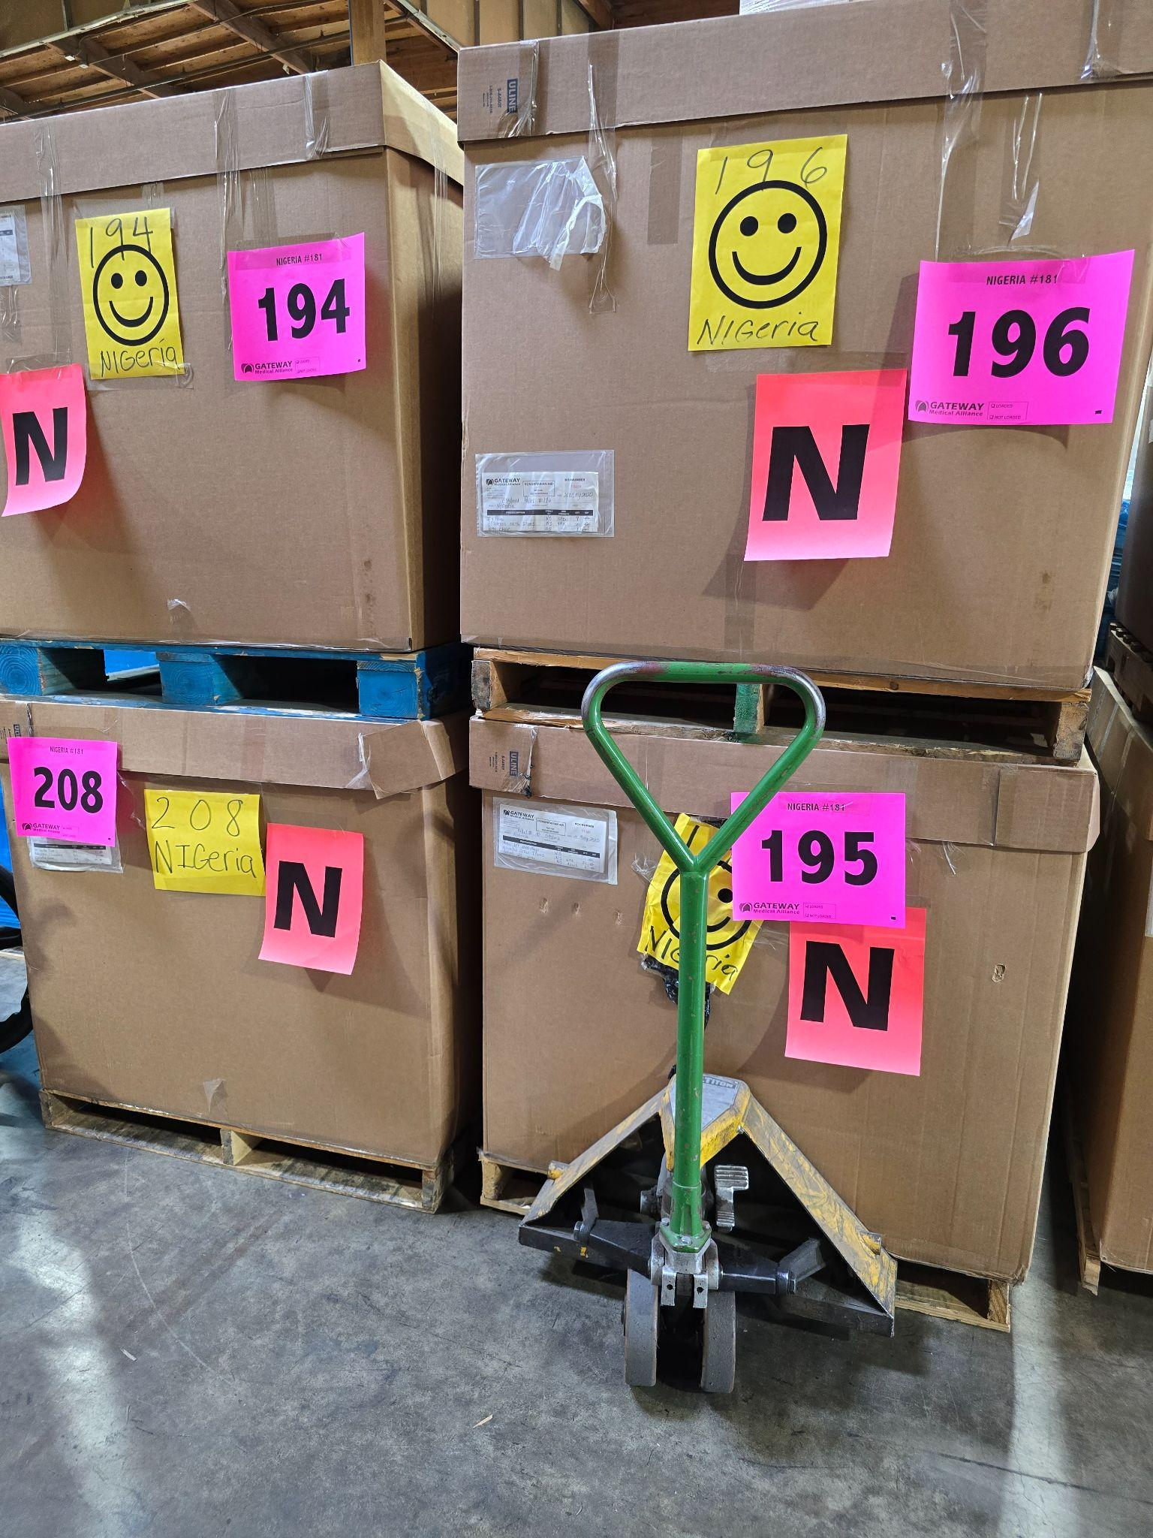
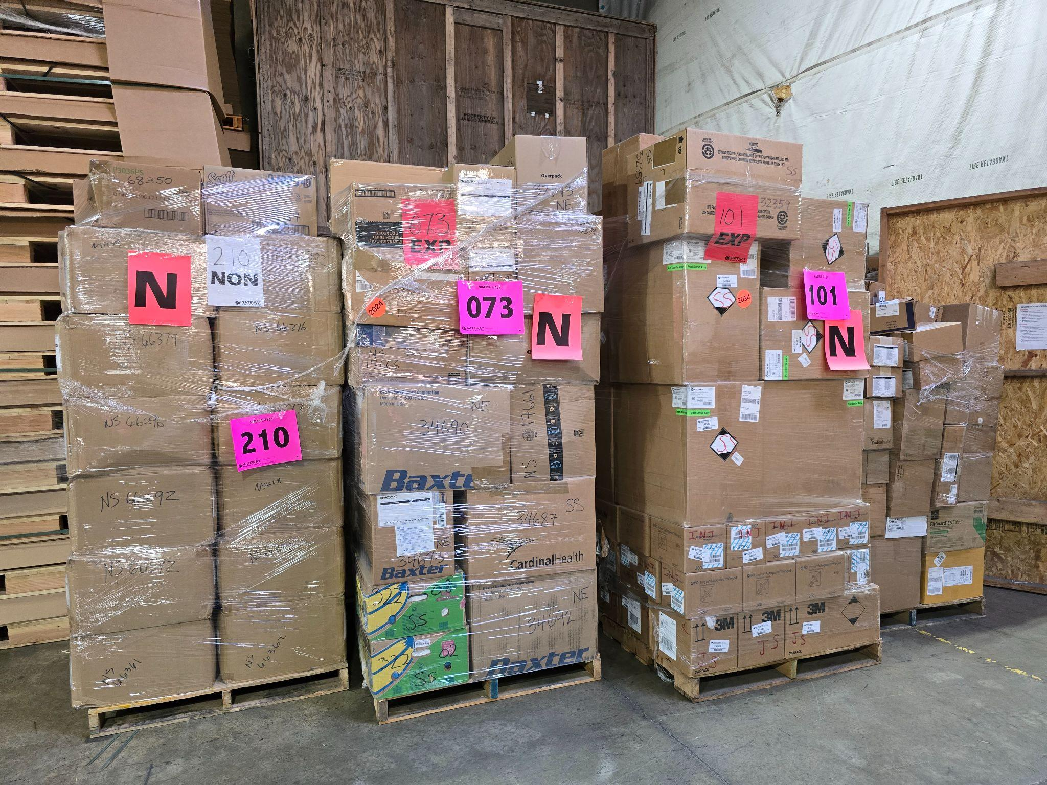

Slide 5
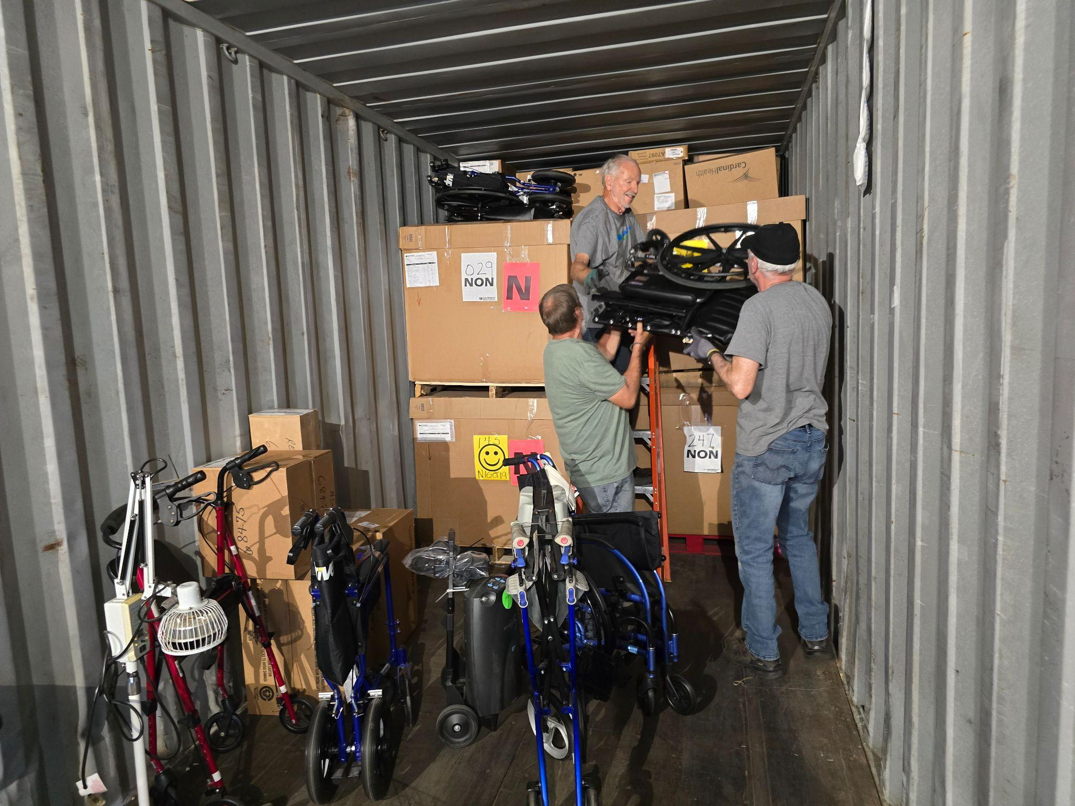

Slide 6
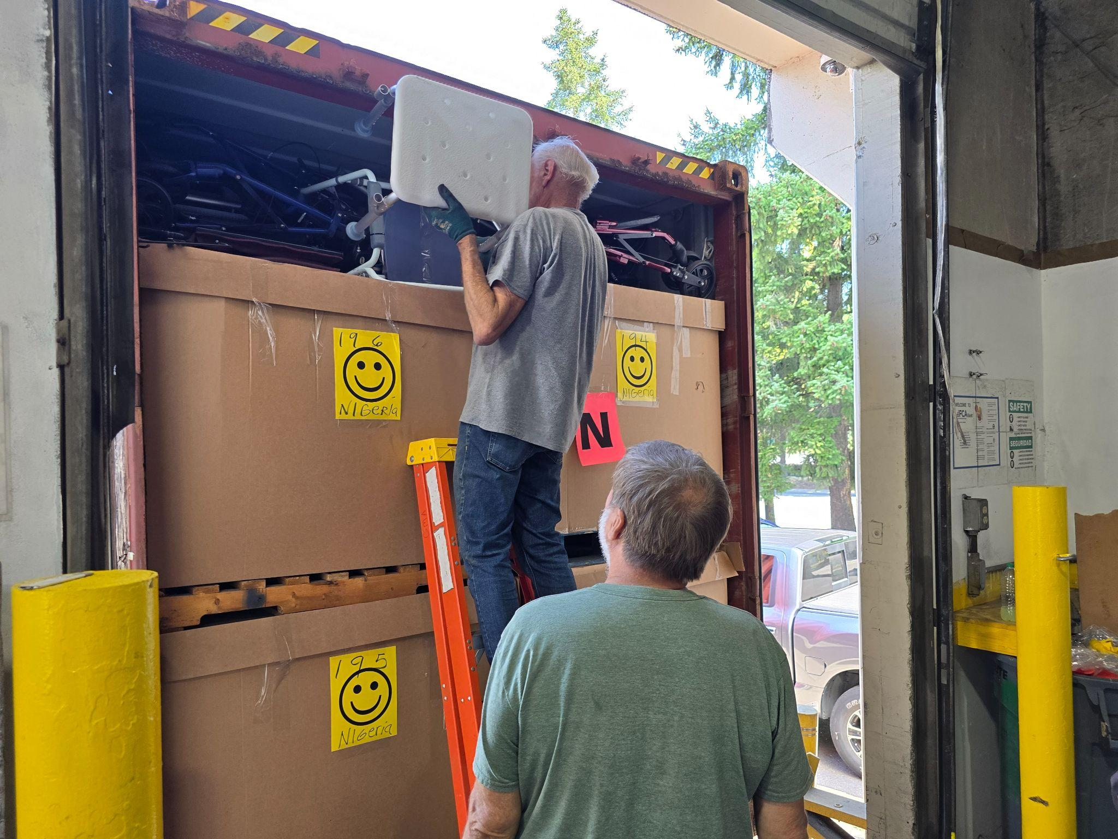
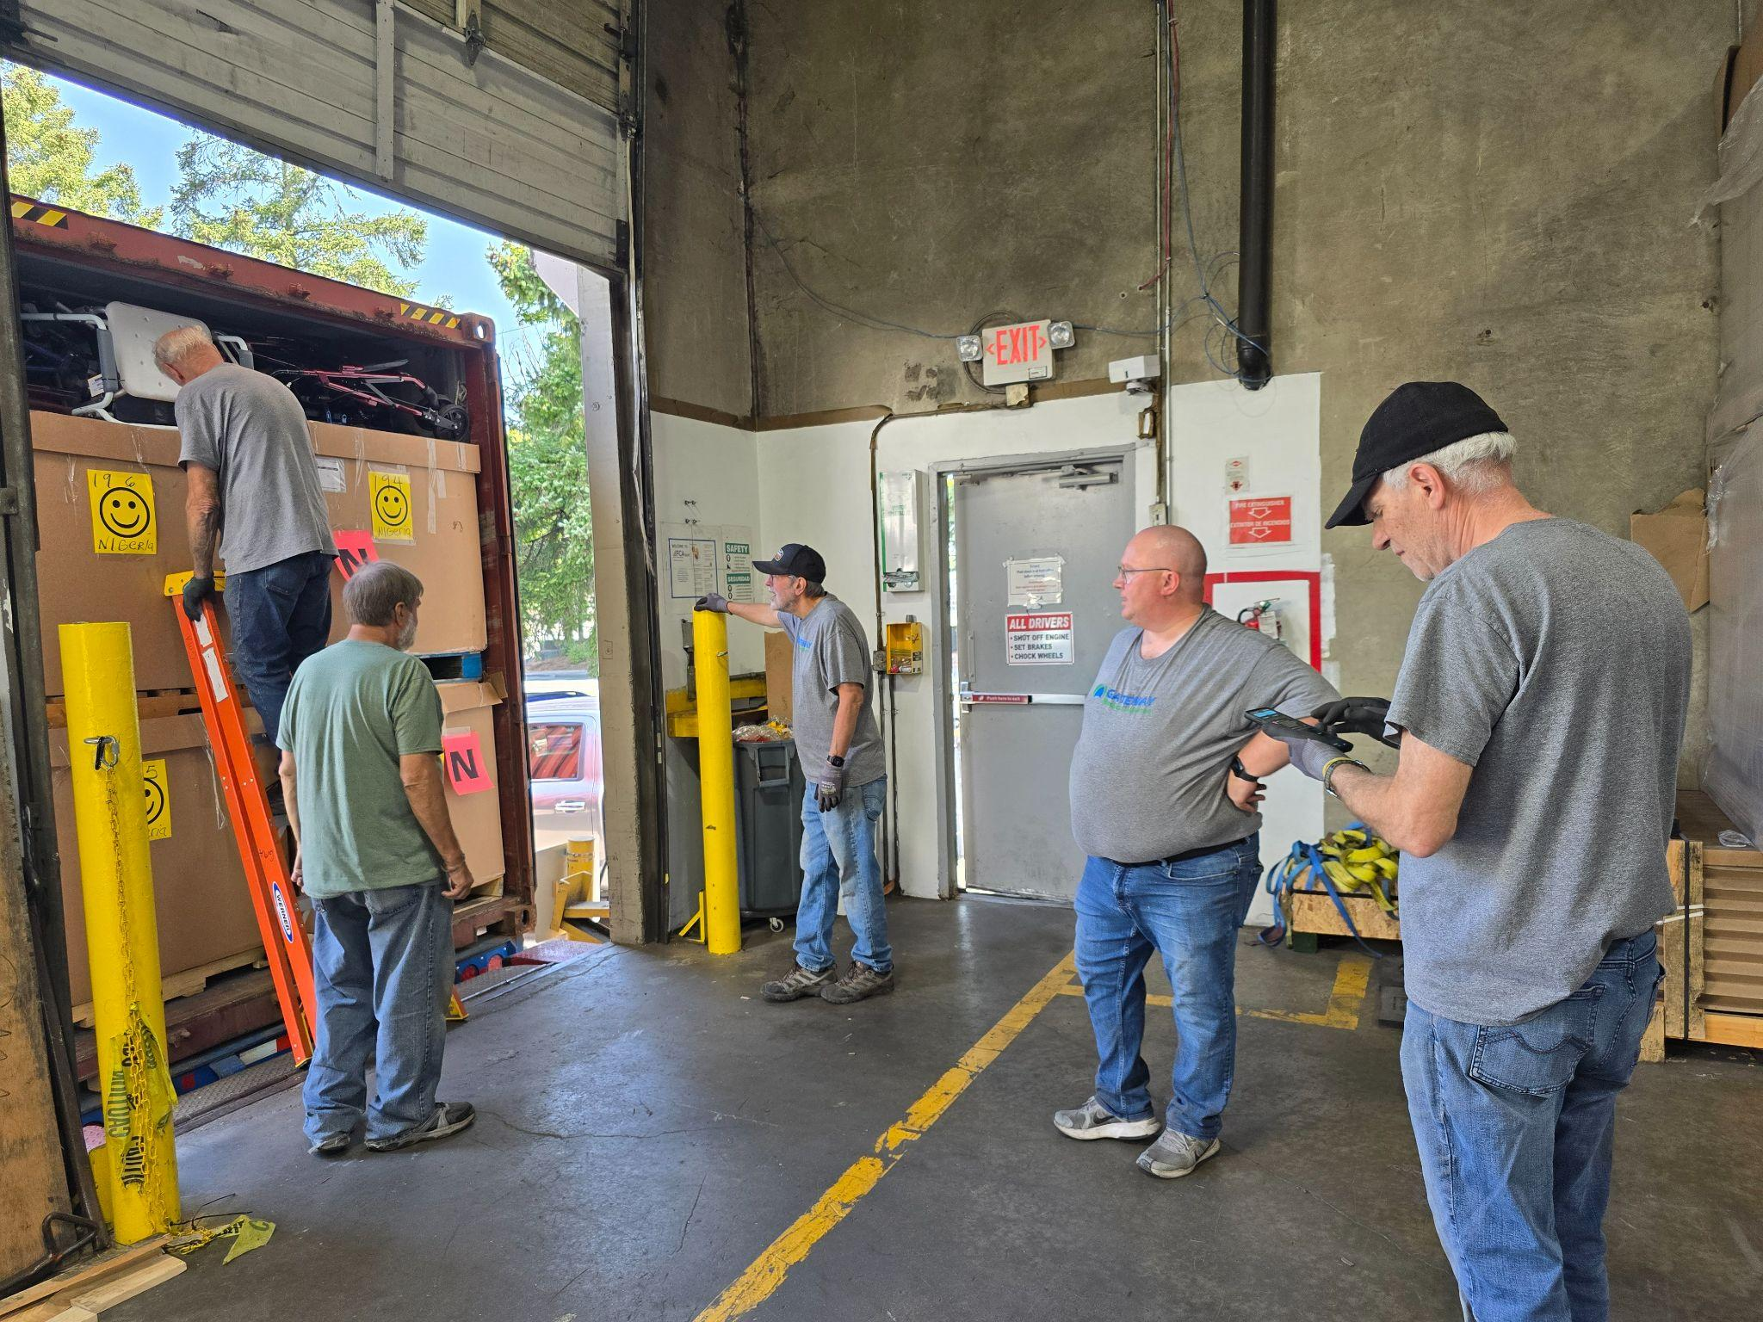

Slide 7
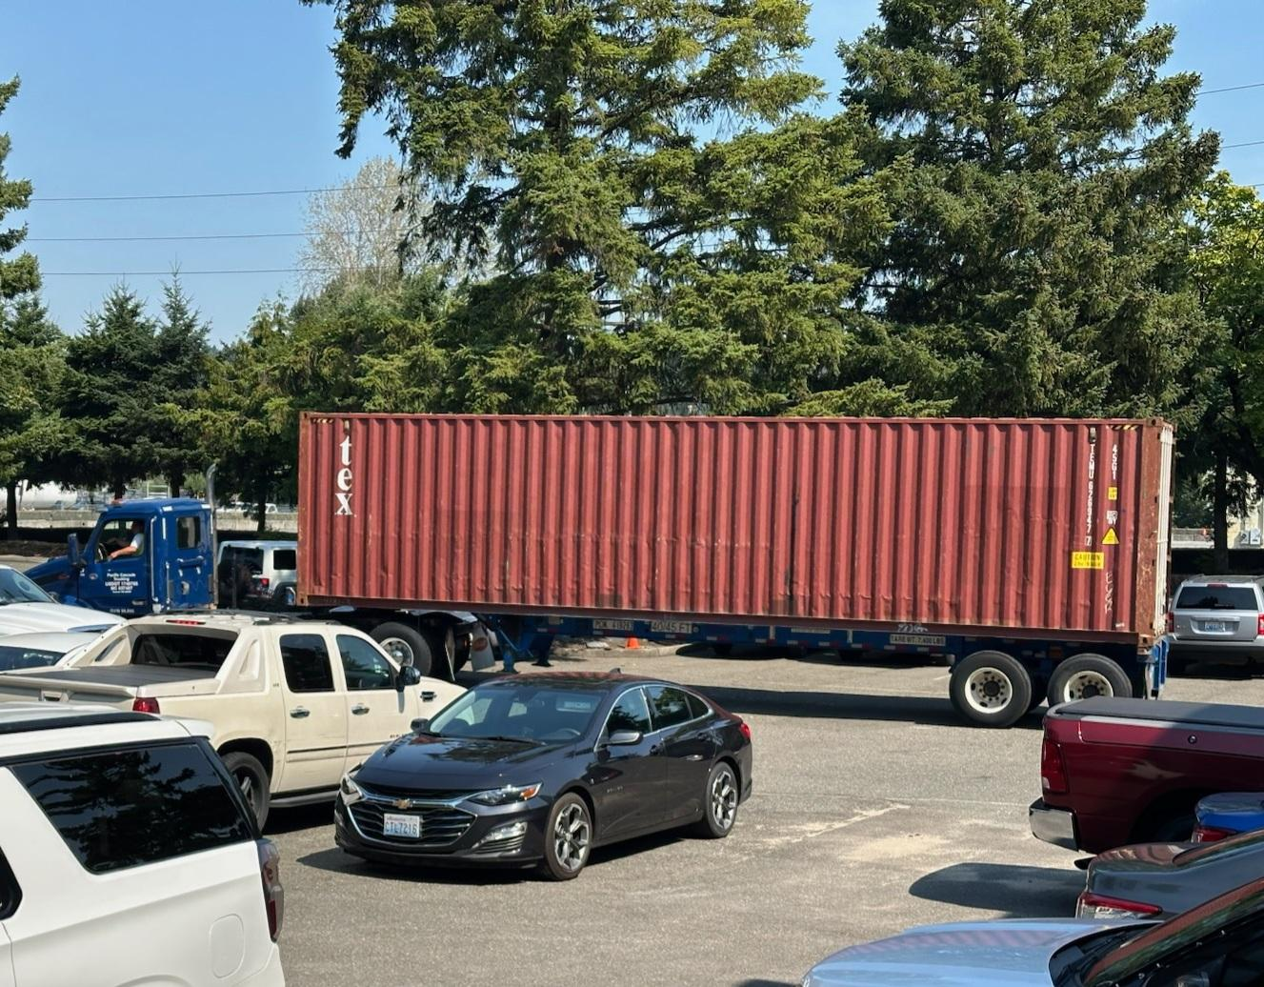

Slide 8

Today’s Message
Keeping Step
with the Spirit
Key Scripture
Galatians 5:22-23

Slide 9


Slide 10

Self-Control

