Slide 1
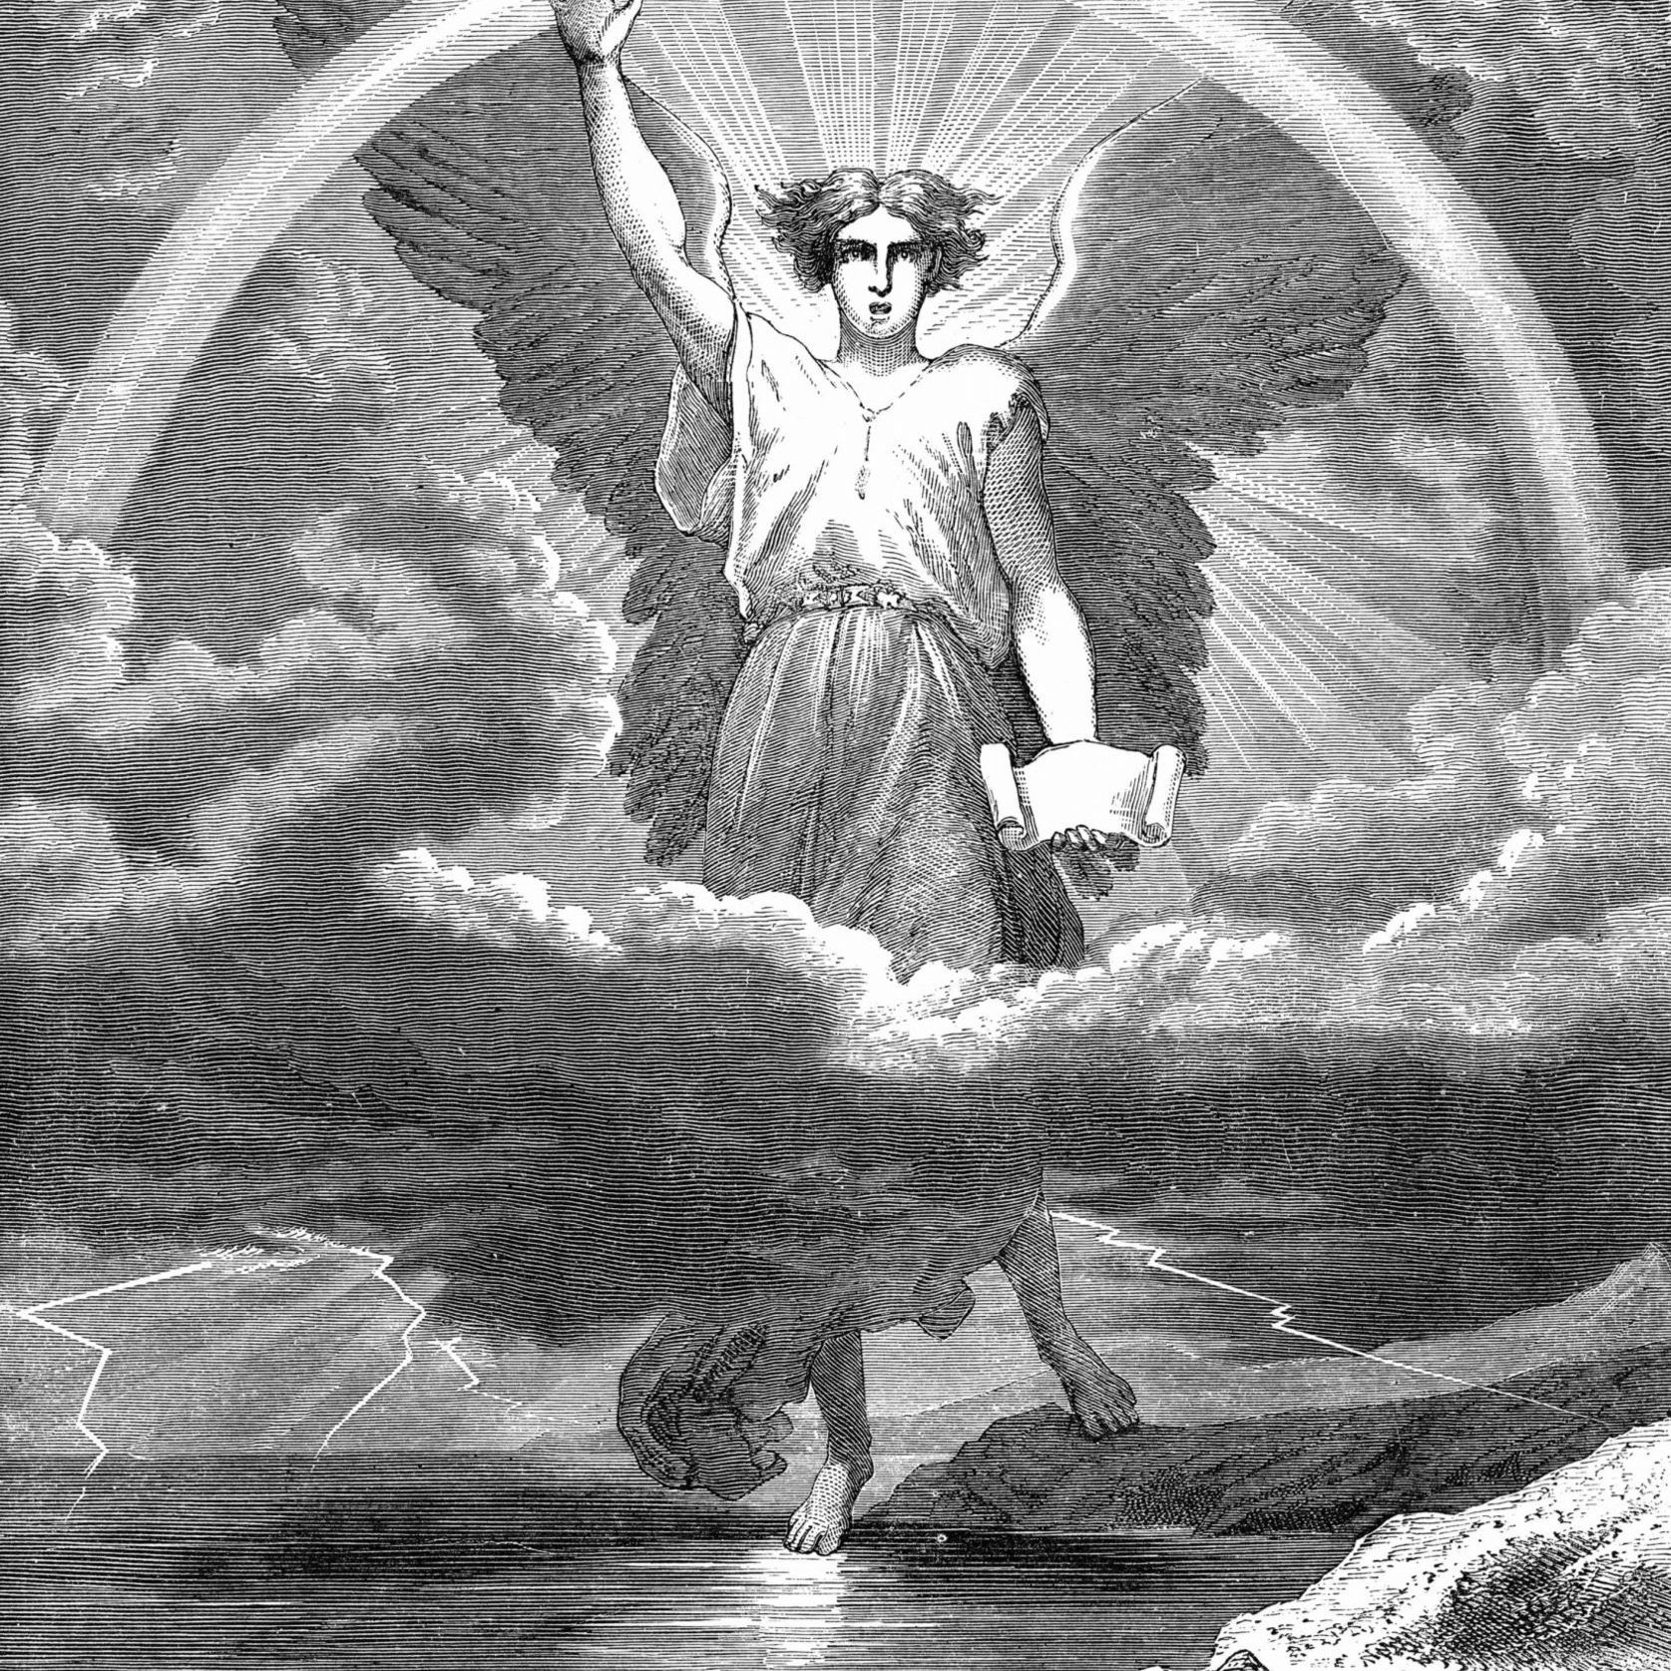
Angels:
The Host of Heaven
Today’s Scripture:
Psalms 103:21

Slide 2
Psalm 103:21
Praise the Lord, you his heavenly hosts, you his servants who do his will.

Slide 3
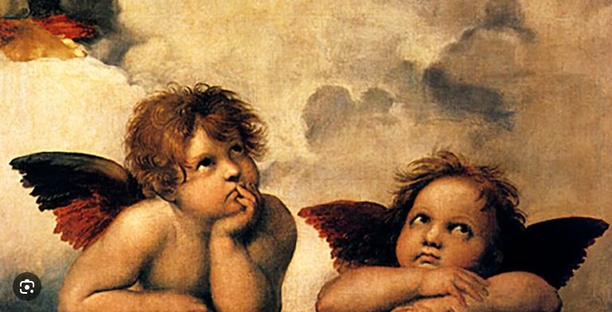
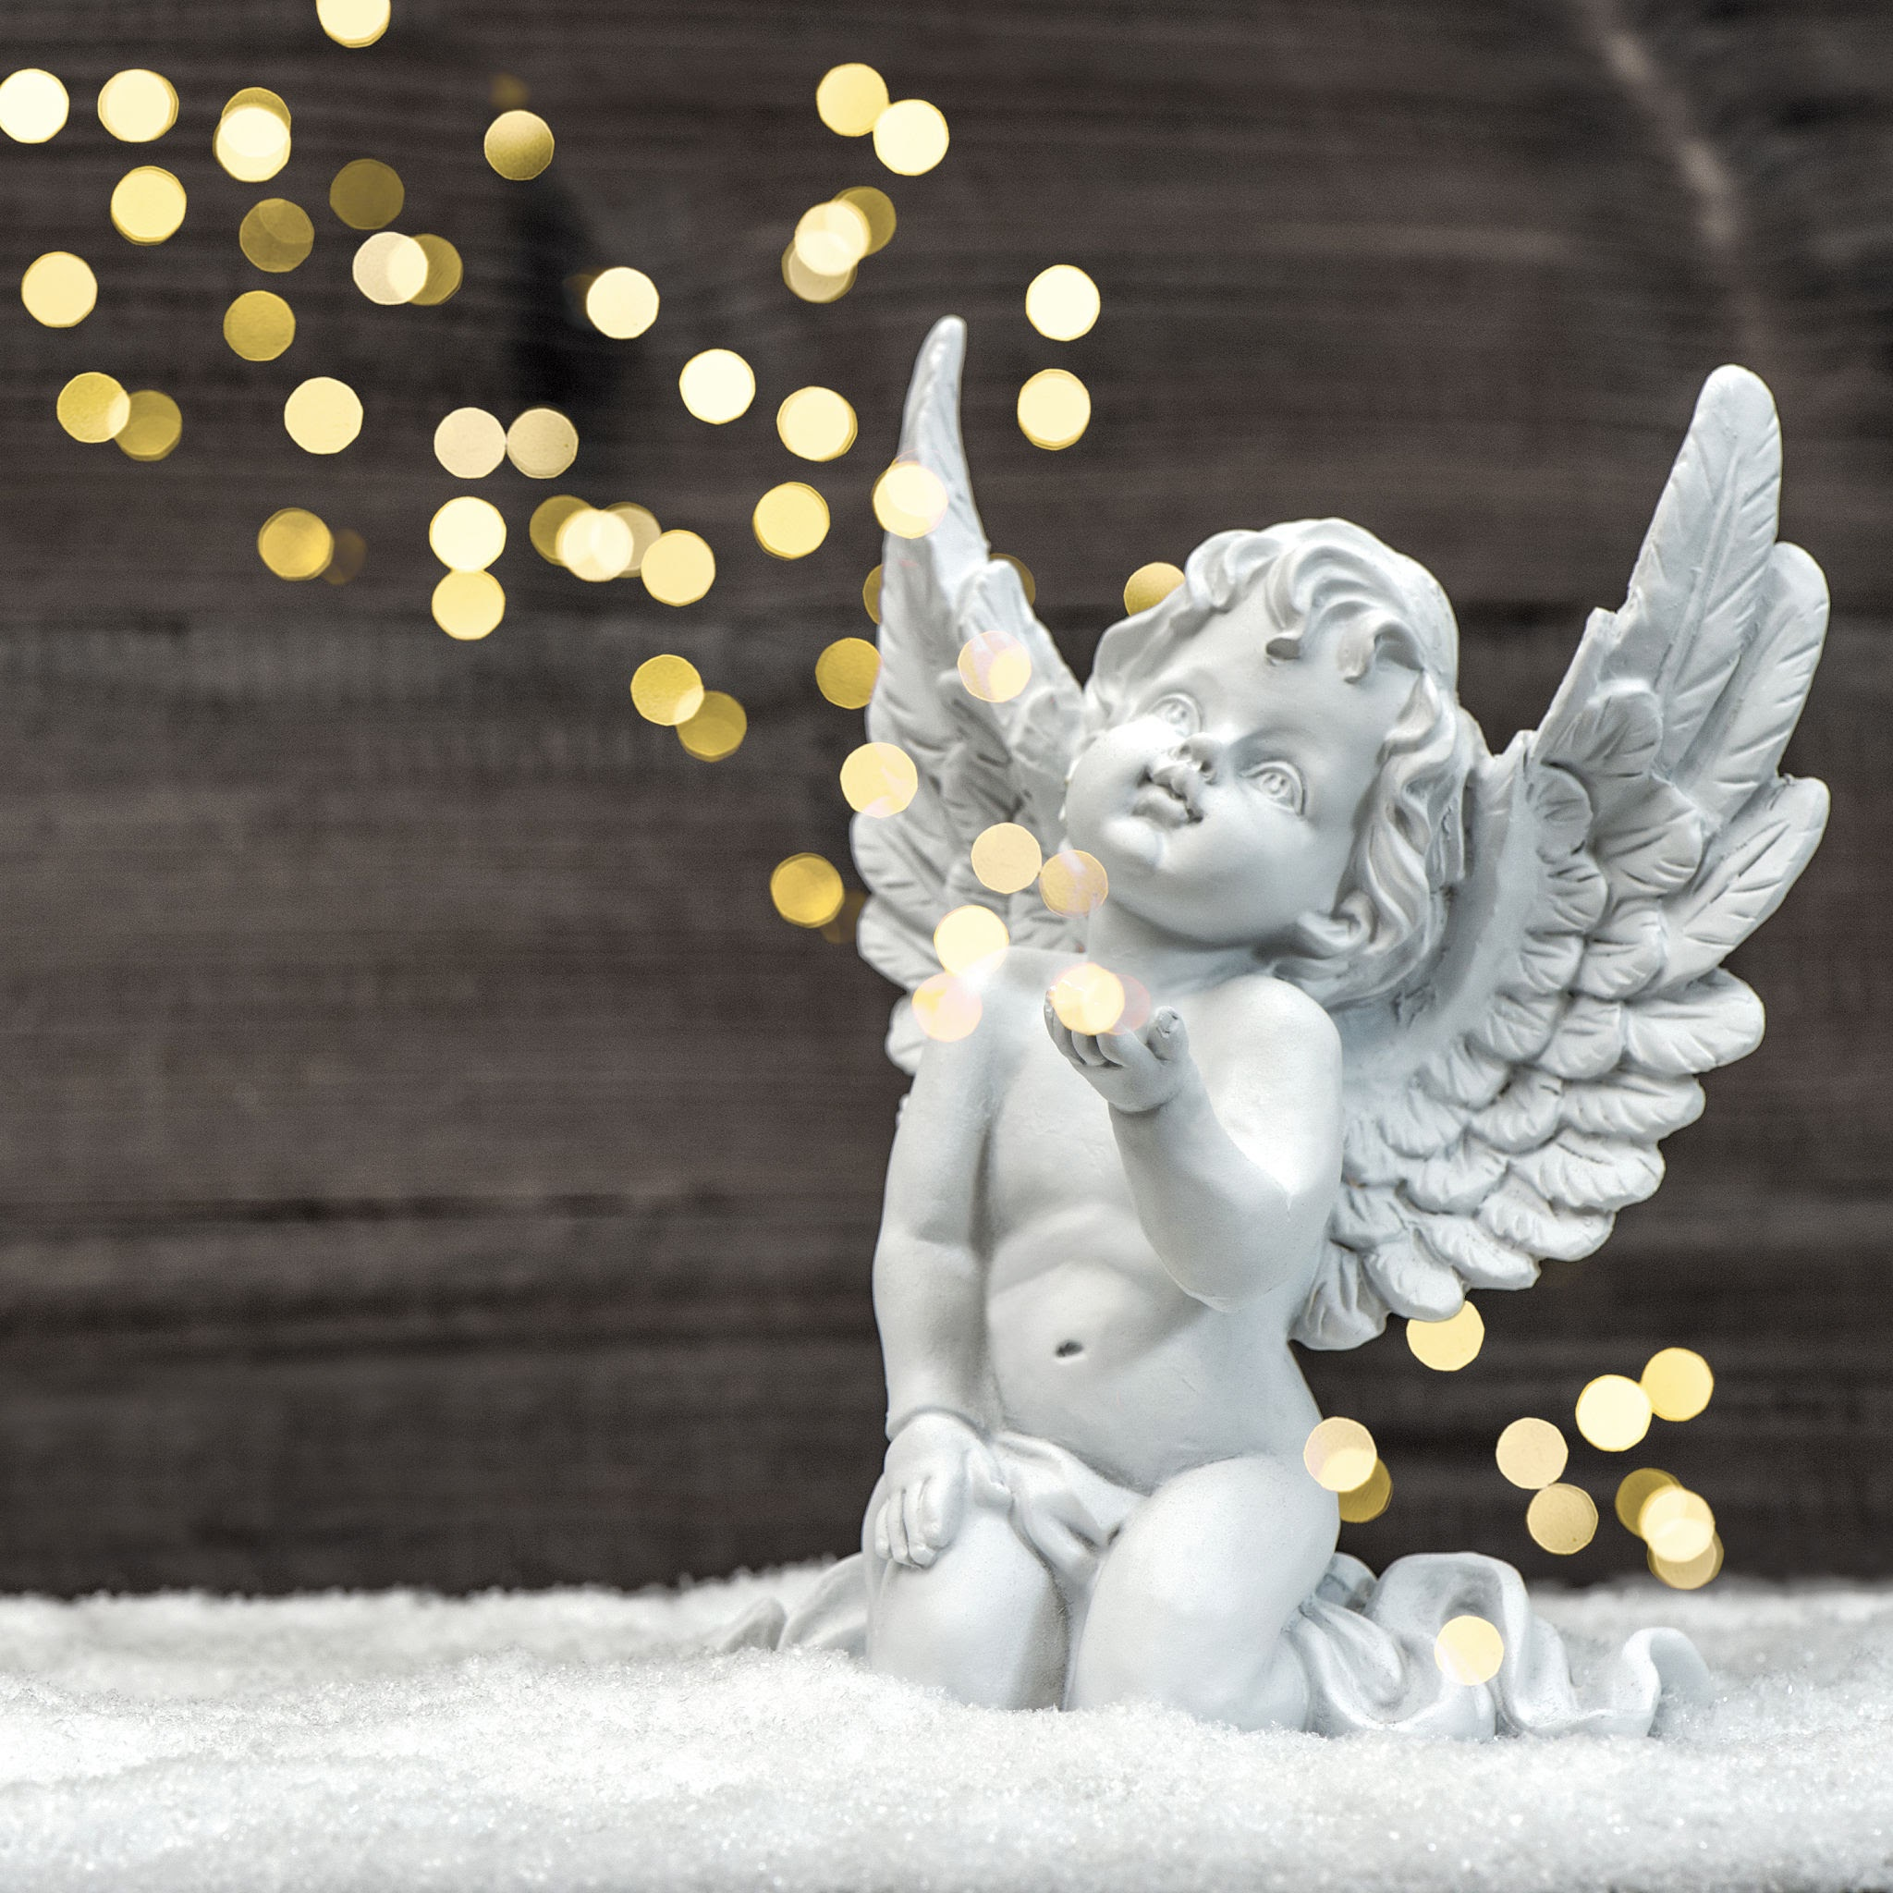
The angels
we imagine

Slide 4
Genesis 2:1-3
Thus the heavens and the earth were completed in all their vast array.
By the seventh day God had finished the work he had been doing; so on the seventh day he rested from all his work

Slide 5
Then God blessed the seventh day and made it holy, because on it he rested from all the work of creating that he had done.

Slide 6
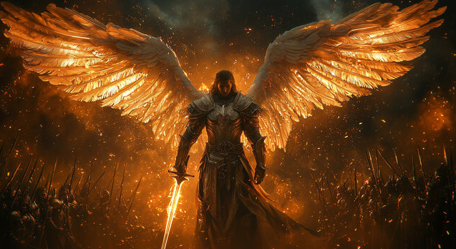

Slide 7
Nehemiah 9:6
You alone are the Lord. You made the heavens, even the highest heavens, and all their starry host, the earth and all that is on it, the seas and all that is in them. You give life to everything, and the multitudes of heaven worship you.

Slide 8
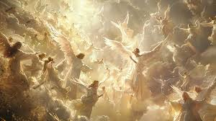

Slide 9
Luke 2: 8-15
8 And there were shepherds living out in the fields nearby, keeping watch over their flocks at night. 9 An angel of the Lord appeared to them, and the glory of the Lord shone around them, and they were terrified.

Slide 10
10 But the angel said to them, “Do not be afraid. I bring you good news that will cause great joy for all people. 11 This will be a sign to you: you will find a baby wrapped in cloths and lying in a manger.”
13 Suddenly a great company of the

Slide 11
heavenly host appeared with the angel, praising God and saying,
14 “Glory to God in the highest heaven, and on earth peace to those on whom his favor rests.”
15 When the angels had left left and gone into heaven, the shepherds said to one another,

Slide 12
“Let’s go to Bethlehem and see this thing that has happened, which the Lord has told us about.”

Slide 13
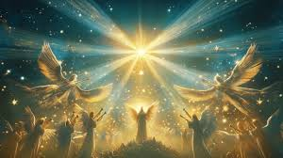

Slide 14


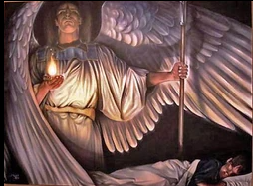
www.covingtonwacc.org/angels

