Slide 1
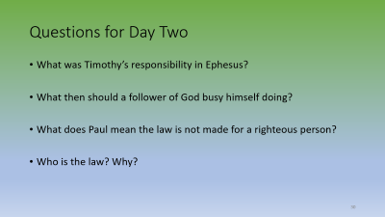
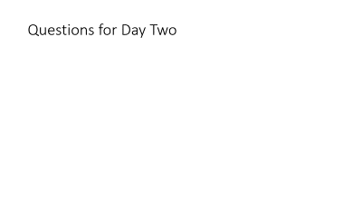
1st Timothy
Bible Study
Day 1

Slide 2
What is a Bible Study?

Slide 3
There are several methods to study the Bible:
Inductive:
  Who
  What
  When
  Why
  Why
  How
Soap Method
  Scripture
  Observation
  Application
  Prayer
Text Method
Talk to God in prayer
Encounter God & humanity in scripture, what does it say about God and humanity
eXamine your heart,should be confessed, added, taken away or maintained
Talk to God and others, what has been shown in scripture

Slide 4
There are several methods to study the Bible:
Verse-Mapping
  Write chosen passage
  Write out 2 different translations
  Circle key words to look up, definitions, synonyms, root word
  Explore meaning of passage and cross references
  Write a 1-2 sentence summary
Topical
  Choose a topic
  Look up references
  Choose verses to study
  Ask questions about the topic
  Read verses to see how they address your questions
  Summarize your conclusions
  Write out your application
Character Study
Choose character
Find passages about them
Read the passages finding out about them
Application points for your life

Slide 5
Many Study Methods to Reach One Truth
The different study methods all share the same goal:
They are designed to help you better understand and live out the truth of God’s Word.

Slide 6
What is the historical background to the Epistle (Inductive Method)?

Slide 7
WHO
Paul
Timothy

Slide 8
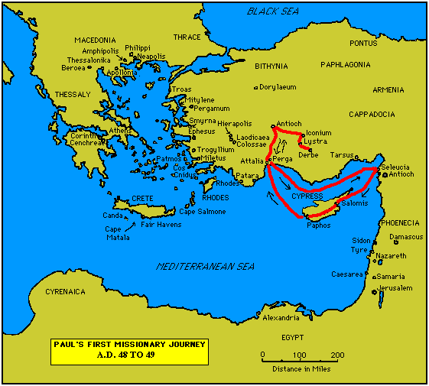
Significant Events in Paul’s 1st Missionary Journey
48 A.D.
From Antioch Paul, Barnabas and John (surnamed Mark) begin their first journey. They travel to Cypress (Cyprus) and Perga.
John Mark leaves Paul and Barnabas at Perga and returns to Jerusalem (see Acts 13:13). After Perga Paul and Barnabas journey to Antioch in Pisidia, Iconium, Lystra and Derbe.
Agrippa II (see Acts 25) made king of Chaleis.
49 A.D.
Paul and Barnabas go back to visit the same places they did in 48 A.D. and return to Antioch.
Cumanus made procurator of Judaea (about this time)

Slide 9
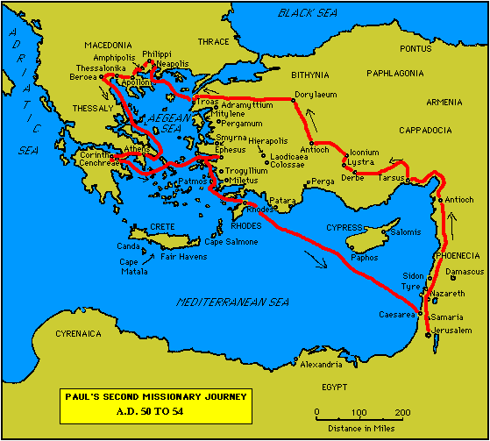
Significant Events in Paul's Second Missionary Journey
50 A.D.
Paul and Barnabas attend the "Council of Jerusalem" (see Acts 15).
51 A.D.
Second missionary journey begins. Paul and Barnabas travel to Antioch.
At Antioch John Mark (who left them at Perga on their first missionary journey) wishes to rejoin Paul/Barnabas. A disagreement ensues between Paul and Barnabas about whether to allow Mark to come with them. The argument is so heated that Paul finally decides to take Silas with him to Tarsus, Derbe, Lystra, Iconium and Antioch in Pisidia. Barnabas takes John Mark and travels to the island of Cypress (Cyprus).
At Lystra Paul meets Timothy, who accompanies him on the rest of his journey.
52 A.D.
Paul/Silas/Timothy travel to Troas, Philippi, Thessalonica and Beroea (Berea).
Jews from Thessalonica come to Beroea and stir up the people against Paul. He is sent by sea to Athens. Silas and Timothy stay in Beroea for a time. It is possible Timothy later travels to Athens, meets Paul, and is sent to revisit Thessalonica.
Paul travels to Corinth and writes 1 Thessalonians. Timothy and Silas are with him. Paul meets Aquila and Priscilla.
53 A.D.
Paul stays in Corinth and writes 2 Thessalonians.
54 A.D.
Paul, Aquila and Priscilla leave Corinth in the Spring and arrive at Ephesus. Aquila and Priscilla stay in Ephesus as Paul travels on to Jerusalem. Paul arrives in the city in the Summer (Pentecost). He then goes to Antioch.

Slide 10
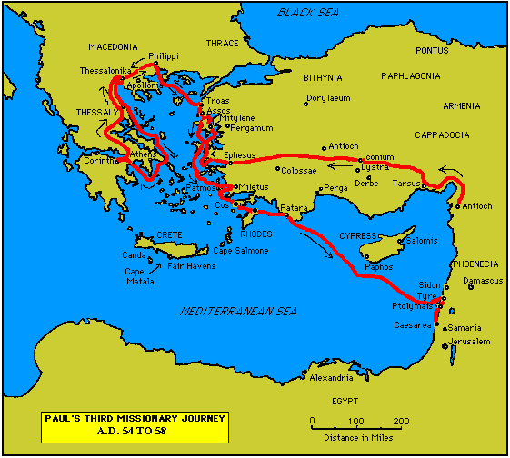
Significant Events in Paul’s 3rd Missionary Journey
54 A.D.
Paul begins his third missionary journey. He leaves Antioch and goes to Ephesus.
Priscilla and Aquila are already in Ephesus and make contact with Apollos. After teaching him thoroughly about Christ, they and the brethren send Apollos to Corinth.
55 A.D.
Paul continues to stay in Ephesus.
56 A.D.
Paul continues to stay in Ephesus. 57 A.D.
In the Spring at Ephesus Paul writes 1 Corinthians.
In Summer he leaves Ephesus for Troas. He proceeds to Philippi.
It is in Philippi during the Autumn that it is believed Paul wrote II Corinthians. Titus arrives in the city.
In the Winter Paul goes to Corinth, where he writes the book of Galatians.
58 A.D.
In the Spring Paul writes the book of Romans.
Paul leaves Corinth and goes to Philippi and Miletus.
In the summer (Pentecost) Paul arrives in Jerusalem. He is arrested and sent to Caesarea.

Slide 11
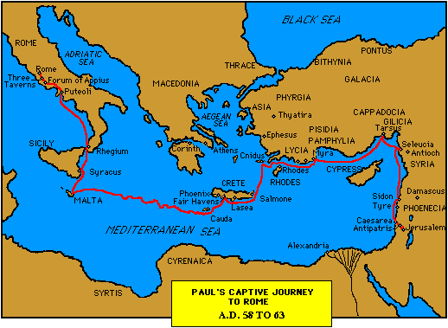
Significant Events in Paul's Final Missionary Journey
58 A.D.
Paul is arrested in Jerusalem and goes to Caesarea. He is sent to Felix, Roman Procurator of Judea.
59 A.D.
Paul is in Caesarea.
60 A.D.
In the Autumn (about August) Paul is sent to Rome by Festus.
In the Winter Paul is shipwrecked at Malta.
61 A.D.
Paul arrives in Rome in the Spring.
62 A.D.
Paul at Rome.
In the Spring Paul writes the books of Philemon, Colossians and Ephesians. He may have written the book of Hebrews this year.
In the Autumn Paul writes the book of Philippians.
63 A.D.
Paul is acquitted in the Spring and goes to Macedonia and Asia Minor.
64 to 68 A.D.
In A.D. 64 it is possible Paul went to Spain (See Romans 15:28). The Great Fire of Rome occurs, followed by persecution of Roman Christians.
In A.D. 65 Paul may have continued in Spain
In A.D. 66 Paul may have travelled from Spain to Asia Minor (See 1 Timothy 1:3). The Jewish Wars begin.
In the Summer of A.D. 67 Paul writes 1 Timothy from Macedonia. He writes Titus from Ephesus in the Autumn. In the winter he is in the city of Nicopolis.
During the Spring of A.D. 68 Paul is in a Roman prison. He writes his last epistle, 2 Timothy. The Apostle Paul is executed in the Summer (May or June). Nero dies in the middle of June.

Slide 12
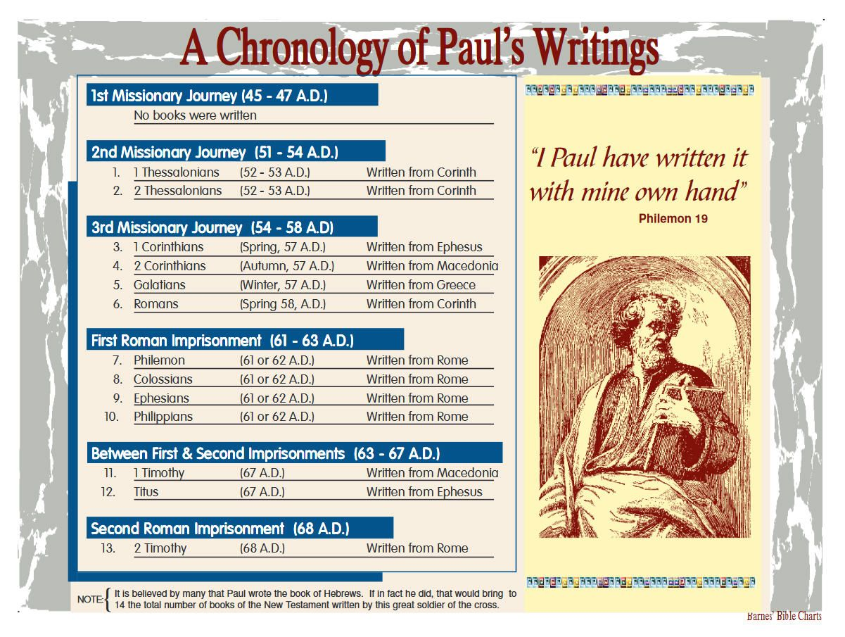

Slide 13
Timothy
Timothy was raised by his parents and grandmother, though Paul only describes his mother and grandmother in 2 Timothy 1:5, “when I call to remembrance the genuine faith that is in you, which dwelt first in your grandmother Lois and your mother Eunice, and I am persuaded is in you also.”
His father was said to be a Greek while his mother was a Jew. It is believed that when Paul was evangelizing in their city, Eunice converted to Christianity and was even mentioned by Paul in the book of Acts.
2 Timothy 3:15 shares what impressed Paul about Timothy –his knowledge of the Holy Scriptures, which made him “wise for salvation through faith which is in Christ Jesus.” Some time later, Paul made the decision to bring Timothy with him in spreading the gospel and had him ordained and circumcised to avoid any questioning or ridicule with Jewish Christians.

Slide 14
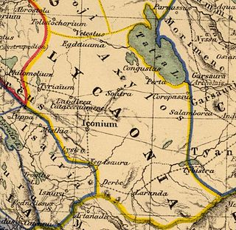
Lystra
The site of Lystra is believed to be located 30 kilometres (19 mi) south of the city of Konya (Iconium in the New Testament), north of the village of Hatunsaray and some 15 kilometres (9.3 mi) north of a small town called Akoren. A small museum within the village of Hatunsaray displays artifacts from ancient Lystra.
Lystra is the ancient name of the village visited by Paul the Apostle. There is a present-day village called "Kilistra" near Gökyurt, a village of the Meram district of Konya province. Ancient ruins can be seen near

Slide 15
WHAT:
Is the passage about:
Religious instruction to the gentiles
Is the problem being addressed:
False teachings

Slide 16
WHEN
67 A.D.

Slide 17
WHERE
Paul is in Macedonia
Timothy in Ephesus (modern day Turkey)

Slide 18
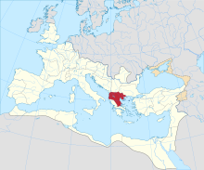
Roman Province of Macedonia

Slide 19
EPHESUS ef'-e-sus (Ephesos, "desirable"):
A city of the Roman province of Asia, near the mouth of the Cayster river, 3 miles from the western coast of Asia Minor, and opposite the island of Samos.
With an artificial harbor accessible to the largest ships, and rivaling the harbor at Miletus, standing at the entrance of the valley which reaches far into the interior of Asia Minor, and connected by highways with the chief cities of the province, Ephesus was the most easily accessible city in Asia, both by land and sea.
Its location, therefore, favored its religious, political and commercial development, and presented a most advantageous field for the missionary labors of Paul.
The city stood upon the sloping sides and at the base of two hills, Prion and Coressus, commanding a beautiful view; its climate was exceptionally fine, and the soil of the valley was unusually fertile.

Slide 20
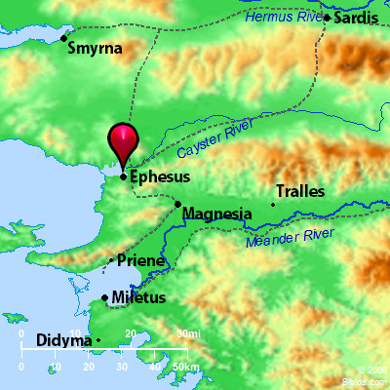
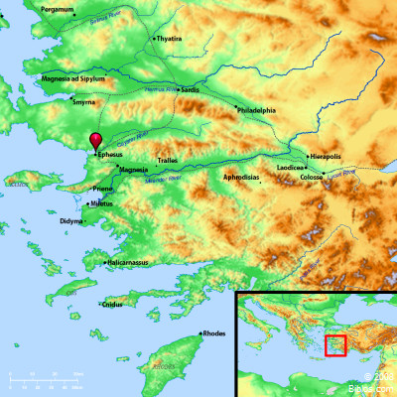
On the Map

Slide 21
WHY: HOW:
To counter false teachings
Writing instructions for actions to be taken by Timothy

Slide 22
1st Timothy Chapter 1:1
Paul stresses his apostleship – In almost all of his epistles, Paul mentions his apostleship. He does not do this in a boasting way. Rather he comments that this is merely in accordance with the “commandment of God.” Generally Paul mentions his apostleship as a reminder to the reader that they should follow the instructions inside as he is acting as God’s messenger. Timothy of course already knew that Paul was an apostle. And they had a close relationship. So it seems less necessary to mention it here. In doing so, it is almost as if Paul has some inkling that this letter will be read by others besides Timothy. Perhaps he also intended for this letter to be read to a wider audience. In any case he certainly expected that even though he was friends with Timothy, Timothy still needed to respect his God given authority.
1Paul, an apostle of Jesus Christ by the commandment of God our Saviour, and Lord Jesus Christ,
which is our hope;

Slide 23
1st Timothy Chapter 1:2
Paul views Timothy as his son – Paul was very likely single with no children. But he was nonetheless a father still too many. Timothy was one of his spiritual children and they clearly enjoyed a close and affectionate relationship. In Deuteronomy 6:4-9 Moses instructs the Israelites on the importance of teaching God’s commands to the next generation. Clearly those without children of their own are not absolved from this responsibility.
2Unto Timothy, my own son in the faith: Grace, mercy,
and peace, from God our Father and Jesus Christ our Lord.

Slide 24
Questions:
Since Timothy knows Paul, why do you think Paul mentions the fact that he is an apostle?
What can we see about the relationship between Paul and Timothy?
How can this verse be an encouragement to those who don’t have biological children?
What is the source of grace and peace?
Some passages:
Acts 13:1-3
Acts 16:1-4
Philippians 2:20-22

Slide 25
How does this Introduction compare to the Introductions to other writings by Paul?
Different:
Romans Only Paul’s Credentials
1&2 Corinthians Only Paul’s Credentials
Ephesians Only Paul’s Credentials
Galatians Only Paul’s Credentials
Similar:
Philippians Mentions Timothy
Colossians Mentions Timothy
1&2 Thessalonians Mentions Timothy
Philemon Mentions Timothy
Same:
1&2 Timothy
Titus

Slide 26

What is grace?

Slide 27
What is the source of grace and peace?
From God and Christ Jesus our Savior
Paul’s greetings always include “grace and peace”
His greeting to Timothy adds “mercy.”
Mercy means favor and approval.

Slide 28
How can this verse be an encouragement to those who don’t have biological children?
Dedicate yourself to discipleship and you may have many more kids than the most prolific physical parents ever could. And these spiritual kids can stand beside you for eternity worshiping the Lamb.

Slide 29
Application:
It is the responsibility of every believer, married or single, to pass God’s words on to the next generation. Through discipleship those without families of their own can both expand God’s family and also participate in and enjoy the benefits of His family. Discipleship is a fruitful outlet for expressing those natural feelings of fatherhood or motherhood while at the same time doing great good for God’s kingdom.
So if you are single, do not be discouraged with thoughts like, “I will never have a family of my own. I can never experience what it is like to have kids.” Instead dedicate yourself to discipleship and you may have many more kids than the most prolific physical parents ever could. And these spiritual kids can stand beside you for eternity worshiping the Lamb.

Slide 30
Questions for Day Two
What was Timothy’s responsibility in Ephesus?
What then should a follower of God busy himself doing?
What does Paul mean the law is not made for a righteous person?
Who is the law? Why?

