Slide 1
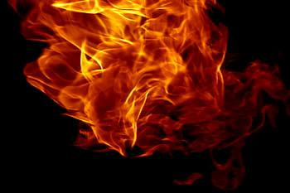
Current Series!
It’s Hell….
but Heaven is coming!

Slide 2
This week
Hell…Becoming FIREPROOF!
Key Scripture: Dan 3: 16-18, Isa 43:2, Rom 5:9

Slide 3
Galatians 5:22-23
22 The poor man died and was carried by the angels to Abraham’s side. The rich man also died and was buried, 23 and in Hades, being in torment he lifted up his eyes and saw Abraham far off and Lazarus at his side.

Slide 4
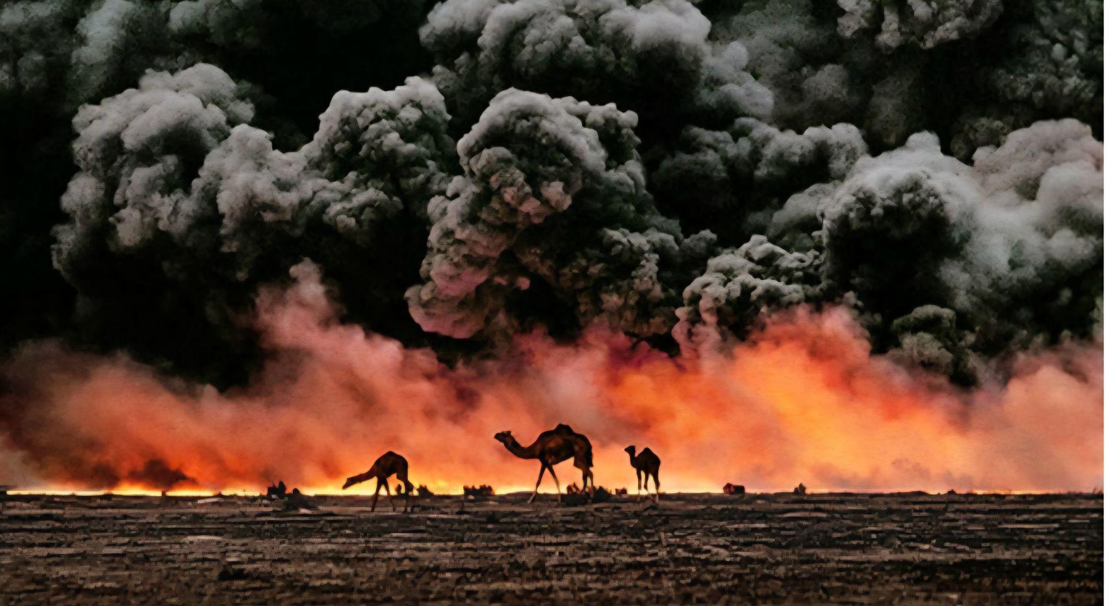

Slide 5
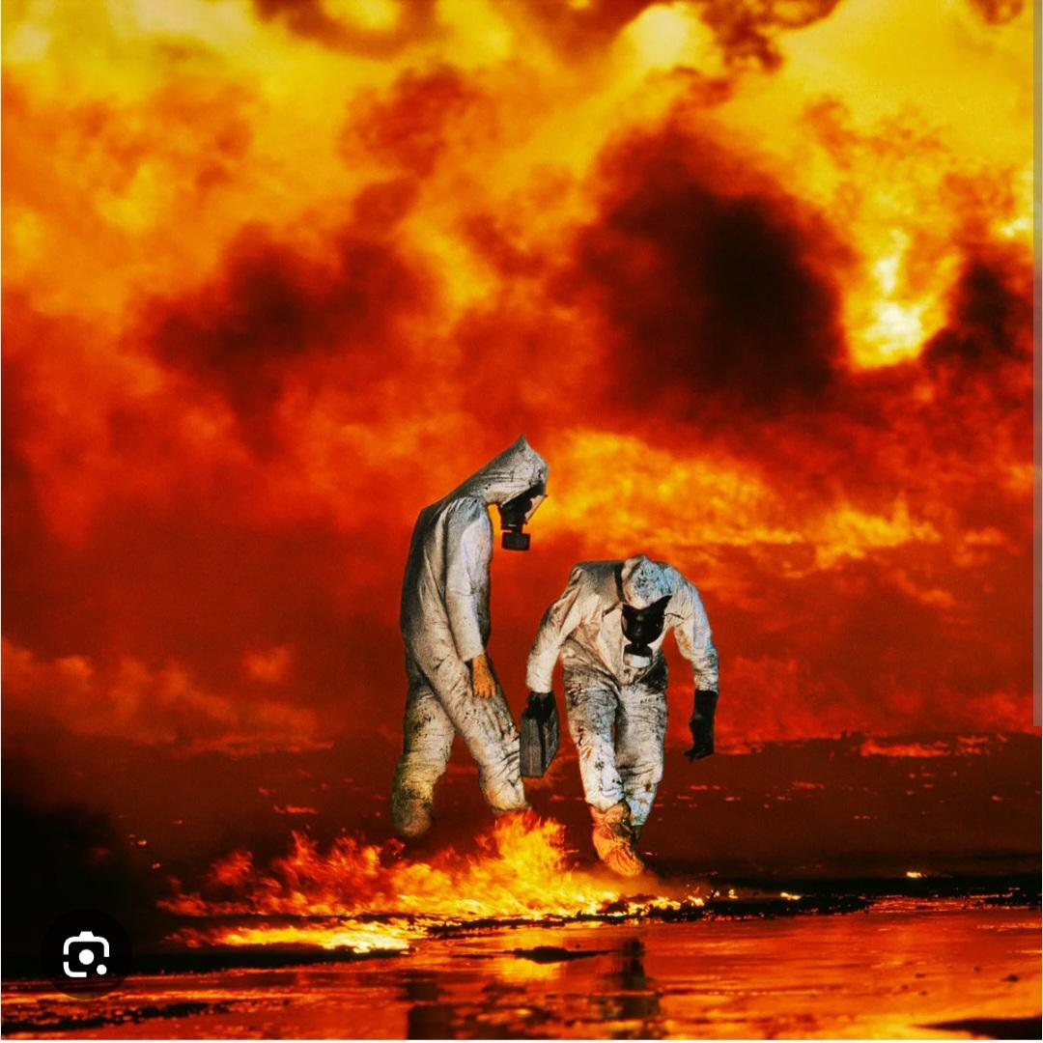

Slide 6
You’re
Fireproof
In
CHRIST

